Slide 1
Pathways in Crisis Services Project
CRJ 106 Introduction to Corrections
Notes:
Pathways to Crisis Services (PICS) Curriculum Infusion Packages (CIPs) are a product for educators and trainers developed in 2022/2023 by the Center for the Application of Substance Abuse Technologies (CASAT). The main developers of crisis services materials are April Lang-Barroga, LMFT, LCADC, NCC, and Bianca D. McCall, LMFT. Additional guidance and editing support were provided by, Terra Hamblin, MA, Nancy Roget, MS, and Sophia Graham, BS.
This product was developed to help community college/university faculty, as well as clinical supervisors and recovery support staff have access to brief, science-based content with the goal of providing materials that can be easily infused into existing substance use disorder and related courses (e.g., social work, nursing, criminal justice, foundation of addiction courses, ethics, counseling courses, etc.). Individuals can select the specific content to infuse into existing curricula/materials depending on the specific needs of their learners. Each slide in the slide decks contains notes to provide guidance on the topics along with references and handouts where appropriate. If you require further information, please do not hesitate to contact the CASATs PICS Project Staff located at CASAT (775-784-6265) You are free to use these slides and pictures, but please give credit to PICS when using them by referencing the PICS Program at the beginning of your presentation.
Funding for this product/publication was made possible in whole or in part by the Nevada Division of Public and Behavioral Health Bureau of Behavioral Health, Prevention, and Wellness (DHHS). The views expressed in these materials do not necessarily reflect the official policies or views of DHHS or the State of Nevada nor does mention of trade names, commercial practices, or organizations imply endorsement by the U.S. Government or the State.
Additional resources are available to enhance and support the information provided in this brief presentation.

Slide 2
Curriculum Infusion Introduction

Slide 3
Overview of Crisis Services
Notes:
This infusion on the Overview of Crisis Services compiles ….
Each slide contains detailed notes for the trainer to provide guidance in effectively presenting the content, as necessary.
These slides are designed to be used in an Introductory level Criminal Justice class.
Ideally, these slides would be added to the class in the time following the presentation of the material on Police Roles and Ethics.
By this point in the class, students would be aware of the structure of the criminal justice system, the problems with collecting and interpreting criminal justice data, and the creation of laws and law enforcement history in America. While this information can be placed anywhere in the class, following policing and law enforcement makes logical sense due to the various crises that law enforcement officers respond to and deal with daily, and the effects these interactions have on the mental and physical health of the officers.

Slide 4



Topics
Crisis Response System
Suicide Prevention
Suicide and Substance Abuse
Trauma
Cultural Considerations
Compassion Fatigue and Self Care
Notes:
This presentation will discuss seven areas of importance to Criminal Justice Professionals. Some of these areas will deal with material that is important to being effective as a professional. Some of the other material will deal with things you need to know and to do to have a long and healthy career as a professional. All of this is important material for those of you who plan to work in the field, but it is also important for those of you who plan to work in other fields that generate significant levels of stress.
The Crisis Response System. This is an important area because most of you have no experience with crisis response. You don't know how it works and more importantly you don't know how effective it can be when utilized properly. This portion of the presentation will show you the advantages to early and dedicated responses.
2) Suicide Prevention. The past few years have been difficult on many levels. School has become more stressful, many jobs have become much more difficult, and workers and students are starting to show that strain. Which is why it is important to have this discussion at the undergraduate level so when you move into the field as a professional you will be more prepared for crises when they arise.
3) Suicide and Substance Abuse. This is an area that is not often discussed and is critical to the knowledge base of a high-quality professional. Suicide does not exist in a vacuum. The link between substance use and suicide is both important and strong. It needs to be discussed and as future professionals in the field this is knowledge you must have to be as effective as possible.
4) Trauma. Trauma is often discussed at a general level, with little emphasis placed on where it comes from and how it can be handled effectively. This portion of the discussion will broaden your thoughts and beliefs about both the causes of trauma and the historically narrow view of how trauma impacts behavior and the use of substances.
5) Cultural Considerations. This is an area that is not often discussed in college classes, in spite of its importance to professionals in the field. In order to be effective as a professional you have to consider the population you are
dealing with and the ways that population may differ from your own in terms of experience and social behavior. Sometimes, being effective means knowing the proper person to speak with and how to address them most effectively to achieve your goal. Many of those processes are taught without any consideration of the cultural differences of the client.
6) Compassion Fatigue and Self Care. As mentioned above we have gone through a rather difficult few years. This has resulted in an abundance of things to be sad about and an unfortunate lack of things which create joy. In short, our compassion has been exhausted and we are in a state of compassion fatigue. This information will make you aware of this and offer some ideas and solutions. To survive in this field it is necessary to take the time to make sure you are at your best. Specifically, you need to make sure that you take care of yourself so you can take care of others. This section will help you understand the importance of self-care, and discuss some of the ways in which you can achieve that balance of professional effectiveness and self-care.

Slide 5
Disclaimer
This presentation may include readings, media, and discussion around topics such as suicide, trauma, and crisis intervention and may be difficult.
Please listen to yourself and reach out if you are having difficulty with these topics.
Notes:
Read the Disclaimer:
This presentation may include readings, media, and discussion around topics such as suicide, trauma, and crisis intervention, some of this information may be difficult to hear and process.
It is important for you to care for your safety and well-being. If this topic and conversation elevates you, please reach out to someone and seek help immediately.
If you notice someone in the class who appears to be reacting negatively to this information, please notify the instructor so steps can be taken to assist the student.

Slide 6
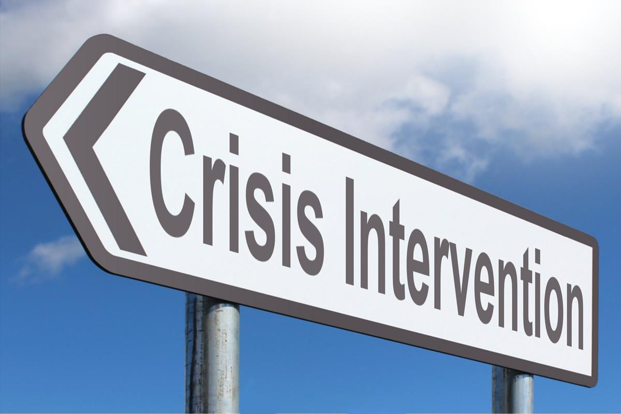
Crisis Intervention
Notes:
SUBJECT MATTER: CRISIS RESPONSE SYSTEM
The goal of this section is to show some of the causes and reasons for Crises, how to recognize someone in Crisis, and the Crisis Response System.
The Crisis Continuum includes various crisis services for individuals with behavioral health needs, with the goal being to effectively and specifically respond to these crises and create pathways toward effective assessment and treatment.
Why is this information important to persons who wish to work as professionals in the Criminal Justice System?
If you plan to work in the justice system, there is no doubt you will be encountering persons in crisis. It doesn't matter if you are working as a law enforcement professional, a legal professional, or working in the corrections world, you are going to be seeing people who are not at their best. Some of these persons will be in states of crisis, and your professional and educated response to them may make the interaction more successful and effective.
This is important information! The knowledge that this training will provide will make you better at your job and improve your effectiveness as a professional in the justice system.

Slide 7
National State of Emergency:
Youth & Adolescent Mental Health
This worsening crisis in child/adolescent mental health is inextricably tied to the stress brought on by COVID-19 and the ongoing struggle for racial justice and represents an acceleration of trends observed prior to 2020.
Notes:
SUBJECT MATTER: SUICIDE PREVENTION
READ: slide
These are challenging times, and those who are at the greatest risk for mental health problems are those who would also be at the greatest risk In the best of times.
Specifically, children and adolescents.
Adolescence has been referred to as a time of Expanding Vulnerabilities and Increasing Opportunities.
Because of their age, adolescents are venturing further from home, they are interacting with a larger number of people, and some of those people are older and may not have their best interest in mind.
Also because of their age, adolescents are more attuned to social pressures and influences. This makes them vulnerable to social pressures and prone to make poor decisions, especially if there is an older person who creates social pressure to make poor decisions.
Based on these expanding opportunities, increased vulnerabilities, and growing social interactions, this group has historically been at the greatest risk for crisis.
Add to this the situation created by a viral pandemic and you get a recipe for risk that is unprecedented.
Discussion Points:
This is not just the fault of the coronavirus pandemic - youth and adolescent mental health declined prior to the pandemic- NV youth suicides increased by 90% in 2019
Nationwide suicide attempts nearly doubled in girls ages 12-17
In 2021, there were a reported 75,000 drug overdose deaths which is a 28% increase from the previous year.

Slide 8
National State of Emergency:
Youth & Adolescent Mental Health
THE TOP THREE CAUSES OF DEATH BY AGE GROUP
0 to 1 year:
1 Conditions that were present at birth
2 Conditions due to premature birth (short gestation)
3 Accidents (unintentional injuries)
1 to 4 years:
1 Accidents (unintentional injuries
2 Conditions that were present at birth
3 Homicide
Notes:
SUBJECT MATTER: SUICIDE PREVENTION
On the next slides we will see the realities of the state of youth mental health. These slides present the most common causes of death for youth, broken down by age range.
READ: slide
Notice that for this first slide, the causes are primarily medical and accidental. That will change as the child approaches adolescence. Often, children are injured during the birth process or shortly thereafter, which results in problems that contribute to their death. As they get older and become more active, accidents become more probable and contribute statistically two of the age groups death rate.
Reference:
AAP-AACAP-CHA Declaration of a National Emergency in Child and Adolescent Mental Health. (2021). https://www.aap.org/en/advocacy/child-and-adolescent-healthy-mental-development/aap-aacap-cha-declaration-of-a-national-emergency-in-child-and-adolescent-mental-health/

Slide 9
National State of Emergency:
Youth & Adolescent Mental Health
THE TOP THREE CAUSES OF DEATH BY AGE GROUP
5 to 9 years:
1 Accidents (unintentional injuries)
2 Cancer
3 Conditions that were present at birth
10 to 14 years
1 Accidents (unintentional injuries)
2 Suicide (intentional self-harm)
3 Cancer
Notes:
SUBJECT MATTER: SUICIDE PREVENTION
On the next slides we will see the realities of the state of youth mental health. These slides present the most common causes of death for youth, broken down by age range.
READ: slide
Notice that for this second slide, the causes are primarily medical and accidental up until the age of 9, then things shift, and suicide moves into the second spot, followed by the most common disease which for this group is cancer. Notice how just in the space of a few years cancer has been pushed down to 3rd as suicide has moved on to the top three causes of death.
Please don't Overlook the age groups we are talking about here. These are still kids under the age of 14. For this group suicide has already moved into the second spot.
This is why we're having this discussion! Suicide is becoming a bigger problem earlier in life than it ever had in historical past.
Reference:
AAP-AACAP-CHA Declaration of a National Emergency in Child and Adolescent Mental Health. (2021). https://www.aap.org/en/advocacy/child-and-adolescent-healthy-mental-development/aap-aacap-cha-declaration-of-a-national-emergency-in-child-and-adolescent-mental-health/

Slide 10
National State of Emergency:
Youth & Adolescent Mental Health
Rates of childhood mental health concerns and suicide rose steadily between 2010-2020
By 2018 suicide was the second leading cause of death for youth ages 10-24.
Notes:
SUBJECT MATTER: Youth & Adolescent Mental Health
This slide supports the ideas presented in the earlier slides about expanding opportunities and increasing vulnerabilities. It also shows how critical crisis intervention is to this problem and how important learning how to recognize persons in crisis and to react accordingly can be to the survival of those persons.
Notice that the rates of childhood mental health concerns began increasing in 2010, but suicide didn’t move to the second spot for 10-24 year olds until 2018.
We can infer something important from this. These adolescents who eventually committed suicide were likely in an increasing state of crisis for some time before their deaths.
Had these adolescents been around persons who could recognize the signs of crisis and had there been proper crisis intervention services available, many of these kids could have been saved.
This is why this information infusion and training is being offered in your class. Many of you will be on the front lines of this battle, and this knowledge will make you more effective.
Reference:
AAP-AACAP-CHA Declaration of a National Emergency in Child and Adolescent Mental Health. (2021). https://www.aap.org/en/advocacy/child-and-adolescent-healthy-mental-development/aap-aacap-cha-declaration-of-a-national-emergency-in-child-and-adolescent-mental-health/

Slide 11
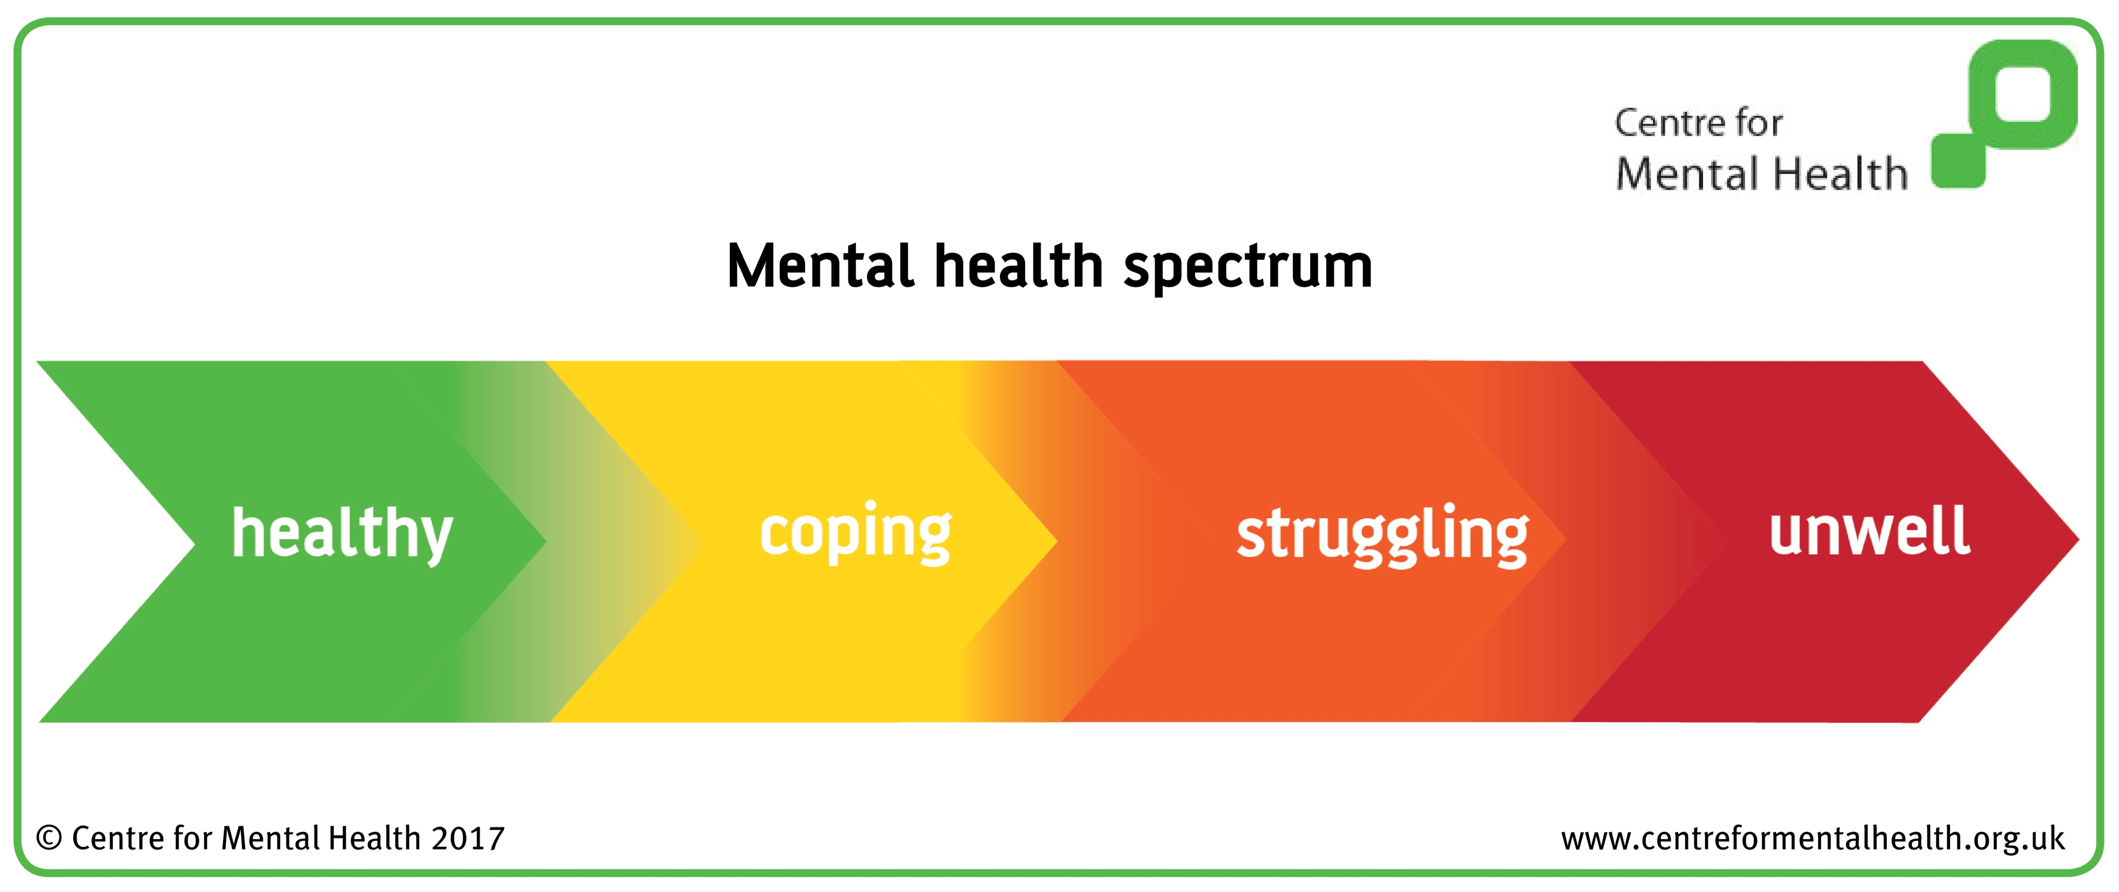
Mental Health Spectrum
Mental Health is non-binary
Suicide is the end stage of mental health disease
Notes:
SUBJECT MATTER: The Mental Health Spectrum
READ: slide contents.
Discussion Points:
Our mental health state (or experience) exists on a continuum, and it is influenced by our behavioral health, physical health, spiritual health; and social health.
These Social Determinants of Health (SDOH) include relationships, environmental health, safety, community connectedness, access to resources, education, employment, etc.
These SDOH factors can be in both your real life and VIRTUAL life. As I'm sure you all realize, things which occur in the virtual world can cause stress and disrupt your life in the real world!
Coping strategies are not always positive- especially for individuals who are responding to trauma, and intergenerational trauma.
A negative coping strategies are responses that are intended to help (think drinking to forget a breakup) but they actually harm your mental and physical health.
Suicidal ideation, gestures, and attempts are symptoms of a mental health crisis- someone is unwell
A mental health crisis can become fatal from things like suicide and drug overdose.
These types of fatalities ARE preventable!
Healthcare and behavioral healthcare systems can become better at preventing fatalities by reshaping the mental health culture, improving screening, improving reporting, and identification of the symptoms;
Increasing compassion and decreasing the stigma for those experiencing a mental health crisis, along with improved competence for those who work in the field and are able to identify those at risk earlier in the crisis process and deliver and appropriate response.
For example, there is a substantially Increased risk for drug overdose death in youth who have lost a sibling to suicide. A competent professional must know to look for this and to be aware of the signs that might indicate that the survivor is in crisis and at risk.
So why is this slide so important? Because until recent times the belief was mental illness and mental health were a dichotomy- you were either mentally healthy or mentally ill. Society and science have come to realize that mental illness is more of a continuum, and many of us are not perfectly mentally healthy, but also not so unwell as to require significant resources. If you consider the graphic on this slide, you will see that suicide is now believed to be the last stage of mental health disease. Meaning, if the individual can be identified and helped before they reach the end stage, a suicide can be avoided in a life can be saved.
Reference:
Centre for Mental Health (2017)

Slide 12
How to help in an emotional crisis:
If you suspect a friend or family member is experiencing an emotional crisis, your help can make a difference.
Spotting the Signs:
Neglect of Personal Hygiene
Dramatic change in sleep habits, sleeping more often or not well.
Weight gain or loss.
Decline in performance at work or school.
Pronounced changes in mood, such as irritability, anger, anxiety or sadness.
Withdrawal from routine activities and relationships.
Notes:
SUBJECT MATTER: CRISIS RESPONSE SYSTEM
READ:
Now we are going to spend a few minutes discussing crisis recognition and learning how to navigate an emotional crisis.
ASK: What constitutes a crisis? Many individuals experience crisis in one area of their lives, but the remainder of their lives may be relatively stable. Maybe they are experiencing crisis in a relationship, but not necessarily in other parts of their lives. When too many areas of a person's life are in crisis, then the person might be moving towards being in a full emotional crisis, and in need of professional intervention.
Possible answers include substance use, depression, breakup, death/grief, suicidal thoughts/plan, natural disasters, moving from one location to another, etc.
READ THE SLIDE
The first step is to be able to spot the signs:
Neglect of Personal Hygiene
Dramatic change in sleep habits, sleeping more often or not well.
Weight gain or loss.
Decline in performance at work or school.
Pronounced changes in mood, such as irritability, anger, anxiety or sadness.
Withdrawal from routine activities and relationships.
ASK: How can you be helpful to another person?
Possible answers: listening to the person, connecting the person to professional help, contacting 988, etc.
Remember! ANY person can help another person. You do not have to be licensed counselor or a professional to acknowledge a person’s pain and recognize that they are suffering.
Whether you are a peer, family member, or friend we all have an investment in the welfare of another human being. CONNECTION is what heals.
Even if you lack the skills to help the person work through their problems, you might be able to simply keep the person stabilized long enough for them to find the professional help they need. This is why it's everyone's duty to help persons in crisis. You might not be the last person to help them, but you might be the first! Even if all you do is encourage them to contact a crisis line and ask for help.
The next slide will indicate how to make contact with professionals using a crisis line and how the crisis line process resolves cases.
Resource:
American Psychological Assocation: How to help in an emotional crisis. (2013) https://www.apa.org/topics/mental-health/help-emotional-crisis

Slide 13
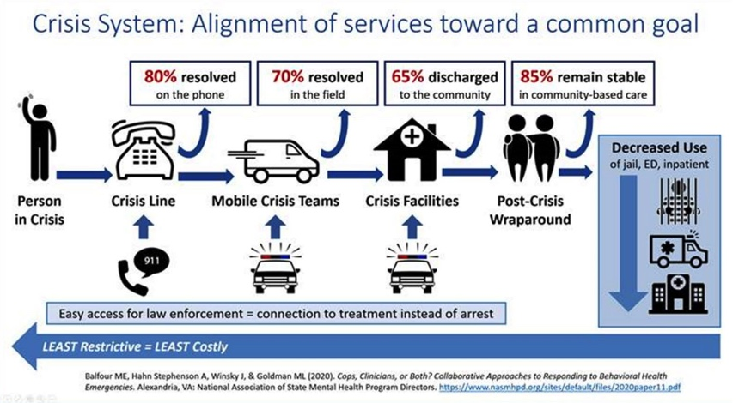
Crisis Services in Alignment
Notes:
SUBJECT MATTER: CRISIS RESPONSE SYSTEM
What happens when someone calls the crisis hotline?
As the diagram shows, in a typical crisis system:
80% of mental health crises are resolved on the phone- through the utilization of a crisis line designated specifically for mental health, substance use and suicide crises.
The 988 crisis lines is designed to:
Connect a person in a behavioral health crisis to trained staff who can address their immediate needs and help connect them to ongoing care
Reduce healthcare spending with more cost-effective early intervention
Reduce the use of law enforcement, public health, and other safety resources
Meet the growing need for crisis intervention
Help end stigma toward those seeking or accessing behavioral healthcare
The Guiding Principles of the 988 crisis line system are:
• To provide Universal and convenient access
• Improve public awareness and engagement
• Provide resources for self-help
• Have multi-channel availability
• Provide a reliable and timely response
Connection to resources and follow-up
• Localized response
• Connection to local public health and safety services
• Follow-up as needed
High-quality and personalized experience
• Tailored support
• Consistency in line with best practices
Reference:
National Association of State Mental Health Program Directors (2020): https://www.nasmhpd.org/sites/default/files/2020paper11.pdf
Image Credit:

Slide 14

Suicide Prevention Starts with You
Notes:
SUBJECT MATTER: SUICIDE PREVENTION
READ SLIDE:
Remember, as was mentioned earlier, suicide can be viewed as end stage mental health disease. If the process can be interrupted prior to reaching end stage then a suicide can be prevented.
We will be reviewing suicide prevention risk and protective factors, suicide risk assessments, and how to work with someone who is suicidal.
Please be aware of how you are responding to the material.
Suicide is a difficult topic to learn about discuss. Virtually everyone has been affected by a suicide. If you find this material troubling, let someone know and you can take a break while this material is being discussed.

Slide 15
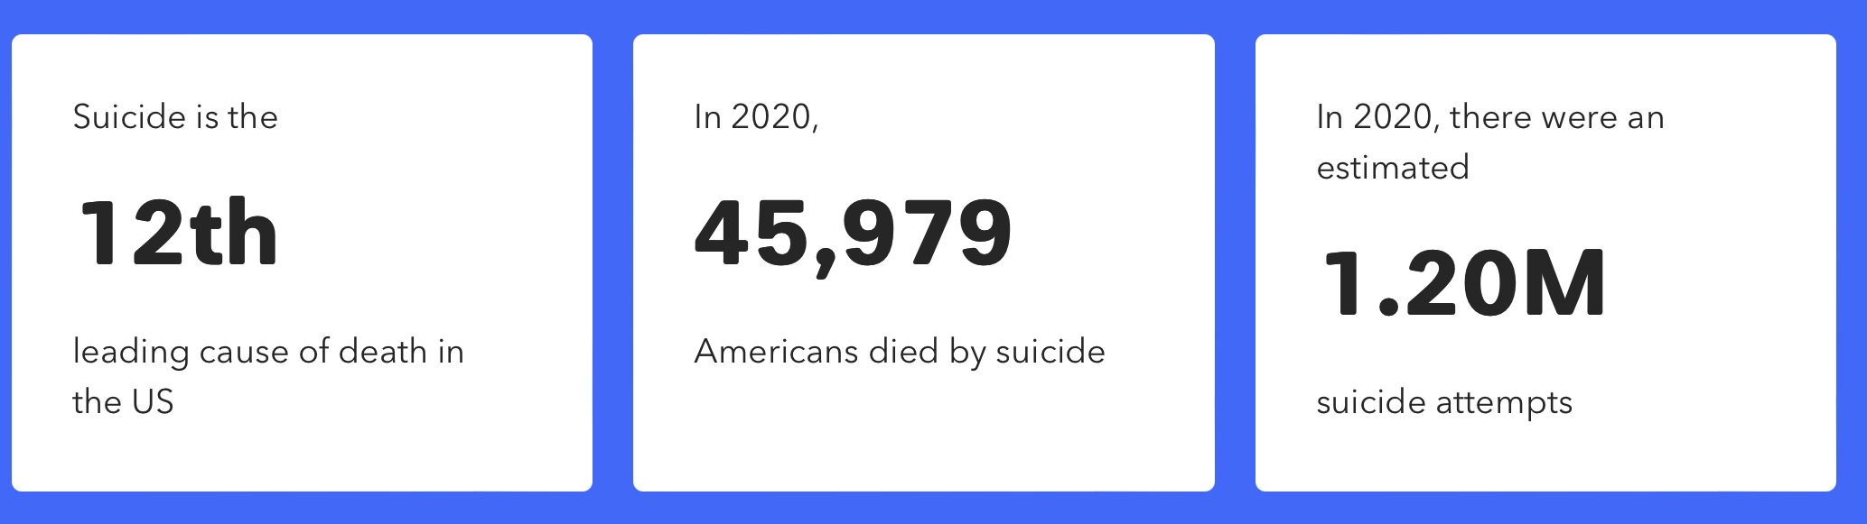
Centers for Disease Control
Mental health challenges and conditions represent our nation’s largest source of disability.
Notes:
SUBJECT MATTER: SUICIDE PREVENTION, 2020
45,979 Suicide Deaths
1.2 Million Suicide Attempts
3.2 Million Suicide Plans
12.2 Million People with Suicide Thoughts
75,000 Drug Overdose Deaths in 2020.
This number increased by 28% in 2021!

Slide 16
Some Statistics:
Suicide is a global pandemic
Notes:
SUBJECT MATTER: SUICIDE STATISTICS
Read each new line as it flies in.

Slide 17
Some Statistics:
Suicide is a global pandemic
#1 killer of teenage girls across the globe – more than natural disasters, war, and homicide combined.
Notes:
SUBJECT MATTER: SUICIDE STATISTICS
Read each new line as it flies in.

Slide 18
Some Statistics:
Suicide is a global pandemic
#1 killer of teenage girls across the globe – more than natural disasters, war, and homicide combined.
In the U.S. suicide death toll is higher than car crashes
Notes:
SUBJECT MATTER: SUICIDE STATISTICS
Read each new line as it flies in.

Slide 19
Some Statistics:
Suicide is a global pandemic
#1 killer of teenage girls across the globe – more than natural disasters, war, and homicide combined.
In the U.S. suicide death toll is higher than car crashes
Columbia Suicide Rating Scale - Asking the questions saves lives, prevents violence, and criminality
Notes:
SUBJECT MATTER: SUICIDE STATISTICS
Read each new line as it flies in.

Slide 20
Some Statistics:
Suicide is a global pandemic
#1 killer of teenage girls across the globe – more than natural disasters, war, and homicide combined.
In the U.S. suicide death toll is higher than car crashes
Columbia Suicide Rating Scale - Asking the questions saves lives, prevents violence, and criminality
Emergency room data suggests more than 40% cross-utilization between drug overdose-related emergencies and mental health-related emergencies such as depression and suicide.
Notes:
SUBJECT MATTER: SUICIDE STATISTICS
Read each new line as it flies in.

Slide 21
Some Statistics:
Suicide is a global pandemic
#1 killer of teenage girls across the globe – more than natural disasters, war, and homicide combined.
In the U.S. suicide death toll is higher than car crashes
Columbia Suicide Rating Scale - Asking the questions saves lives, prevents violence, and criminality
Emergency room data suggests more than 40% cross-utilization between drug overdose-related emergencies and mental health-related emergencies such as depression and suicide.
Removing the stigma helps to stop people from suffering in silence and self-medicating with drugs and alcohol
Notes:
SUBJECT MATTER: SUICIDE STATISTICS
Read each new line as it flies in.

Slide 22
Sudden changes
in behavior
is a key identifier
that someone may be at risk of suicide
Notes:
SUBJECT MATTER: SUICIDE RISK
READ SLIDE
As mentioned above, sudden changes in an individual's behavior are one of the key identifiers for crisis risk.
While these may be identifiers, they are not definitive and to be certain of the risk you need to look a little more deeply into what's going on in the person's life.
Next, we're going to discuss some of the risk factors to look for in determining a person‘s potentially harmful state

Slide 23
Discussion
What are “risk” factors…
What are considered the “drivers” to suicide?
Notes:
SUBJECT MATTER: SUICIDE RISK
Research investigating suicide attempts and deaths by suicide has yielded many specific risk factors and warning signs for future suicidal behaviors.
The differences among risk factors, warning signs, and "drivers," are person-specific variables that lead individuals to desire death by suicide.
Death of a loved one
Loss of employment
Legal issues
Financial distress

Slide 24
Discussion
But if there are factors that create “risk” are there also factors that diminish risk?
Notes:
SUBJECT MATTER: SUICIDE RISK
Criminal Justice, Criminology, and Juvenile Delinquency Studies all deal with Risk and Protective Factors.
These are some of the factors that can place a person at GREATER risk of suicide, and some of the factors that can work to mitigate, or to protect the person
EVEN IF THERE ARE SIGNIFICANT RISK FACTORS
The risk and protective factors identified on the screen are used for anyone assessing if a person is at risk for suicide.
The list is not exhaustive, there are obviously other factors that are not on the list, these are just the most likely factors.
When we encounter someone who is in crisis, we are powerless to change the risk factors that have preceded that encounter.
BUT, we can offer some of the protective factors in the second column that change the outcome and improve the person’s chances of survival and long term health.

Slide 25
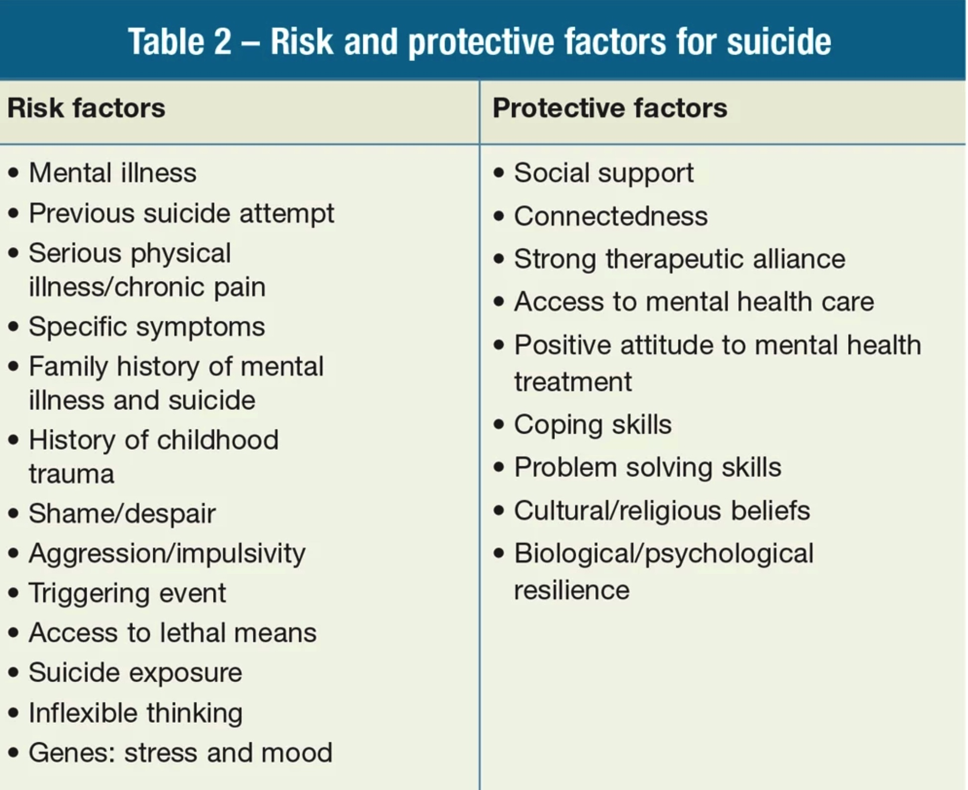
Risk and Protective Factors for Suicide
Notes:
SUBJECT MATTER: SUICIDE RISK and PROTECTION FACTORS
Read each line, do RISK first, then discuss PROTECTIVE factors and expand on each one to show how students can provide protections for their friends.

Slide 26
What was missing?
Notes:
SUBJECT MATTER: SUICIDE RISK
Wait for responses, they will likely not get it, but if they do commend their insight.

Slide 27
What was missing?
Substance Use and Suicide
Notes:
SUBJECT MATTER: SUICIDE and SUBSTANCE USE
Substance Use and Suicide have been behaviorally linked for a very long time.
They have also been ignored and neglected because the connections are complex.
Are these connections complex?
From a research standpoint, there is a possibility that the arrow goes from substance use to suicide, indicating substance use is a risk factor.
But there is also a possibility that those who are suicidal may be more inclined to use substances in an unhealthy way.
And there is a third possibility that a third factor, like trauma, maybe contributing to both substance use and suicidal thoughts.
Which is why the relationship between these two variables is considered complex and difficult to empirically steady

Slide 28
Substance Use and Suicide
Deaths by SUICIDE. In 2020, 18 states had higher suicide death rates compared with 2019, including seven states with statistically significant increases.
ALCOHOL-induced deaths. In 2020, every state and the District of Columbia had higher alcohol death rates compared with 2019.
DRUG-induced deaths. In 2020, 47 states plus the District of Columbia had higher drug-induced drug rates compared with 2019.
Deaths from ALCOHOL, DRUGS, and SUICIDE. In 2020, 49 states and the District of Columbia saw higher rates of death from alcohol, drugs, and suicide combined compared with 2019.
Notes:
SUBJECT MATTER: SUICIDE and SUBSTANCE USE
Read slide before offering the related data below.
Data from 17 states NVDRS (National violent death reporting system)
22% of suicides involve alcohol intoxication, (30-40% of suicide attempts)
Opiates, including heroin and prescription painkillers present in 20% of U.S. suicide deaths.
Marijuana-10%, cocaine-4%, amphetamines-3%
In total, there were 186,763 alcohol-induced, drug-induced, and suicide deaths—or an age-adjusted rate of 54.8 deaths per 100,000 people—in the United States in 2020.
This is a 20 percent increase over 2019 and a 77 percent increase over 2010.
Resource:
Trust for America’s Health (2022): https://www.tfah.org/wp-content/uploads/2022/05/TFAH_2022_PainIntheNation_Fnl.pdf

Slide 29
Suicide and Substance Use
Over 50% of suicides associated with dependence on drugs/alcohol
At least 25% of people with alcohol/drug active addiction die by suicide.
More than 70% of adolescent suicides are associated with drug/alcohol use.
Individuals treated for substance use are 10x greater risk of suicide.
Depression is a common co-occurring diagnosis among people who use substances
Notes:
SUBJECT MATTER: SUICIDE and SUBSTANCE USE
Read slide and pause between bullet points to let the information soak in.
In addition to the overwhelming impact of suicide on youth, we are seeing a prevalence of substance misuse and suicide.
Summation points below:
Substance Use places a person at higher risk of suicide.
Co-Occurring is the simultaneous presence of two or more diseases (mental health and substance use) in a person.
References:
Center for Substance Abuse Treatment. Addressing Suicidal Thoughts and Behaviors in Substance Abuse Treatment. Treatment Improvement Protocol (TIP) Series, No. 50. HHS Publication No. (SMA) 15-4381. Rockville, MD: Substance Abuse and Mental Health Services Administration, 2009.
A Link Between Substance Abuse and Suicide Rates | SoCal Sunrise Recovery. (2022). Southern California Sunrise Recovery Center. https://socalsunrise.com/substance-abuse-and-suicide/

Slide 30
However, not all substances are the same, and some modern substances are much more lethal.
Notes:
SUBJECT MATTER: SUICIDE and SUBSTANCE USE
If you were to consider the range of substances out there, which ones would you consider the most likely to cause death?
Why would you consider this substance to be the dangerous one?
How would this specifically contribute to death?
The next slide will show the different mechanisms that researchers believe connect these drugs to suicide.

Slide 31
Opiates and Suicide – 3 Possible Links
Higher doses of opioids offer increased access to lethal means
Opiates have disinhibiting effects, increasing the likelihood of acting on suicide impulses
People who take higher risk doses share other characteristics that explain the link with suicide
SPRC – Suicide Prevention Resource Center
Notes:
SUBJECT MATTER: SUICIDE and SUBSTANCE USE
Higher doses of opioids offer increased access to lethal means.
This is especially problematic today due to the increased potency of modern manufactured opiates.
The amount of Fentanyl necessary to end a life is shockingly small, and the margin of error that separates getting high from dying is almost microscopic.
Opiates have disinhibiting effects, increasing the likelihood of acting on suicide impulses.
Here, the researchers are proposing that the disinhibiting effect of opiates can remove some of the protective factors making suicide more likely.
This effect can be even larger if the person feels shame or guilt from the use of the opiates.
People who take higher risk doses share other personality characteristics that may explain part of the link with suicide
Here the researchers are saying that certain personality characteristics, like thrill seeking, may contribute to both opiate use and suicidal actions.

Slide 32
Trauma
Notes:
SUBJECT MATTER: SUBSTANCE USE and TRAUMA

Slide 33

Trauma
Single event
Reoccurring-strain trauma
Complex trauma
Historical-Intergenerational trauma
Notes:
SUBJECT MATTER: TRAUMA
Trauma is a very misunderstood and misrepresented part of the human experience.
We misrepresent trauma as if it has to be something catastrophic- and that there are “worse” traumas than others.
We misunderstand trauma because we think that an experience that would not be trauma inducing for us should not induce trauma in others.
We think that someone who experiences a “worse” trauma deserves more understanding and compassion, regardless of how it affects them.
This is ALL untrue.
Traumatization is believed to occur when both internal and external resources are inadequate to cope with external threats.
TRAUMA CAUSES A PERSON TO CHANGE THEIR VIEW
Their view of THEMSELVES,
Their view of THE WORLD,
AND
THE RELATIONSHIP BETWEEN THEMSELVES AND THE WORLD
Trauma can be caused by a single event
Trauma can be caused by a multiple events
Trauma can be the result of prolonged stress
Trauma can result from unmanaged diseases or medical conditions
Trauma can be anticipatory and may not be related to an actual event or experience
Anticipatory trauma would be something like having a loved one at end of life, and we anticipate the grief from their loss or death.
Trauma can be historical, related to adverse childhood experiences,
Trauma can result from repetitive and persistent intergenerational cycles.
Trauma can be COMPLEX, producing immediate and/or delayed responses
These responses which can be intrusive and disrupt some or all of the five major life domains.
What are these domains?
The physical self
The emotional self
The cognitive self
The behavioral self, and
The existential self.
Thus, Trauma can change
The physical self- make you less healthy
The emotional self- make you sad or angry or unhappy
The cognitive self- make you unable to focus or to learn
The behavioral self- make you behave in inappropriate ways, like risk taking or anger resulting in fights
The existential self- make you lose faith in the society or the relationships you have with others.

Slide 34
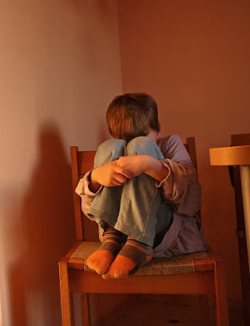




Traumatic Experiences:
Poverty
Childhood neglect
Physical, sexual, and emotional abuse
Racism, discrimination, and oppression
Living with a family member with mental health or substance use disorders
Sudden, unexplained separation from a loved one
Violence in the community, war, or terrorism
Notes:
SUBJECT MATTER: TRAUMA
READ slide:
Share with students some specific examples of what a person identifies as trauma: car accident, death of a parent, living with an alcoholic parent, fertility issues, being held at gun point, etc.
Reiterate after reading the list of experiences:
TRAUMA IS ANY INCIDENT OR OCCURRENCE WHICH CAUSES A PERSON TO CHANGE THE VIEW OF THEMSELVES, THE WORLD, AND THE RELATIONSHIP BETWEEN THE TWO.

Slide 35
Common Responses to Trauma
PHYSICAL | EMOTIONAL | COGNITIVE
Nausea and/or gastrointestinal distress Sweating or shivering Faintness Muscle tremors or uncontrollable shaking Elevated heartbeat, respiration, and blood pressure | Numbness and detachment Anxiety or severe fear Guilt (includes survivor guilt) Exhilaration as a result of surviving Anger | Difficulty concentrating Rumination or racing thoughts Distortion of time and space Memory problems
35
Notes:
SUBJECT MATTER: TRAUMA
So, how do we identify whether or not we are ourselves, or someone we know is experiencing a trauma response- Let’s review the following 5 domains: PHYSICAL, EMOTIONAL, COGNITIVE, BEHAVIORAL, AND EXISTENTIAL.
Evidence of PHYSICAL responses to trauma:
READ (or have a student read) the characteristics
PHYSICAL
may be indicating a response to trauma (not all-inclusive)
Evidence of EMOTIONAL Trauma:
READ (or have a student read) the characteristics
EMOTIONAL
Numbness and detachment ARE a response. Often times first responders will report this. And it’s important to note that numbness is still a response.
Guilt includes survivor guilt as well
Evidence of Cognitive Trauma:
READ (or have a student read) the characteristics
COGNITIVE
Rumination or racing thoughts: for example, replaying the traumatic event over and over again
Distortion of Time and Space: For example, a traumatic event may be perceived as if it was happening in slow motion, or a few seconds can be perceived as minutes.
Memory Problems: when a person is asked for details of a trauma and they say ”I don’t know, or I’m having a hard time recalling details”. This is common and speaks to the brain’s mechanism of protecting the self by storing an experience that has difficult retrieval.
In the Criminal Justice World, professional are exposed to A LOT of trauma.
They witness traumatic events
They engage in behaviors that are necessary for their jobs, but they are still internally traumatic
They deal with traumatized persons who can create vicarious trauma in those who interact with them (more on this in a moment).

Slide 36
Common Responses to Trauma
BEHAVIORAL | EXISTENTIAL
Startled reaction Restlessness Difficulty expressing oneself Argumentative behavior Withdrawal and apathy Avoidant behaviors Sleep and appetite disturbances Increased use of alcohol, drugs, & tobacco | Intense use of prayer Restoration of faith in the goodness of others (E.G., Receiving help from others) Loss of self-efficacy Despair about humanity, particularly if the event was intentional Immediate disruption of life assumptions (E.G., Fairness, safety, goodness, predictability of life)
Notes:
SUBJECT MATTER: TRAUMA
Next are the Behavioral and Existential domains.
BEHAVIORAL– we typically notice the behavior changes in a person
EXISTENTIAL- these are all responses to trauma
Highlight to students:
We typically see physical and behavioral responses as more obvious when it comes to young people experiencing a trauma response.
Physical, emotional and cognitive responses in high-performance/high-achievement adults
Cognitive and existential responses in middle-aged adults who are parents, and older adults.
AND REMEMBER, THESE RESPONSES MAY BE IMMEDIATE OR DELAYED BY MINUTES, HOURS, DAYS, WEEKS, MONTHS, AND YEARS!
Classroom Exercise:
Consider what you want to do as a criminal justice professional.
Where and in what kind of situation would you expect to experience trauma?
How do you think this trauma would affect you?
When do you think this trauma would affect you? Immediately or much later?
In the next slide we will discuss and examine some of the common responses to trauma early in life.

Slide 37






Exposure to traumatic experiences:
2.5 times
more likely to have sexually-
transmitted infections
4 times
more likely to have chronic obstructive pulmonary disease
2 times
as likely to smoke
Extremely debilitating for children
Long-term effects that have huge implications as an adult
7 times
more likely to consider themselves an alcoholic
10 times
as likely to have injected street drugs
12 times
as likely to have attempted suicide
Resource: Relationship of Childhood Abuse and Household Dysfunction to Many Leading Causes of Death in Adults
Notes:
SUBJECT MATTER: TRAUMA
Read: The statistics you are looking at are derived from the Adverse Childhood Experiences Study.
ACEs are defined as;
Traumatic Events Occurs From 0 To 17 Years (61%/ experience 4 or more)
Violence, Abuse, Neglect, Suicide, SUD, MH, Instability, Separation, Incarceration
Impact On Future Violence Victimization And Perpetration
Lifelong Health & Opportunity
The Image shows statistics for individuals with an ACE score of 4 or more were approximately:
2 times as likely to smoke
2.5 times more likely to have sexually transmitted infections
4 times more likely to have COPD
7 times more likely to consider themselves an alcoholic
10 times as likely to have injected street drugs
12 times as likely to have attempted suicide
DISCUSSION: What might this information provide to a client who is seeking treatment for a SUD (substance use disorder)?
Reference:
Felitti, V. J., Anda, R. F., Nordenberg, D., Williamson, D. F., Spitz, A. M., Edwards, V., Koss, M. P., & Marks, J. S. (1998). Relationship of Childhood Abuse and Household Dysfunction to Many of the Leading Causes of Death in Adults. American Journal of Preventive Medicine, 14(4), 245–258. https://doi.org/10.1016/s0749-3797(98)00017-8
https://www.ajpmonline.org/article/S0749-3797(98)00017-8/abstract

Slide 38
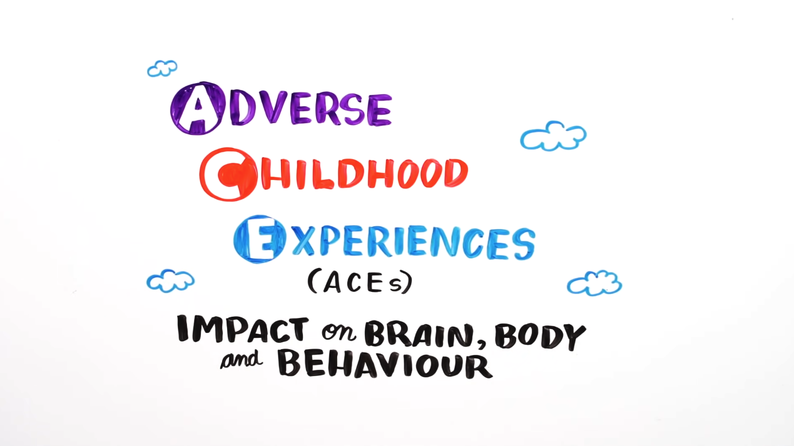
Adverse Childhood Experiences (ACEs)
Notes:
SUBJECT MATTER: Adverse Childhood Experiences (ACE’s)
Adverse Childhood Experiences also referred to as ACEs.
ACEs are defined as;
Traumatic Events Occurs From 0 To 17 Years (61% of those surveyed experienced 4 or more ACEs)
Violence, Abuse, Neglect, Suicide, SUD, Mental Health, Instability, Separation, Incarceration
Impact On Future Violence Victimization And Perpetration
Lifelong Health & Opportunity
This video will explore ACEs and the impact on our brain, body and behavior.
WATCH VIDEO: Youtube: Adverse Childhood Experiences (ACEs): Impact on Brain, Body, and Behavior (6:02 minutes) https://youtu.be/W-8jTTIsJ7Q

Slide 39
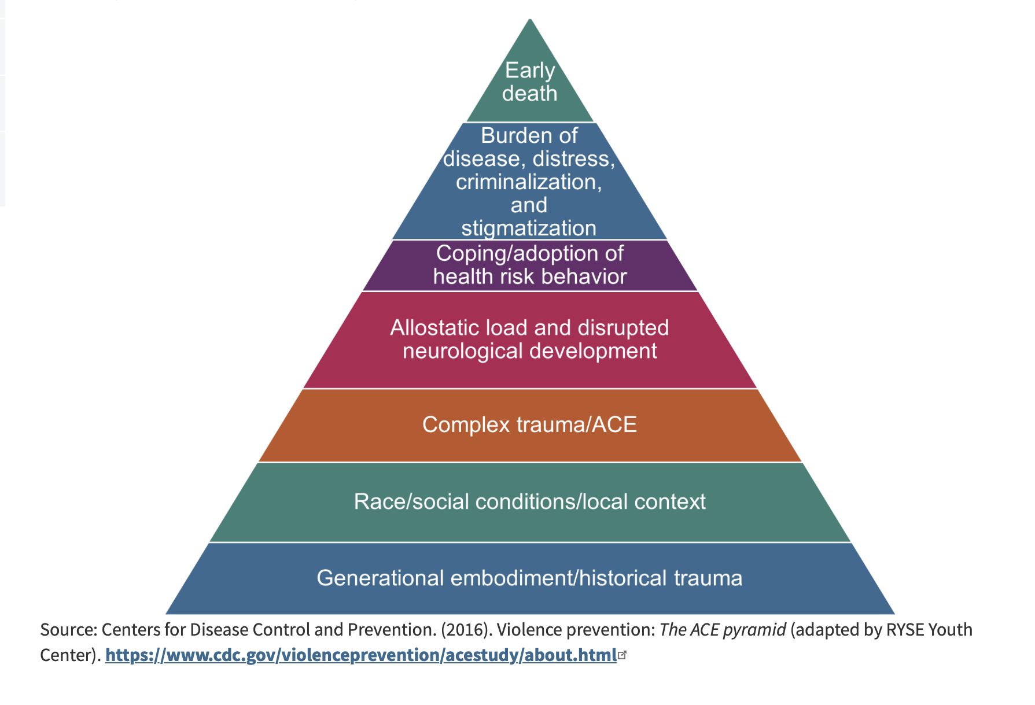
Adverse Childhood Experiences (ACE’s)
Notes:
SUBJECT MATTER: Adverse Childhood Experiences (ACEs)
Now we are going to discuss Adverse Childhood Experiences
Not surprisingly, it has been found that traumatic childhood events may negatively affect adult health and therefore have an impact throughout an adult person’s lifespan.
The Original ACE Study
The foundational ACE Study was conducted by the Centers for Disease Control and Kaiser Permanente in the mid-1990s with a group of patients insured through Kaiser Permanente.
The initial study focused on how traumatic childhood events may negatively affect adult health.
The 17,000 participants surveyed were asked about their experiences with childhood maltreatment, family dysfunction, and current health status and behaviors.
The ACEs Pyramid on the left side of the image below represents the conceptual framework created, which illustrates how strongly ACEs are related to a person’s well-being throughout their lifespan.
The ACE study found a direct link between childhood trauma and adult onset of chronic disease, incarceration, and employment challenges.
The higher the number of ACEs, the greater the incidence of negative outcomes as captured in the ACE Pyramid.
In 2015, the RYSE Center adapted the pyramid as seen on the right side of the image below to include two layers on the bottom that account for the role historical trauma and social location play in a person’s health outcome.
This revised model aligns better with the Socio-Ecological Model and accounts for the influences of each sphere on health outcomes.
Reference:
Centers for Disease Control and Prevention. (2016). Violence Prevention: The ACE pyramid (adapted by RYSE Youth Center). https://nhttac.acf.hhs.gov/soar/eguide/stop/adverse_childhood_experiences
Image: https://nhttac.acf.hhs.gov/soar/eguide/stop/adverse_childhood_experiences

Slide 40
Vicarious Traumatization:
Refers to a transformation in cognitive schemas and belief systems resulting from empathic engagement with clients’ traumatic experiences that may result in ‘‘significant disruptions” in:
  One’s sense of meaning, connection, identity, and world view
  One’s affect tolerance, psychological needs, beliefs about self and others, interpersonal relationships, and sensory memory’’
    Pearlman & Saakvitne, 1995, p. 151
Notes:
SUBJECT MATTER: VICARIOUS TRAUMATIZATION
READ the slide
Justice System professionals and can also be impacted by the traumatic events of others.
It can change or disrupt their sense of meaning, their connection to society, and their world view.
For example, female officers who repeatedly deal with female victims of interpersonal violence may change their behaviors and beliefs to be similar to those who were victimized, even though they never directly experienced violence themselves.
This potential increases when the traumatized person is similar to the person they are interacting with. This includes female officers dealing with traumatized females, as well as officers with a certain racial or ethnic background dealing with persons who have been victims of racist attacks.
Listening to and supporting these victimized women can result in indirect or vicarious traumatization.

Slide 41
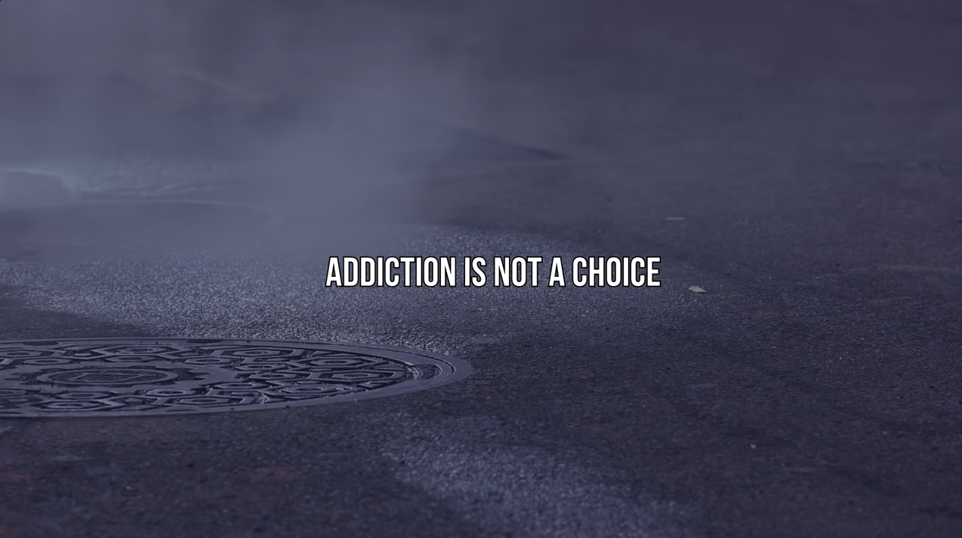
Gabor Maté: The Best Explanation of Addiction I’ve Ever Heard
Notes:
SUBJECT MATTER: TRAUMA
Let’s take a look at this video that talks about addiction and its connection to trauma.
The person in this video is the real deal. He has seen the world of addictions through the eyes of a doctor and counselor, and his experiences are both real and valid.
You may want to take note of his name, he has several videos available online. If you find this enlightening or just interesting, I suggest you seek out more of his work and learn from his experiences.
[Play video from slide]
Gabor Maté: The best explanation of addiction I’ve ever heard. (9:50 minutes) Youtube: https://youtu.be/ys6TCO_olOc
Discussion Topics:
How does the emotional, physical, & spiritual pain a person experiences contribute to a person’s addiction?
Internal resources vary person to person. How does a person access their own resilience?
Further Information
Dr. Gabor Maté official webpage https://drgabormate.com/about/

Slide 42

Culture
Notes:
SUBJECT MATTER: CULTURAL CONSIDERATIONS
Next, we are going to review Cultural Considerations and how culture impacts a person.
Why is this an issue?
Criminal Justice agencies are subcultures, and they have rules, roles, language, and behaviors that are distinct from the rest of the world.
The same is true for other subcultures.
To be an effective practitioner you need to be able to communicate with the person or persons you're interacting with in an effective manner.
That requires an understanding of their culture, and how their culture may have contributed to their situation. Once this is understood, helping them deal with that situation becomes easier and much more effective.
Image: Flickr

Slide 43
What is Culture?
Culture is the learned and shared knowledge that specific groups use to generate their behavior and interpret their experience of the world. I
It comprises beliefs about reality, how people should interact with each other, what they “know” about the world, and how they should respond to the social and material environments in which they find themselves. It is reflected in their religions, morals, customs, technologies, and survival strategies. It affects how they work, parent, love, marry, and understand health, mental health, wellness, illness, disability, and death.
National Center of Cultural Competence, Georgetown (2005)
Notes:
SUBJECT MATTER: CULTURAL CONSIDERATIONS
Read the slide and ask students for examples of cultures they belong to.

Slide 44
What is Subculture?
Cultures generally contain subcultures. .
Notes:
SUBJECT MATTER: CULTURAL CONSIDERATIONS
Understanding our own, and someone else’s cultural identity gives us a greater understanding of how they may respond to crises.
It can also be considered a crisis of identity.
When the ways we view ourselves, the world, and the relationships between “us” and “them” are in conflict, we typically experience a level of stress which can lead to crisis.

Slide 45
What is Subculture?
Cultures generally contain subcultures.
These subcultures revolve around such things as gender, age, class, race, religion, occupation, or sexual orientation and identity.
Notes:
SUBJECT MATTER: CULTURAL CONSIDERATIONS
When the ways we view ourselves, the world, and the relationships between “us” and “them” are in conflict, we typically experience a level of stress which can lead to crisis.

Slide 46
What is Subculture?
Cultures generally contain subcultures.
These subcultures revolve around such things as gender, age, class, race, religion, occupation, or sexual orientation and identity.
They tend to have their own norms, beliefs, and language that differs from the larger culture.
Notes:
SUBJECT MATTER: CULTURAL CONSIDERATIONS
The best way to alleviate some of these negative outcomes is to have an understanding of the culture you are dealing with and how some of their cultural behaviors came about and why they are important.
Such knowledge may keep you from making unintended mistakes and violating the norms of the culture. This will allow you to be more effective as a professional and more successful in dealing with certain unique subcultures.

Slide 47
Cultural Impact on Mental Health Crisis
These cultural meanings can influence how the patient:
    Seeks or avoids treatment
    Perceives and expresses symptoms
    Copes with stress and capacity to manage crisis
    Adheres to treatment plans
    Attaches stigma to mental illness crisis
Notes:
SUBJECT MATTER: CULTURAL CONSIDERATIONS
Culture affects how we experience and interpret the world.
Culture, including beliefs, values, norms, and behaviors, affects how we experience and interpret the world, including the meaning we impart to the experience of a mental illness crisis.
Culture can also influence how a patient engages with the behavioral health and/or healthcare systems.
In a performance and outcome-driven society that assigns a lot of weight to the social perception of success; stigma is an enormous barrier to help-seeking for those in crisis.
This becomes important in the clinical world because some cultures view seeking help as a sign of weakness. In order to be successful when dealing with these sorts of cultures, you have to respect their beliefs but get them to understand that the intervention is in their best interest. This will improve compliance and increase the success of the intervention.

Slide 48
Cultural Awareness
Having a firm grasp of what culture is and what it is not
Having insight into intracultural variation
Understanding how people acquire their cultures and culture’s important role in personal identities, life ways, and mental and physical health of individuals and communities;
Being conscious of one’s own culturally shaped values, beliefs, perceptions, and biases
Observing one’s reactions to people whose cultures differ from one’s own and reflecting upon these responses
Seeking and participating in meaningful interactions with people of differing cultural backgrounds.
Notes:
SUBJECT MATTER: CULTURAL CONSIDERATIONS
Why is it important to be conscious of your own culturally shaped values, beliefs, perceptions, and biases?
Why do you think it is important to seek and participate in meaningful interactions with people from different cultural backgrounds?
What opportunities do you have on campus, to participate in meaningful interactions with people from a different cultural backgrounds?
Class Discussion:
Share with the class some language or behavior that is specific to a sub-culture that you belong to. For example, if you play sports share some of the terms used in the sport that you play. That's an example of subcultural language. Now share some of the behaviors common to that subculture. Ask for a show of hands to see how many people were aware of that language or that behavior as being common within that subculture.

Slide 49

Importance of Cultural Awareness
Cultural awareness is a critical feature of effective health and mental health policy, planning, resource allocation, and service delivery across the entire spectrum of care, including health promotion and prevention.
This is so because cultural perspectives inform people’s identification and interpretation of symptoms and define the diseases, illnesses, and disabilities they recognize. Culture also shapes their ideas of appropriate treatment.
Notes:
SUBJECT MATTER: CULTURAL CONSIDERATIONS
Subcultural example!
Jail Stigma- comparison of inner-city residents and suburban residents.
Their subcultures are very different, and this is exemplified in their views of going to jail.
Show of hands, how many of you have family members who would be disappointed or shocked if he went to jail?
For inner city residents this is not the case. Going to jail is common in that subculture and it's not stigmatized the same way it is for non-inner-city residents.
So, what are the steps and areas necessary to be culturally aware and sensitive?

Slide 50

DISCUSSION
Cultural…
Awareness
Sensitivity
Competence
Humility
50
Notes:
SUBJECT MATTER: CULTURAL CONSIDERATIONS DISCUSSION
Discussion Points:
Cultural Awareness: is a critical feature of effective health and mental health policy, planning, resource allocation, and service delivery across the entire spectrum of care, including health promotion and prevention.
Cultural Sensitivity: is being aware of cultural differences and NOT judging or assigning value to those differences (positive or negative)
Cultural Competence: doesn’t mean you are an authority in the values and beliefs of every culture. There is a shift in the paradigm we should be aiming to achieve cultural competence and rather, we should seek to achieve cultural humility.
Cultural Humility: is defined by the willingness to have ‘Courageous Conversations’ – diversity and inclusion are necessary to create a safe space to courageously let our guards down in order to be vulnerable, honest, and transparent about our unique experiences of the world; being willing to ask questions with intentions of gaining an understanding of someone’s else’s culture and lived experiences.
The last one is critical, you need to both be aware and knowledgeable, AND not be superior about your culture.

Slide 51

Compassion Fatigue
is the emotional and physical fatigue experienced by professionals due to their chronic use of empathy in helping others in distress
Figley and colleagues introduced compassion fatigue as a more ‘‘user-friendly’’ term to describe the phenomena of secondary traumatic stress.
There are some distinctions between these terms, but all three terms refer to the negative impact of clinical work with traumatized clients.
Figley et al., 1995, 1996, 2002; Newell et al., 2016; Stamm, 2010 Turgoose & Maddox, 2017
Notes:
SUBJECT MATTER: COMPASSION FATIGUE AND SELF CARE
Now we get to the last section of the presentation. These two areas are tied together because Compassion Fatigue requires Self Care to avoid BURNOUT.

Slide 52
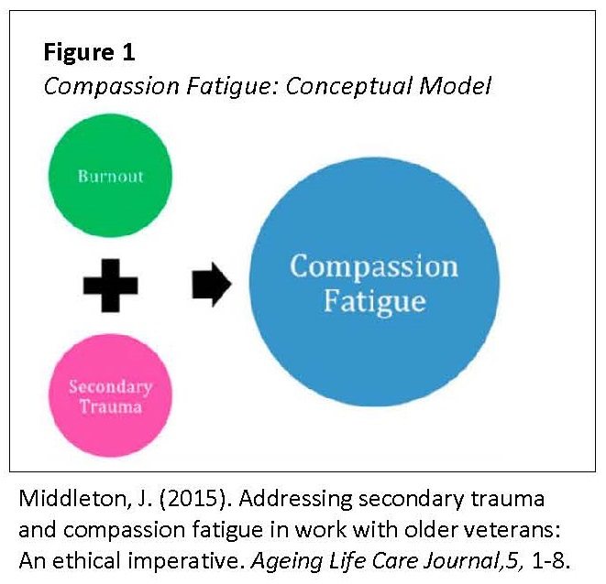
Empathy Based Stress
Notes:
SUBJECT MATTER: COMPASSION FATIGUE AND SELF CARE
This slide indicates that the person's most at risk for compassion fatigue or persons who are both experiencing burnout and have experience secondary trauma.
They have cared for too long, they have carriage too deeply and have worked diligently to improve lives.
They have not, however, taken good enough care of themselves and thus they are unable to care like they used to.

Slide 53
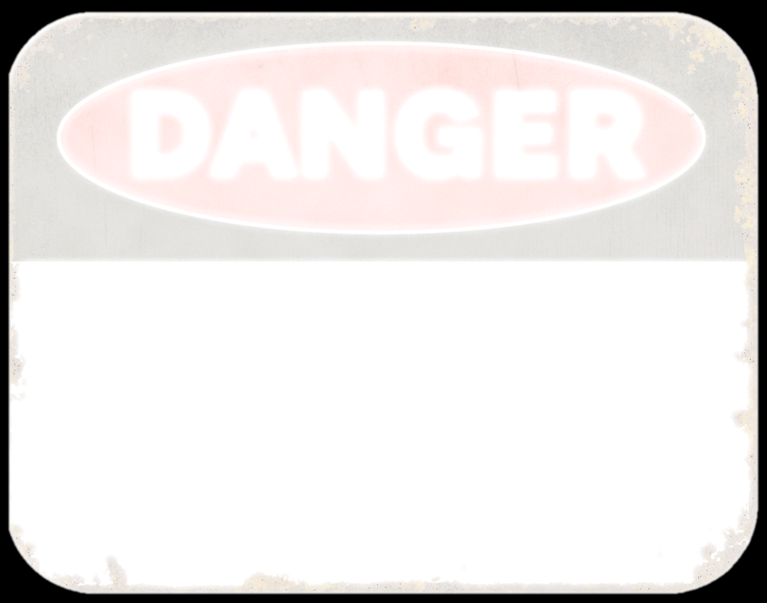
It is essential that students as part of their training learn how to prevent and manage workplace stress and compassion fatigue
‘Students unprepared to address the emotional challenges of social work practice may be at risk of experiencing occupational stress conditions….’
Courtois, 2002; Dunkley & Whelan, 2006; Figley, 2002, p.428
Notes:
SUBJECT MATTER: COMPASSION FATIGUE AND SELF CARE
This training hopes to offer you tools and education that prior generations did not receive.
The goal here is to get you to realize that self-care is critical to being good and effective at your job. It's not a sign of weakness it's a sign of intelligence.
This has not always been the case, which is why so many fields have experienced burnout levels that were unreasonable and unnecessary.
Hopefully, with the proper training and change in the culture of criminal justice professionals, burnout levels will diminish and self-care will be seen as a regular part of the job.

Slide 54
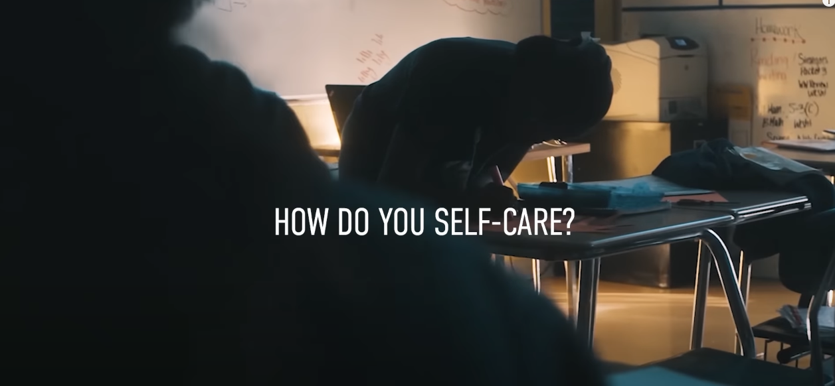
Self Care – Powerful Study Motivation (2020)
Notes:
SUBJECT MATTER: COMPASSION FATIGUE AND SELF CARE
Introduction of Self-care to your students. “Let’s take a look at this video and its introduction to self-care. While you watch this video, I would like you to think about how this message applies to you.”
[WATCH video]
Youtube: Self Care – Powerful Study Motivation (2020) https://youtu.be/hyO8PNTwyYo (8:06 minutes)
Discussion Questions:
What does self care mean to you?
How do you know when you have enough self care?

Slide 55
Now, Let’s Circle This Discussion Back Around To Compassion Fatigue And Tie It In To Self Care.
Notes:
SUBJECT MATTER: COMPASSION FATIGUE, SELF CARE, and OCCUPATIONAL STRESS
Substance Use and Suicide have been behaviorally linked for a very long time.
They have also been ignored and neglected because the connections are complex.
Are these connections complex?
From a research standpoint, there is a possibility that the arrow goes from substance use to suicide, indicating substance use is a risk factor.
But there is also a possibility that those who are suicidal may be more inclined to use substances in an unhealthy way.
And there is a third possibility that a third factor, like trauma, maybe contributing to both substance use and suicidal thoughts.
Which is why the relationship between these two variables is considered complex and difficult to empirically steady

Slide 56

Ethics, Compassion Fatigue, and Self Care
Ethical principles state: “First, do no harm” and “Do Good”.
In order to do no harm and to provide effective services behavioral health professionals should care for themselves to ensure quality, ethical services. (Figley, Huggard, & Rees, 2013)
Notes:
SUBJECT MATTER: COMPASSION FATIGUE and ETHICAL BEHAVIOR
Ask students if they have heard of these ethical principles. The intent of this slide is to begin the discussion that behavioral health professionals have an ethical duty to care for themselves in order to prevent and deal with compassion fatigue, burnout, and secondary traumatic stress in an effective manner.
References:
Figley, C.R., Huggard, P., & Rees, C. (2013). Introduction. In C.R. Figley, P. Huggard, & C. Rees (Eds.). First Do No Self-Harm: Understanding and Promoting Physician Stress Resilience. New York, NY: Oxford University Press.
Lachman, V.D. (2016). Compassion fatigue as a threat to ethical practice: Identification, personal and workplace prevention/management strategies. MEDSURG Nursing, 25(4), 275-278.
IMAGE CREDIT: Shutterstock (purchased image).
Slide Credit: Pacific Southwest Addiction Technology Transfer Center Network. Compassion Fatigue and the Behavioral Health Workforce Curriculum Infusion Package. https://uclaisap.org/html2/compassion-fatigue-behavioral-workforce-cip.html

Slide 57

When talking about self-care as an ethical issue, let’s review these important terms -
Compassion Fatigue & Compassion Satisfaction:
  Compassion Fatigue is the emotional and physical fatigue experienced by professionals due to their chronic use of empathy in helping others in distress. Figley, 1995; Newell et al., 2016; Stamm, 2010; Turgoose & Maddox, 2017)
  Compassion Satisfaction refers to those aspects of work that are rewarding and fulfilling to the human service professional. (Conrad & Keller-Guenther, 2006; Stamm, 2005)
Providing help, kindness, empathy, and support can lead to compassion fatigue unless self-care plans, self compassion, and self-awareness activities are put in place.
Notes:
SUBJECT MATTER: COMPASSION FATIGUE and ETHICAL BEHAVIOR
Read slide and explain the ethical reasons for self-care.
This is no different than a professional athlete staying in good shape so he or she can be the best player on the team.
To do any less than that would be to deprive the team and their fellow players of their skills and contributions.
Or basically not doing what they are being paid to do.

Slide 58
Compassion Fatigue Symptoms
Compassion fatigue is a serious problem that can undermine a person’s mental and physical health and negatively affect their relationship and ability to care for others (Cocker & Joss, 2016).
24 Compassion Fatigue Symptoms:
Diminished ability or interest to care for others | Feeling like a failure as a helper
Preoccupation with people you help | Drops in Productivity
Mental and/or physical exhaustion | Emotional numbness
Anger and irritability | Trouble separating personal and personal life
Anxiety and/or depression | A decreased capacity to experience sympathy and empathy
Intrusive Thoughts | Dysfunctional coping behaviors (i.e. misusing alcohol or drugs)
Sleep problems | Taking more time off work
Being easily startled | Reduced decision-making ability
Hopelessness about helping work | Feeling disconnected
Flashbacks | Decreased satisfaction or enjoyment with work
Hypervigilance | (Cocker & Joss, 2016; Clay, 2020; Stamm, 2010)
Avoidance of certain activities, situations or people you help
Notes:
SUBJECT MATTER: COMPASSION FATIGUE and ETHICAL BEHAVIOR
This slide is an overview of Compassion Fatigue Symptoms.
READ slide to students.
Propose a discussion with the students about what would their warning signs include if/when they reach compassion fatigue.
Reference:
Brown, H., PhD. (2022, October 4). What Is Compassion Fatigue? 24 Causes & Symptoms Explained. PositivePsychology.com. https://positivepsychology.com/compassion-fatigue/

Slide 59
Other Terms in the Compassion Fatigue Literature
Co-victimization
Secondary Survivor
Emotional Contagion
Secondary victimization
Traumatoid Stress
Empathic Identification
Empathic Attunement
Newell et al., 2016
Notes:
SUBJECT MATTER: COMPASSION FATIGUE and ETHICAL BEHAVIOR
Here is a list of other terms that appear in the compassion fatigue literature. Ask students if they are familiar with these other terms. The article by Newell and colleagues (2016) does an excellent review of these terms and the time periods they were in use.
References:
Newell, J. M., Gardell, D. N., & MacNeil, G. (2016). Clinician response to client traumas: A chronological review of constructs and terminology. Trauma, Violence, & Abuse, 17, 306-313.
Maslach, C. (2001). What have we learned about burnout and health? Psychology and Health, 16, 607-611.
Slide Credit: Pacific Southwest Addiction Technology Transfer Center Network. Compassion Fatigue and the Behavioral Health Workforce Curriculum Infusion Package. https://uclaisap.org/html2/compassion-fatigue-behavioral-workforce-cip.html

Slide 60
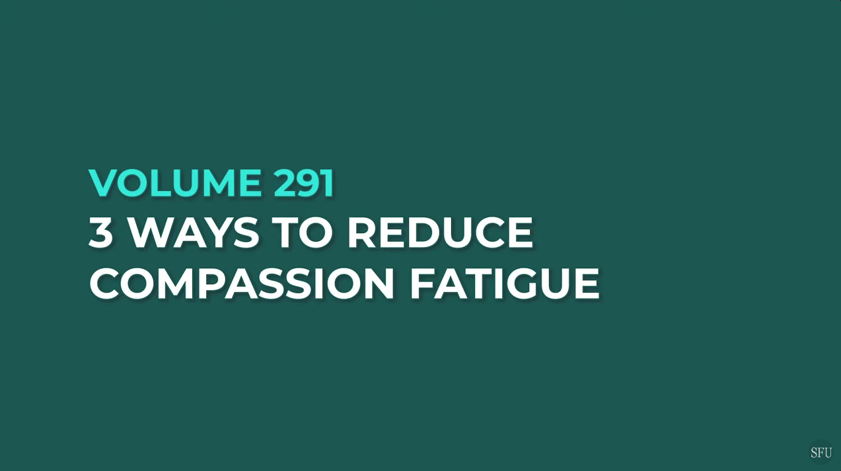
3 Ways to Reduce Compassion Fatigue
Notes:
SUBJECT MATTER: COMPASSION FATIGUE
This video introduces 3 ways to reduce compassion fatigue for helpers.
[WATCH video]
Youtube: https://youtu.be/8jJqOp1EvA8 (6:03 minutes)
Discussion:
How will you know if your job is contributing to compassion fatigue?
What hobbies keep you feeling pleasure and disconnect from your work?

Slide 61
Resources:
Zero Suicide Institute: https://zerosuicideinstitute.com/
Zero Suicide Listserv: https://zerosuicide.edc.org/movement/zero-suicide-listserv
NV Office for Suicide Prevention: http://suicideprevention.nv.gov/
NV Zero Suicide Initiative: https://nvopioidresponse.org/initiatives/zs/
The Lifeline and 988: https://988lifeline.org/current-events/the-lifeline-and-988/
UNR LiveWell Resource Page: https://www.unr.edu/livewell
UNR Disabilities Resource Center: https://www.unr.edu/drc
Nevada Center for Excellence in Disabilities Directory: https://www.unr.edu/education/faculty-and-
staff/nevada-center-for-excellence-in-disabilities
CASAT on Demand Resources & Downloads: https://casatondemand.org/resources_downloads/
Pacific Southwest Addiction Technology Transfer Center (PSATTC): psattc.org
SAMHSA’s Technology Transfer Centers (TTC) Programs: techtransfercenters.org
The Mental Health Technology Transfer Center Network: https://mhttcnetwork.org/
The Prevention Technology Transfer Center Network: https://pttcnetwork.org/
Department of Health & Human Services Aging and Disability Services Division: https://adsd.nv.gov/
Notes:
Resources and Further Reading

Slide 62
Notes:
The goal of the Pathways in Crisis Services (PICS) Project is to ensure that undergraduate/graduate students get exposed to crisis intervention services and skills while in school in order to prepare them to do crisis intervention services which includes: risk determination; early intervention; de-escalation strategies; how to conduct warm hand off; and understanding the new (988) system.

