Slide 1
Pathways in Crisis Services Project
Suicide Prevention
Notes:
Pathways to Crisis Services (PICS) Curriculum Infusion Packages (CIPs) are a product for educators and trainers developed in 2022/2023 by the Center for the Application of Substance Abuse Technologies (CASAT). The main developers of crisis services materials are April Lang-Barroga, LMFT, LCADC, NCC, and Bianca D. McCall, LMFT. Additional guidance and editing support were provided by, Terra Hamblin, MA, Nancy Roget, MS, and Sophia Graham, BS.
This product was developed to help community college/university faculty, as well as clinical supervisors and recovery support staff have access to brief, science-based content with the goal of providing materials that can be easily infused into existing substance use disorder and related courses (e.g., social work, nursing, criminal justice, foundation of addiction courses, ethics, counseling courses, etc.). Individuals can select the specific content to infuse into existing curricula/materials depending on the specific needs of their learners. Each slide in the slide decks contains notes to provide guidance on the topics along with references and handouts where appropriate. If you require further information, please do not hesitate to contact the CASATs PICS Project Staff located at CASAT (775-784-6265) You are free to use these slides and pictures, but please give credit to PICS when using them by referencing the PICS Program at the beginning of your presentation.
Funding for this product/publication was made possible in whole or in part by the Nevada Division of Public and Behavioral Health Bureau of Behavioral Health, Prevention, and Wellness (DHHS). The views expressed in these materials do not necessarily reflect the official policies or views of DHHS or the State of Nevada nor does mention of trade names, commercial practices, or organizations imply endorsement by the U.S. Government or the State.
Additional resources are available to enhance and support the information provided in this brief presentation.
Date last updated: January 2023

Slide 2
Overview of Suicide Prevention
Notes:
Suicide Prevention-Lead is designed to provide comprehensive training and awareness in suicide prevention, focusing on available resources and initiatives in Nevada. Participants will explore various training opportunities, offered by the Nevada Office of Suicide Prevention and the American Foundation for Suicide Prevention. There is a discussion about the transition to the new 988 mental health crisis hotline, aiming to encourage individuals to shift from using the former 800 number and 911, to the designated 988 number.
Suicide Prevention-Train focuses on suicide safety and prevention, providing participants with essential training opportunities to become effective helpers and advocates. Participants will explore Living Works programs, including safeTALK, an entry-level alert helper training, and ASIST, an advanced training designed for mental health professionals.
Suicide Prevention- Identify focuses on identifying suicide risks through the utilization of assessment tools such as the Columbia Suicide Severity Rating Scale (C-SSRS), ASQ, SAFE-T and PHQ-9. Students will learn how to effectively administer and interpret these assessment tools to evaluate the severity of suicidal ideation and behavior. Additionally, the course introduces the Zero Suicide framework, with a specific focus on the "Identify" component, which emphasizes the importance of systematic suicide risk identification and intervention.
Suicide Prevention-Treat offers an in-depth exploration of evidence-based treatments for individuals experiencing suicidality, focusing on Cognitive-Behavioral Therapy for Suicide Prevention (CBT-SP), Dialectical Behavior Therapy for Suicide Prevention (DBT-SP), and the principles of Motivational Interviewing. Students will gain a comprehensive understanding of these therapeutic approaches and their applications in working with individuals at risk of suicide. Introduction of the Zero Suicide framework, highlighting the "Treat" component, which emphasizes the implementation of evidence-based treatments and interventions to effectively address suicidality. Suicide Prevention-Engage focuses on effectively engaging individuals who display behavioral signs and other invitations to intervene. During this course, Participants learn strategies for building rapport, establishing trust, and initiating safety planning which emphasizes the crucial element of restricting access to lethal means. Additionally, the course introduces the Zero Suicide framework, highlighting the "Engage" component, which underscores the importance of active and compassionate engagement with individuals at risk. Suicide Prevention-Transition & Improve focuses on the effective transition and support of patients at risk of suicide, throughout the continuum of care. Participants will learn strategies for providing warm hand-offs, ensuring seamless transitions between healthcare providers and settings. The course emphasizes best practices in documentation, including the utilization of Electronic Health Record (EHR) systems to enhance communication and continuity of care. Participants will also explore common barriers that clients face when accessing follow-up care and develop strategies to address these challenges.
Each slide contains detailed notes for the trainer to provide guidance in effectively presenting the content, as necessary. Full citations for the content are included in the notes for each slide.

Slide 3
Disclaimer
This presentation may include readings, media, and discussion on topics which include suicide, trauma, and crisis intervention. These topics may result in stress reactions.
Please monitor your reactions and if necessary, reach out to someone you trust if these topics cause considerable discomfort.
Notes:
Read the Disclaimer: This presentation may include readings, media, and discussion on topics which include suicide, trauma, and crisis intervention. These topics may result in stress reactions. Please monitor your reactions and if necessary, reach out to someone you trust if these topics cause considerable discomfort.

Slide 4
Suicide Prevention Starts With You
Notes:
SUBJECT MATTER: SUICIDE PREVENTION
Transition Slide: Inform students we will be reviewing suicide prevention risk and protective factors, suicide risk assessments, and how to work with someone who is suicidal. Please be aware of how you are responding to the material and how you might have discussions of suicide with your clientele. Suicide is a difficult topic to learn about and experience. Please be considerate of your students when they are sharing.
Image Credit:
Banner: Picryl
Person: Bing, Microsoft

Slide 5
Mental Health Spectrum
Mental Health is multidimensional (non-binary)
Suicide is the end stage of mental health disease
Notes:
SUBJECT MATTER: SUICIDE PREVENTION
READ: slide contents.
Potential Discussion Questions:
What are some other examples of binary - aka - black and white - aka - all or nothing thinking, leading to behavioral health challenges such as substance misuse and abuse, and perhaps criminal behavior? Ex: Love me – Love me not, Win – Lose, Sinner – Saint, Fail – A+ or Succeed
Suicidality is a mental health disorder. Do you agree with or disagree with this statement, and why? Ex: There are behavioral choices that can lead to higher risk for certain cancers. Would you ever tell a cancer patient they are selfish and committing cancer because they were perhaps exposed to cancer-causing agents?
Key Points:
Our mental health state (or experience) exists on a continuum, and it is influenced by our behavioral health, physical health, spiritual health; and social health (Social Determinants of Health- SDOH which include relationships, environmental health, safety and community, connectedness, access to resources, education, employment, etc. AND this is in real life (IRL) and digital or virtual life)
Dis-ease which goes on without acknowledgement is unidentified, and unmanaged increases the risks of a mental health crisis.
Coping strategies are not always positive- especially for individuals who are responding to trauma, and intergenerational trauma where negative coping strategies such as substance misuse and abuse are primary coping models. Ex: Military and consuming alcohol.
Suicide ideation, gestures, and attempts are symptoms of a mental health crisis- someone is unwell
A mental health crisis can be fatal, resulting in suicide death, and drug overdose death
These types of fatalities ARE preventable- healthcare and behavioral healthcare systems can become better at preventing fatalities by reshaping mental health culture at every facility, improving screening, reporting, and identification of the symptoms; increased compassion for those experiencing a mental health crisis ( we tend to villainize, criminalize, and dehumanize- project our personal philosophies and relationships to trauma and misdiagnose the root causes), improved competence and confidence in delivering the appropriate responses
Increased risk for drug overdose death in youth (sibling) suicide loss survivors
Reference:
Centre for Mental Health (2017)
Image Credit: Centre for Mental Health https://www.centreformentalhealth.org.uk/blogs/mental-health-all-working-across-spectrum

Slide 6
Source: The Colombia Lighthouse Project
Notes:
SUBJECT MATTER: SUICIDE PREVENTION
WATCH VIDEO: Saving Lives Worldwide – A Call to Action – The Columbia Lighthouse Project (5:19). October 19, 2016: https://youtu.be/csPPsstf2og
Potential Discussion Question:
What are your thoughts about the statistic- 90% of mass shooters are experiencing some level of untreated suicidality?
Key Points:
Suicide is a global pandemic
#1 killer of teenage girls across the globe – more than natural disasters, war, and homicide combined.
In the U.S. suicide death toll is higher than car crashes
Columbia Suicide Rating Scale - Asking the questions saves lives, prevents violence, and criminality
Emergency room data suggests more than 40% cross-utilization between drug overdose-related emergencies and mental health-related emergencies such as depression and suicide.
Removing the stigma stops people from suffering in silence and self-medicating with drugs and alcohol.
Reference: The Columbia Lighthouse Project, Saving Lives Worldwide - A Call to Action (2016) https://cssrs.columbia.edu/

Slide 7
National State of Emergency: Youth & Adolescent Mental Health
This worsening crisis in child/adolescent mental health is inextricably tied to the stress brought on by COVID-19 and the ongoing struggle for racial justice and represents an acceleration of trends observed prior to 2020.
Rates of childhood mental health concerns and suicide rose steadily between 2010-2020 – by 2018 suicide was the second leading cause of death for youth ages 10-24. (October 2021 )
Notes:
SUBJECT MATTER: SUICIDE PREVENTION
Now that we have discussed how mental health is on a continuum and can impact any person at any time. Let’s take a look at how suicide is impacting our youth. The pandemic has intensified this crisis: across the country, we have witnessed dramatic increases in Emergency Department visits for all mental health emergencies including suspected suicide attempts.
READ: slide
Potential Discussion Questions:
How has the coronavirus pandemic exacerbated the problems youth and adolescents face, regarding their mental health?
What are some possible factors which contribute to the increases in suicide attempts specifically among girls ages 12-17?
What are some possible factors which contribute to the increases in drug overdose deaths specifically among youth ages 16-24?
Key Points:
This is not the fault of the coronavirus pandemic - youth and adolescent mental health declined prior to the pandemic- NV youth suicides increased by 90% in 2019
At the time of this declaration (October 2021), disproportionately 140,000 children of color lost a caregiver (from January 2020 to October 2021)
Suicide attempts nearly doubled in girls ages 12-17
In 2021, there were a reported 75,000 drug overdose deaths which is a 28% increase from the previous year.
Reference:
AAP-AACAP-CHA Declaration of a National Emergency in Child and Adolescent Mental Health. (2021). https://www.aap.org/en/advocacy/child-and-adolescent-healthy-mental-development/aap-aacap-cha-declaration-of-a-national-emergency-in-child-and-adolescent-mental-health/

Slide 8
Centers for Disease Control
Mental health challenges and conditions represent our nation’s largest source of disability.
Notes:
SUBJECT MATTER: SUICIDE PREVENTION
45,979 Suicide Deaths
1.2 Million Suicide Attempts
3.2 Million Suicide Plans
12.2 Million People with Suicide Thoughts
75,000 Drug Overdose Death* (Increases 28% in 2021)
References: Center for Disease Control and Prevention (CDC) Data and Statistics Fatal Injury Report for 2020
Image Credit: https://afsp.org/suicide-statistics/

Slide 9
Suicide and Substance Use
Over 50% of suicides associated with dependence on drugs/alcohol
At least 25% of people with alcohol/drug active addiction die by suicide.
More than 70% of adolescent suicides are associated with drug/alcohol use.
Individuals treated for substance use are 10x greater risk of suicide.
Depression is a common co-occurring diagnosis among people who use substances
Notes:
SUBJECT MATTER: SUICIDE PREVENTION
In addition to the overwhelming impact of suicide on youth, we are seeing a prevalence of substance misuse and suicide.
READ: slide, highlighting statistics.
Potential Discussion Questions:
What comes up for you when you see the statistics?
How might you utilize this information when talking about suicide prevention with your peers?
Key Points:
Substance Use places a person at higher risk of suicide.
Co-Occurring is the simultaneous presence of two or more diseases (mental health and substance use) in a person.
References:
Center for Substance Abuse Treatment. Addressing Suicidal Thoughts and Behaviors in Substance Abuse Treatment. Treatment Improvement Protocol (TIP) Series, No. 50. HHS Publication No. (SMA) 15-4381. Rockville, MD: Substance Abuse and Mental Health Services Administration, 2009.
A Link Between Substance Abuse and Suicide Rates | SoCal Sunrise Recovery. (2022). Southern California Sunrise Recovery Center. https://socalsunrise.com/substance-abuse-and-suicide/

Slide 10
Substance Use and Suicide
Deaths by SUICIDE. In 2020, 18 states had higher suicide death rates compared with 2019, including seven states with statistically significant increases.
ALCOHOL-induced deaths. In 2020, every state and the District of Columbia had higher alcohol death rates compared with 2019.
DRUG-induced deaths. In 2020, 47 states plus the District of Columbia had higher drug-induced drug rates compared with 2019.
Deaths from ALCOHOL, DRUGS, and SUICIDE. In 2020, 49 states and the District of Columbia saw higher rates of death from alcohol, drugs, and suicide combined compared with 2019.
Notes:
SUBJECT MATTER: SUICIDE PREVENTION
Data from 17 states NVDRS (National violent death reporting system)
22% of suicides involve alcohol intoxication, (30-40% of suicide attempts)
Opiates, including heroin and prescription painkillers present in 20% of U.S. suicide deaths.
Marijuana-10%, cocaine-4%, amphetamines-3%
In total, there were 186,763 alcohol-induced, drug-induced, and suicide deaths—or an age-adjusted rate of 54.8 deaths per 100,000 people—in the United States in 2020; this is a 20 percent
increase over 2019 and a 77 percent increase over 2010.
Resource:
Trust for America’s Health (2022): https://www.tfah.org/wp-content/uploads/2022/05/TFAH_2022_PainIntheNation_Fnl.pdf

Slide 11
Leading Methods of Suicide
Notes:
SUBJECT MATTER: SUICIDE PREVENTION
Substance Use and Suicide
This pie chart illustrates the means of suicide deaths by various methods.
Firearms accounted for a majority (53%) of the deaths by suicide, followed by suffocation (27%) and other (8%).
Poisonings accounted for 12% of suicide deaths in 2020.
The accompanying bar graph illustrates the contribution of various substances to poisoning suicides. As the graph shows, other and unspecified drugs and medicaments, and biological substances are contributors to over 49% of poisoning deaths.¹
Reference: CDC, 2021
Centers for Disease Control and Prevention, National Center for Health Statistics. (2021). 1999-2020 Wide Ranging Online Data for Epidemiological Research (WONDER), Multiple Cause of Death files [Data file]. Retrieved from http://wonder.cdc.gov/ucd-icd10.html
Center for Behavioral Health Statistics and Quality. (2021). 2020 National Survey on Drug Use and Health: Detailed Tables. Substance Abuse and Mental Health Services Administration, Rockville, MD. Retrieved from https://www.samhsa.gov/data/report/2020-nsduh-detailed-tables
Image Credit: https://sprc.org/about-suicide/scope-of-the-problem/suicide-and-opioids/

Slide 12
Opiates and Suicide – 3 Possible Links
Higher doses of opioids offer increased access to lethal means
Opiates have disinhibiting effects, increasing the likelihood of acting on suicide impulses
People who take higher risk doses share other characteristics that explain the link with suicide
SPRC – Suicide Prevention Resource Center
Notes:
Read slide.
Make the connection that individuals using opiates may have three possible links to suicide as a person with a substance use disorder.
Reference and Resources:
Suicide Prevention Resource Center (2020) www.sprc.org
Suicide Prevention Resource Center Archived webinars between opioids and suicide: https://sprc.org/event-training/the-intersection-of-opioid-abuse-overdose-and-suicide-the-role-of-chronic-pain/
SAMSHA Webinar PowerPoint Slides: The Intersection of Opioids and Suicide, https://www.samhsa.gov/sites/default/files/programs_campaigns/nation_prevention_week/npw2019-webinar-intersection-of-opioids-and-suicide-10252018.pdf
In Brief: Substance Use and Suicide: A Nexus Requiring A Public Health Approach: https://store.samhsa.gov/shin/content//SMA16-4935/SMA16-4935.pdf
SAMHSA’s Suicide Prevention Resource Center: http://www.sprc.org/
National Suicide Prevention Lifeline: https://suicidepreventionlifeline.org/

Slide 13
Discussion
What are risk factors…
also considered the “drivers” to suicide?
Notes:
SUBJECT MATTER: SUICIDE PREVENTION
Research investigating suicide attempts and deaths by suicide has yielded many specific risk factors and warning signs for future suicidal behaviors. The differences among risk factors, warning signs, and "drivers," are person-specific variables that lead individuals to desire death by suicide.
DISCUSSION:
Read the question aloud and discuss: What are risk factors – also considered the “drivers” to suicide?
After the discussion is finished, go to the next slide for review.
Possible answers:
Death of a loved one
Loss of employment
Legal issues
Financial distress

Slide 14
Sudden changes
in behavior
is a key identifier
that someone may be at risk of suicide
Notes:
Read slide: Sudden changes in behavior is a key identifier that someone may be at risk of suicide.
Reference: National Institute of Mental Health (NIH), Warning Signs of Suicide https://www.nimh.nih.gov/health/publications/warning-signs-of-suicide

Slide 15
Risk and Protective Factors for Suicide
Notes:
SUBJECT MATTER: SUICIDE PREVENTION
The risk and protective factors identified on the screen are used for anyone assessing if a person is at risk for suicide. The list is not all inclusive.
ACTIVITY: Have students read the list of factors. Inquire if they have any questions or concerns about any of the risk or protective factors.
Reference: Berman, L. (2021, May 18). Suicide Prevention in Health Care Systems: Debunking Myths on the Road to Zero Suicide. Johns Hopkins Medicine.

Slide 16
Common Risk Factors for Premature Death
Notes:
SUBJECT MATTER: SUICIDE PREVENTION
Common Risk Factors for Premature Death – Prevention Strategies according to the Institute of Medicine (IOM) Classification System, Retrieved from the National Institute of Mental Health
Key Points:
“Upstream Prevention” is synonymous with universal and selective prevention – awareness and education are key components.
Universal Prevention: universal interventions target the general population and are not directed at a specific risk group. The mission of universal prevention is to deter the onset of substance abuse by providing all individuals with the information and skills necessary to prevent the problem. The entire population is considered at risk and able to benefit from prevention programs.
Selective Prevention: Selective interventions target those at higher-than-average risk for substance abuse.
Indicated Prevention: Indicated interventions target those already using or engaged in other high-risk behaviors to prevent heavy or chronic use.
Center for Substance Abuse Prevention (CSAP) Domains; risk and protective factors and an individual’s character interact through these (6) life or activity domains:
Individual
Family
Peer
School
Community, and
Environment/Society
Within each domain are characteristics and conditions that can function as risk or protective factors, thus each of these domains presents opportunities for prevention.
Discussion Questions: (the illustration shows the target population for universal, selective, and indicated prevention strategies)
What does a universal suicide prevention strategy look like? Ex: Disruptive Family Factors- Community workshops and access to selective support groups
What does a selective suicide prevention strategy look like? Ex: School Difficulties- psychological safety assessment and surveying at every campus, develop emergency mental health action plans
What does an indicated suicide prevention strategy look like? Ex: Emergency Room Visits- administer the Columbia Suicide Severity Rating Scale (CSSRS), Crisis Now Model, etc.
Resource:
National Institute of Mental Health. https://www.nimh.nih.gov

Slide 17
Identifying Areas of High Need and/or Opportunity
Notes:
SUBJECT MATTER: SUICIDE PREVENTION
This image elicits the alarming statistic that 1.3 million annual suicide attempts occur each year. In the purple bubble, you will notice the breakdown of the individuals who attempted suicide and the providers they were seeing in the last 12 months. Substance use treatment, about 110,000. Outpatient Mental Health Treatment 410,000. Parole 28,000 and Probation 79,000. From this brief glimpse into our national data, we can draw the conclusion that we are missing opportunities to provide suicide questionnaires and direct conversations about suicide.
In the blue bubble, you will notice we had 44,965 deaths by suicide. Firearm deaths = 22,938. Emergency Department visits within 12 months prior to death = 21,583. Accessed healthcare within 30 days of death = 20,000. Under 18yo = 2,023. From this information, we are again seeing the missed opportunities for those attempting to access care and not receiving the help they need. Suicide is a preventable death and we need to implement more prevention efforts.
Slide Credit: Substance Abuse and Mental Health Services Administration (SAMHSA), The Intersection of Opioids and Suicide: A Prevention Approach; National Prevention Week Webinar (2018). https://www.samhsa.gov/sites/default/files/programs_campaigns/nation_prevention_week/npw2019-webinar-intersection-of-opioids-and-suicide-10252018.pdf

Slide 18
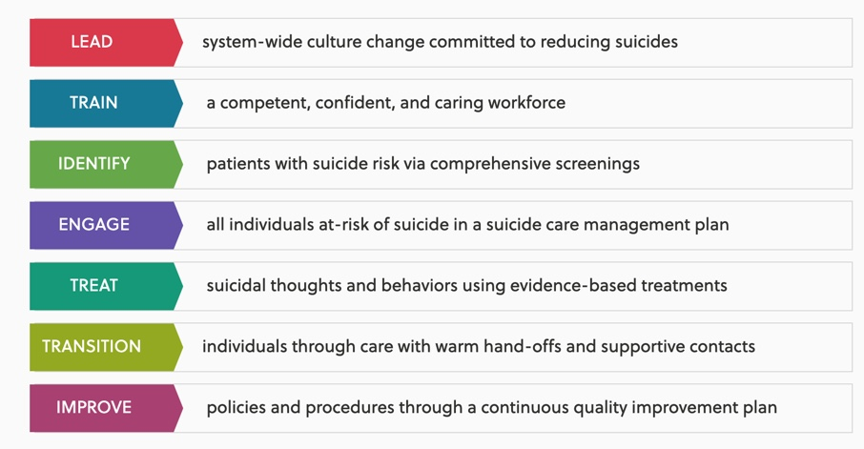
Zero Suicide Framework
Notes:
SUBJECT MATTER: SUICIDE PREVENTION
Let’s take a look at guidelines and provider standards through the lens of the zero suicide framework.
Zero Suicide is a Transformational Framework for Health and Behavioral Health Care Systems. The foundational belief of Zero Suicide is that suicide deaths for individuals under the care of health and behavioral health systems are preventable. Instead of everyone within the crisis system passing off the responsibility for who is to engage a person, who is presenting a risk for suicide….and even further- what level of accountability is on everyone in the continuum of care to be compassionate, to ask questions, and collect relative data, to monitor, support, and transition people through open doors to the right place in real-time. For systems dedicated to improving patient safety, Zero Suicide presents an aspirational challenge and practical framework for system-wide transformation toward safer suicide care.
THE GOAL OF ZERO IS ASPIRATIONAL….BUT when it comes to patient safety, the most FUNDAMENTAL RESPONSIBILITY OF HEALTH CARE, THE ONLY ACCEPTABLE NUMBER OF LOSSES DUE TO ERRORS IN QUALITY OF CARE IS ZERO.
Zero Suicide applies that life-saving mindset to preventing suicide. Zero Suicide models what it takes to make a system-wide, organizational commitment to safer suicide care. Zero Suicide is based on the realization that people experiencing suicidal thoughts and urges often fall through the cracks.
The key components to the framework are LEAD, TRAIN, IDENTIFY, ENGAGE, TREAT, TRANSITION & IMPROVE.
LEAD - starts with the leadership, system-wide change
TRAIN – workforce development, committing to training staff
IDENTIFY – through the use of screening, find the patients/clients at most risk
ENGAGE & TREAT - somebody experiencing a mental health crisis does NOT have a mental health diagnosis!
TRANSITION—How do we transition from a hospital stay to community services?
THE REALITY—People are at a higher risk of suicide 30 days after accessing care. AND in NEVADA we actually see people ending their lives after seeing a therapist or doctor.
Reference: Framework. Zero Suicide. (n.d.). https://zerosuicide.edc.org/about/framework

Slide 19
Discussion
What are ways to create a culture that supports mental health?
Do you believe suicide is preventable?
Notes:
SUBJECT MATTER: SUICIDE PREVENTION
Discussion:
What are ways to create a culture that supports mental health?
Do you believe suicide is preventable?

Slide 20
Collaborators in Suicide Prevention
Notes:
SUBJECT MATTER: SUICIDE PREVENTION
Collaborators in Suicide Prevention include everyone you see. Teachers, bosses, first responders, social services, therapists, doctors, peers, co-workers, family, health departments, etc. ALL of us can alleviate the effects of suicide by connecting, noticing and providing services.
Reference: 2000-2022. International Association for Suicide Prevention (IASP). All rights reserved.
Image Credit: International Association for Suicide Prevention (2020)

Slide 21
Suicide Safer Care Training
Notes:
SUBJECT MATTER: SUICIDE PREVENTION
Read slide: this graph speaks to ASIST (Applied Suicide Intervention Skills Training) training, how long it takes, what it reviews, and who it is designed for.
Knowledge of suicide prevention/intervention training allows all people helping others to have a foundation in how to best help in a crisis.
Image Credit: Suicide Care Training Options located on https://zerosuicide.edc.org/sites/default/files/2020-11/2020.11.18%20Suicide%20Care%20Training%20Options_0.pdf
Reference: Zero Suicide 2016 Education Development Center, zerosuicide.com

Slide 22
Counseling on Access to Lethal Means (CALM)
Reducing access to lethal means is an evidence-based strategy for suicide prevention.
Reducing access to lethal means, such as firearms and medication, can determine whether a person
Advise clients on specific off-site and in-home secure storage options for firearms and strategies to limit access to dangerous medications.
Work with your clients and their families to develop a specific plan to reduce access to lethal means and follow up on the plan over time.
CALM is a free, self-paced, online course for health care and social services providers.
Notes:
SUBJECT MATTER: SUICIDE PREVENTION
READ slide. This slide reviews CALM - Counseling on Access to Lethal Means
The CALM course:
Reducing access to lethal means is an evidence-based strategy for suicide prevention.
Reducing access to lethal means, such as firearms and medication, can determine whether a person
Advise clients on specific off-site and in-home secure storage options for firearms and strategies to limit access to dangerous medications.
Work with your clients and their families to develop a specific plan to reduce access to lethal means and follow up on the plan over time.
Reference:
CALM: Counseling on Access to Lethal Means | Suicide Prevention Resource Center. (2018). https://www.sprc.org/resources-programs/calm-counseling-access-lethal-means​
Link to CALM course description: https://zerosuicidetraining.edc.org/enrol/index.php?id=20​

Slide 23
Treat: Suicide-Specific Brief Interventions: David Jobes
Source: Zero Suicide Institute
Notes:
SUBJECT MATTER: SUICIDE PREVENTION
WATCH: Suicide Specific Brief Interventions https://youtu.be/jwkJ50EY0jQ (3:34)
In this brief video, David Jobes, PhD, professor of psychology at Catholic University, describes four evidence-based brief interventions for people who have attempted or at risk for suicide.
DISCUSSION: How will your knowledge of TMBI (Teachable Moment Brief Intervention) be utilized with a client who has attempted suicide?

Slide 24
Survivors of Suicide Attempts Group (SOSA)
Values of the Support Group
Inspire hope and help people find meaning and purpose in life
Build community connectedness
Engage and support family and friends
Respect and support cultural, ethnic, and spiritual beliefs and traditions
Provide timely access to care and support
Preserve dignity and counter stigma, shame, and discrimination
Promote choice and collaboration in care
Connect persons to peer support
Didi Hirsch Foundation, 2021
Notes:
SUBJECT MATTER: SUICIDE PREVENTION
READ slide to class.
Reference:
Hirsch, D. (2021, April 23). Best Practices Manuals & Toolkits - Didi Hirsch Mental Health Services. Didi Hirsch Mental Health Services -. https://didihirsch.org/download-best-practices-manuals-toolkits/
Manual_for_Support_Groups_for_Survivors_of_Suicide_Attempts.pdf

Slide 25
Goals for the Support Group
Short-term goals of the group include:
Maintaining participant safety and managing risk
Reducing internalized/perceived stigma
Increasing comfort with and ability to speak about the thoughts and feelings that led to their suicide attempt
Decreasing the likelihood of another attempt by learning how to recognize and cope with thoughts of suicide
Increasing coping skills as they relate to suicidal thoughts
Didi Hirsch Foundation, 2021
Notes:
SUBJECT MATTER: SUICIDE PREVENTION
READ slide (continued from previous slide)
Reference:
Hirsch, D. (2021, April 23). Best Practices Manuals & Toolkits - Didi Hirsch Mental Health Services. Didi Hirsch Mental Health Services -. https://didihirsch.org/download-best-practices-manuals-toolkits/

Slide 26
Goals for the Support Group
Short-term goals of the group (continued):
Increasing knowledge about, and the likelihood of using, safety planning tools and resources
Increasing connectedness, including access to peers who can support each other in times of crisis
Creating a “built-in” safety net where members are comfortable sharing thoughts/risk for suicide without fear of how others will react
Managing and reducing lethal means
Increasing hopefulness
Didi Hirsch Foundation,2021
Notes:
SUBJECT MATTER: SUICIDE PREVENTION
READ slide (continued from previous slide)
Reference:
Hirsch, D. (2021, April 23). Best Practices Manuals & Toolkits - Didi Hirsch Mental Health Services. Didi Hirsch Mental Health Services -. https://didihirsch.org/download-best-practices-manuals-toolkits/

Slide 27
Goals for the Support Group
Long-term goals include:
Reducing suicidal desire
Reducing suicidal intent
Increasing protective factors
Preventing future attempts
Creating a peer support network
Increasing in individual’s ability to plan for the future
Notes:
SUBJECT MATTER: SUICIDE PREVENTION
READ slide (continued from previous slide)
Reference:
Hirsch, D. (2021, April 23). Best Practices Manuals & Toolkits - Didi Hirsch Mental Health Services. Didi Hirsch Mental Health Services -. https://didihirsch.org/download-best-practices-manuals-toolkits/

Slide 28
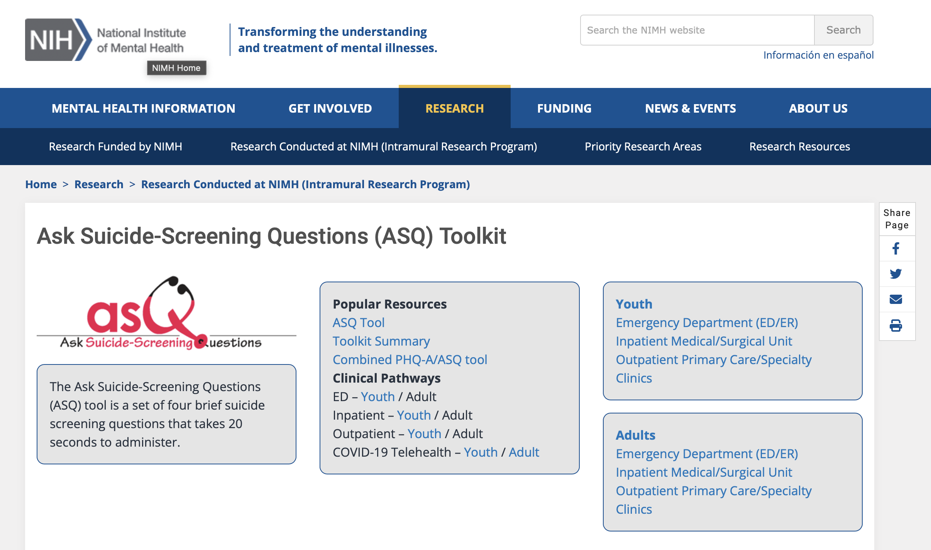
Ask Suicide Questions (ASQ)
Notes:
SUBJECT MATTER: SUICIDE PREVENTION
READ: The Ask Suicide-Screening Questions (ASQ) Toolkit is a free resource for medical settings (emergency department, inpatient medical/surgical units, outpatient clinics/primary care) that can help nurses or physicians successfully identify youth at risk for suicide.
Open this website link: https://www.nimh.nih.gov/research/research-conducted-at-nimh/asq-toolkit-materials to demonstrate how to access the information. The toolkit is organized by medical setting and separates the adults from youth (8yo and up) (medical settings include: emergency department, inpatient medical, clinics, outpatient primary care/specialty clinics). A client who screens positive for suicide risk should receive a follow-up suicide safety assessment (like the BSAA – brief suicide safety assessment) by a trained clinician.
Reference:
Ask Suicide-Screening Questions (ASQ) Toolkit. (n.d.). National Institute of Mental Health (NIMH). https://www.nimh.nih.gov/research/research-conducted-at-nimh/asq-toolkit-materials

Slide 29
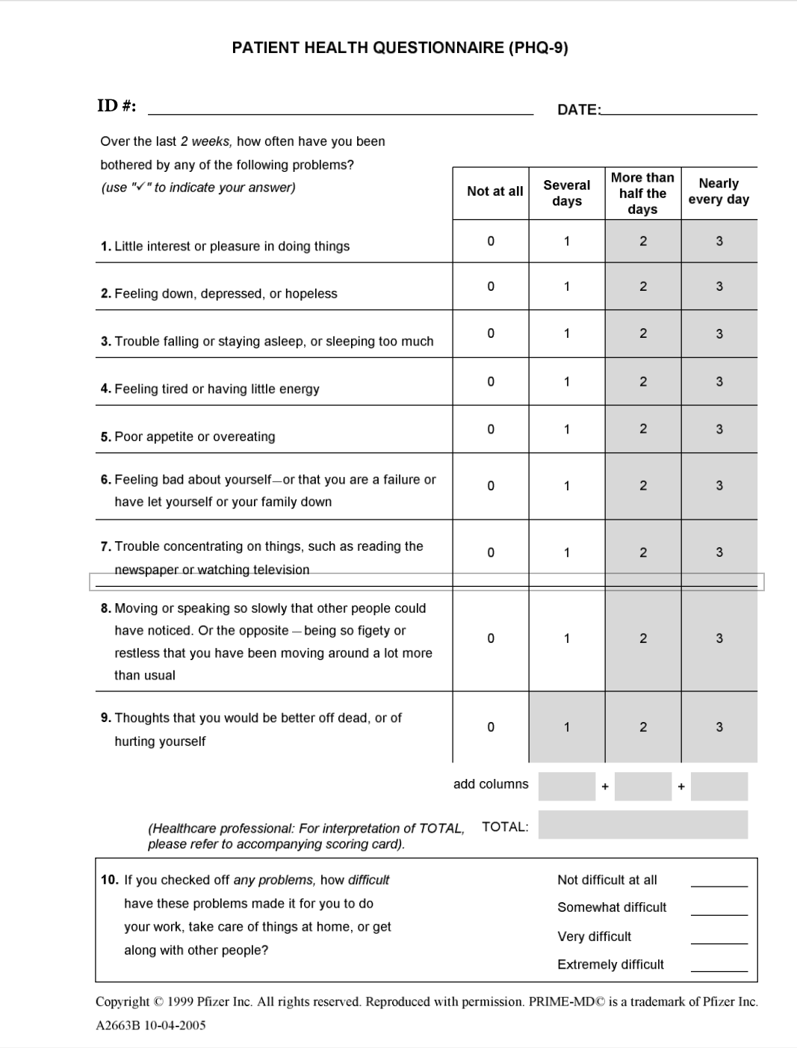
Patient Health Questionnaire-9 (PHQ-9)
…multipurpose instrument for screening, diagnosing, monitoring and measuring the severity of depression
9 items are based on the diagnostic criteria for major depressive disorder in the DSM-IV.
Notes:
SUBJECT MATTER: SUICIDE PREVENTION
READ: The PHQ-9 (Patient Health Questionnaire-9) is another screening tool (self administered, usually given when a client checks in for their appointment and is given to the doctor or therapist to review). It is used for diagnosing, monitoring, and measuring the level of depression. The article located here: https://www.ncbi.nlm.nih.gov/pmc/articles/PMC1495268/ (open on a separate screen) will provide the history of PHQ-9 and it's clinical efficacy. (You may provide this link to students.)
Reference:
Kroenke, K., Spitzer, R. L., & Williams, J. B. (2001). The PHQ-9: validity of a brief depression severity measure. Journal of general internal medicine, 16(9), 606–613. https://doi.org/10.1046/j.1525-1497.2001.016009606.x

Slide 30
Columbia Suicide Severity Rating Scale (C-SSRS)
The C-SSRS is a short questionnaire that can be administered quickly in the field by responders with no formal mental health training, and it is relevant in a wide range of settings and for individuals of all ages.
The website provides information about the C-SSRS, also known as the Columbia Protocol, including the history of its development and how it can be used.
Authoring Agency
Columbia University Medical Center, Center for Suicidal Thinking, Behavior, Attempts Risk Assessment
Notes:
SUBJECT MATTER: SUICIDE PREVENTION
READ: The Columbia Suicide Severity Rating Scale (C-SSRS) is a short questionnaire. Open the following link for resources on applying the C-SSRS questionnaire on a separate screen https://zerosuicide.edc.org/resources/resource-database/columbia-suicide-severity-rating-scale-c-ssrs, click on the "Columbia Suicide Severity Rating Scale (C-SSRS)" link, then scroll down the page until you see brochure and screen cards for different responders. I suggest you open one of the pocket cards, i.e. Columbia Card for Firefighters to demonstrate the usefulness of these cards.
This questionnaire is administered quickly in the field by responders (police, fire, healthcare facilities, military, colleges/schools and correctional facilities) with no formal mental health training.
Inquire if students have questions about the C-SSRS Questionnaire.
Reference:
Columbia Suicide Severity Rating Scale (C-SSRS) | Zero Suicide. (n.d.). https://zerosuicide.edc.org/resources/resource-database/columbia-suicide-severity-rating-scale-c-ssrs

Slide 31
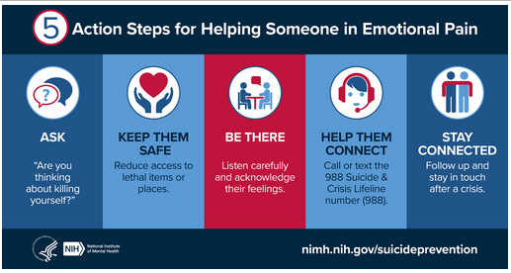
Action Steps for Helping
Notes:
SUBJECT MATTER: SUICIDE PREVENTION
The National Institute of Mental Health (NIH) indicates there are five steps you can take to assist someone in emotional pain. The are:
ASK: “Are you thinking about killing yourself?” It’s not an easy question but studies show that asking at-risk individuals if they are suicidal does not increase suicides or suicidal thoughts.
KEEP THEM SAFE: Reducing a suicidal person’s access to highly lethal items or places is an important part of suicide prevention. While this is not always easy, asking if the at-risk person has a plan and removing or disabling the lethal means can make a difference.
BE THERE: Listen carefully and learn what the individual is thinking and feeling. Research suggests acknowledging and talking about suicide may in fact reduce rather than increase suicidal thoughts.
HELP THEM CONNECT: Save the 988 Suicide & Crisis Lifeline number (call or text 988) and the Crisis Text Line number (741741) in your phone so they’re there if you need them. You can also help make a connection with a trusted individual like a family member, friend, spiritual advisor, or mental health professional.
STAY CONNECTED: Staying in touch after a crisis or after being discharged from care can make a difference. Studies have shown the number of suicide deaths goes down when someone follows up with the at-risk person.
Downloadable resources are available on NIH’s shareable resources webpage: https://www.nimh.nih.gov/get-involved/digital-shareables/shareable-resources-on-suicide-prevention
Reference: National Institute of Mental Health (NIH) https://www.nimh.nih.gov/get-involved/digital-shareables/shareable-resources-on-suicide-prevention

Slide 32
Engaging Individuals Presenting with Suicidality
Source: Zero Suicide Institute
Notes:
SUBJECT MATTER: SUICIDE PREVENTION
WATCH: This short video (2:25) https://youtu.be/ymRDAEhV69o (A lived experience story about what makes a difference) is a reminder of how important it is to see the human you are helping first and foremost, directness in asking about suicidal thinking, and listen to what the person is telling you (build upon the information you receive).
ASK: What came up for you as you watched this video? How will you apply what you learned with those in your life personally and professionally?

Slide 33
My Mental Health: Do I Need Help?
Notes:
SUBJECT MATTER: SUICIDE PREVENTION
It is always important to check in with ourselves, especially when we are working with clients or in behavioral health situations. This NIH document serves as an example of how to check in with our own mental health. A downloadable PDF and additional information can be found at https://www.nimh.nih.gov/health/publications/my-mental-health-do-i-need-help?utm_campaign=shareNIMH&utm_medium=Portal&utm_source=NIMHwebsite.
Reference: National Institute of Mental Health (NIH) https://www.nimh.nih.gov/get-involved/digital-shareables/shareable-resources-on-suicide-prevention

Slide 34
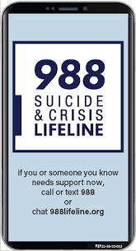
Resources
Suicide Prevention:
Zero Suicide Institute
Zero Suicide Listserv
NV Office for Suicide Prevention
NV Zero Suicide Initiative
The Lifeline and 988
UNR LiveWell Resource Page
Notes:
Resources are provided and should assist in maintaining important referral agencies/support services as well as resources for students.
Zero Suicide Institute: https://zerosuicideinstitute.com/
Zero Suicide Listserv: https://zerosuicide.edc.org/movement/zero-suicide-listserv
NV Office for Suicide Prevention: http://suicideprevention.nv.gov/
NV Zero Suicide Initiative: https://nvopioidresponse.org/initiatives/zs/
The Lifeline and 988: https://988lifeline.org/current-events/the-lifeline-and-988
UNR LiveWell Resource Page: https://www.unr.edu/livewell
Image Credit: SAMHSA 988 Partner Toolkit

Slide 35
Resources
Community Resources:
UNR Disabilities Resource Center
Nevada Center for Excellence in Disabilities Directory
CASAT on Demand Resources & Downloads
Pacific Southwest Addiction Technology Transfer Center (PSATTC)
The Mental Health Technology Transfer Center Network
The Prevention Technology Transfer Center Network
Dep. of Health & Human Services Aging and Disability Services Division
SAMHSA’s Technology Transfer Center (TTC) Programs
Notes:
Resources are provided and should assist in maintaining important referral agencies/support services as well as resources for students.
Community Resources:
UNR Disabilities Resource Center: https://www.unr.edu/drc
Nevada Center for Excellence in Disabilities Directory: https://www.unr.edu/education/faculty-and-staff/nevada-center-for-excellence-in-disabilities
CASAT on Demand Resources & Downloads: https://casatondemand.org/resources_downloads/
Pacific Southwest Addiction Technology Transfer Center (PSATTC): https://attcnetwork.org/centers/pacific-southwest-attc/home
The Mental Health Technology Transfer Center Network: https://mhttcnetwork.org/
The Prevention Technology Transfer Center Network: https://pttcnetwork.org/
Department of Health & Human Services Aging and Disability Services Division: https://adsd.nv.gov/
SAMHSA’s Technology Transfer Centers (TTC) Programs: techtransfercenters.org

Slide 36
Notes:
The Pathways in Crisis Services (PICS) Project provides academic course and professional learning events and content focused on evidence-based crisis programs that include crisis intervention, de-escalation services, mobile crisis and crisis stabilization for Pre-service (students) and Practicing Behavioral Health Professionals with the goal of increasing knowledge and skills leading to use in practice.
This is accomplished by guaranteeing students get exposed to crisis intervention services and skills while in school in order to prepare them to do crisis intervention services which includes: risk determination; early intervention; de-escalation strategies; how to conduct warm-hand-off; and understanding the new (988) system through the development of curriculum infusion and training. Practicing Professionals will have the opportunity to attend a variety of training and technical assistance (T/TA) events to ensure that T/TA in crisis-based programs is available to help prepare these professionals with the knowledge and skills to provide crisis-based services. This project was supported in whole or in part by the Nevada Division of Public and Behavioral Health Bureau of Behavioral Health, Prevention, and Wellness. The opinions, findings, conclusions and recommendations expressed in this publication are those of the author(s) and do not necessarily represent the official views of the State of Nevada or CASAT.

