Slide 1
Pathways in Crisis Services Project
Cultural Considerations
Notes:
Pathways to Crisis Services (PICS) Curriculum Infusion Packages (CIPs) are a product for educators and trainers developed in 2022/2023 by the Center for the Application of Substance Abuse Technologies (CASAT). The main developers of crisis services materials are April Lang-Barroga, LMFT, LCADC, NCC, and Bianca D. McCall, LMFT. Additional guidance and editing support were provided by, Terra Hamblin, MA, Nancy Roget, MS, and Sophia Graham, BS.
This product was developed to help community college/university faculty, as well as clinical supervisors and recovery support staff have access to brief, science-based content with the goal of providing materials that can be easily infused into existing substance use disorder and related courses (e.g., social work, nursing, criminal justice, foundation of addiction courses, ethics, counseling courses, etc.). Individuals can select the specific content to infuse into existing curricula/materials depending on the specific needs of their learners. Each slide in the slide decks contains notes to provide guidance on the topics along with references and handouts where appropriate. If you require further information, please do not hesitate to contact the CASATs PICS Project Staff located at CASAT (775-784-6265) You are free to use these slides and pictures, but please give credit to PICS when using them by referencing the PICS Program at the beginning of your presentation.
Funding for this product/publication was made possible in whole or in part by the Nevada Division of Public and Behavioral Health Bureau of Behavioral Health, Prevention, and Wellness (DHHS). The views expressed in these materials do not necessarily reflect the official policies or views of DHHS or the State of Nevada nor does mention of trade names, commercial practices, or organizations imply endorsement by the U.S. Government or the State.
Additional resources are available to enhance and support the information provided in this brief presentation.
Date last updated: January 2023

Slide 2
Overview of Cultural Considerations
Notes:
Cultural Humility provides an introduction to cultural considerations in the context of healthcare and human services. Participants will utilize the Cultural Factors Wheel, which examines the multifaceted aspects of culture that influence individuals' health beliefs, behaviors, and interactions with care providers.
Health Disparities offers an in-depth exploration of the growing health disparities among specific population groups, examining the social determinants of health and barriers to accessing quality healthcare - including socioeconomic, cultural, and systemic factors.
Implicit Bias provides a comprehensive exploration of implicit bias and its significant impact on the delivery of healthcare, human services, and crisis interventions. Participants will explore the ways in which implicit bias can shape decision-making, communication, and the overall experiences of individuals in crisis.
Cultural Considerations - Group Work focuses on the critical assessment of cultural considerations in group therapy and the importance of cultural awareness in therapeutic interventions. Participants will learn how to recognize and address cultural factors that influence group dynamics, individual experiences, and therapeutic outcomes.
Cultural Considerations – Assessment focuses on the essential skill of asking culturally sensitive questions during assessments and understanding the influence of cultural factors on ASAM (American Society of Addiction Medicine) level of care recommendations. Participants will learn practical techniques to integrate cultural considerations into assessments, including a comprehensive list of culturally sensitive questions.
Each slide contains detailed notes for the trainer to provide guidance in effectively presenting the content, as necessary. Full citations for the content are included in the notes for each slide.

Slide 3
Disclaimer
This presentation may include readings, media, and discussion on topics which include suicide, trauma, and crisis intervention. These topics may result in stress reactions.
Please monitor your reactions and if necessary, reach out to someone you trust if these topics cause considerable discomfort.
Notes:
Read the Disclaimer: This presentation may include readings, media, and discussion on topics which include suicide, trauma, and crisis intervention. These topics may result in stress reactions. Please monitor your reactions and if necessary, reach out to someone you trust if these topics cause considerable discomfort.

Slide 4
Cultural Considerations Word Cloud
Notes:
SUBJECT MATTER: CULTURAL CONSIDERATIONS
Transition Slide: The next few slides will review Cultural Considerations and how culture impacts a person.
Image Credit: Flickr

Slide 5
What is Culture?
Culture is the learned and shared knowledge that specific groups use to generate their behavior and interpret their experience of the world. I
It comprises beliefs about reality, how people should interact with each other, what they “know” about the world, and how they should respond to the social and material environments in which they find themselves. It is reflected in their religions, morals, customs, technologies, and survival strategies. It affects how they work, parent, love, marry, and understand health, mental health, wellness, illness, disability, and death.
National Center of Cultural Competence, Georgetown (2005)
Notes:
SUBJECT MATTER: CULTURAL CONSIDERATIONS
Read definition offered by the National Center of Cultural Competence, Georgetown (2005)
Potential Discussion Questions:
Has this definition evolved (Since 2005)?
How has this definition evolved (Since 2005)?
Key Points:
Culture identification has major influence on our behavioral health; a key contributor to our mental state of being, and mental health
Researcher and Lecturer, Dr. Joe Dispenza says our thoughts lead to (→) our beliefs → feelings → behavior → experiences. Understanding how culture shapes this process is paramount in any service field, especially since we are designated agents of change- the public engages social services when there is a need to adjust and make changes in our lived experiences. In order to foster this change in our experiences, we must first know and accept how we identify culturally and with cultural humility, engage in courageous conversations with people who will respectfully challenge our old patterns and perspectives, producing new thoughts → beliefs → feelings → behavior → experiences.
Reference:

Slide 6
What is Culture?
Culture is the learned and shared knowledge that specific groups use to generate their behavior and interpret their experience of the world.
Culture comprises beliefs about reality, how people should interact with each other, what they “know” about the world, and how they should respond to the social and material environments in which they find themselves.
It is reflected in their religions, morals, customs, technologies, and survival strategies. It affects how they work, parent, love, marry, and understand health, mental health, wellness, illness, disability, and death.
National Center of Cultural Competence, Georgetown (2005)
Notes:
SUBJECT MATTER: CULTURAL CONSIDERATIONS
Read definition offered by the National Center of Cultural Competence, Georgetown (2005)
Potential Discussion Questions:
Has this definition evolved (Since 2005)?
How has this definition evolved (Since 2005)?
Key Points:
Culture identification has major influence on our behavioral health; a key contributor to our mental state of being, and mental health
Researcher and Lecturer, Dr. Joe Dispenza says our thoughts lead to (→) our beliefs → feelings → behavior → experiences. Understanding how culture shapes this process is paramount in any service field, especially since we are designated agents of change- the public engages social services when there is a need to adjust and make changes in our lived experiences. In order to foster this change in our experiences, we must first know and accept how we identify culturally and with cultural humility, engage in courageous conversations with people who will respectfully challenge our old patterns and perspectives, producing new thoughts → beliefs → feelings → behavior → experiences.
Reference: National Center of Cultural Competence, Georgetown (2005), https://nccc.georgetown.edu/

Slide 7
What is Subculture?
Cultures generally always contain subcultures that revolve around:
Gender
Age
Class
Race
Religion
Occupation
Sexual orientation
Identity
Notes:
SUBJECT MATTER: CULTURAL CONSIDERATIONS
Read definition offered by the National Center of Cultural Competence, Georgetown (2005)
Potential Discussion Questions:
Identity is such a broad term. What are some additional ways people identify as? Ex: Student-Athletes
What are some examples of a direct conflict between someone’s cultural identities? Ex: LGBTQIA+, one religion marrying into another, etc.
Key Points:
of a mental health crisis.
Understanding our own, and someone else’s cultural identity gives us a greater understanding of how they may Mental health crises can also be considered a crisis of identity- When the ways we view ourselves, the world, and the relationships between “us” and “them” are in conflict, we typically experience a level of stress which can lead to the experience perceive of crisis situations and the tools one has in conflict resolution during crisis situations.
Reference: National Center of Cultural Competence, Georgetown (2005), https://nccc.georgetown.edu/

Slide 8
Cultural Impact on Mental Health Crisis
These cultural meanings can influence how people:
Seek or avoid treatment
Perceive and express symptoms
Cope with stress and capacity to manage crisis
Adhere to treatment plans
Attach stigma to mental illness crisis
Notes:
SUBJECT MATTER: CULTURAL CONSIDERATIONS
As we’ve discussed- culture affects how we experience and interpret the world. Culture, including beliefs, values, norms, and behaviors, affects how we experience and interpret the world, including the meaning we impart to the experience of a mental illness crisis. Culture can also influence how a patient engages with the behavioral health and/or healthcare systems- Read slide bullet points.
Potential Discussion Questions:
What are some examples of culture having an influence on how the patient seeks or avoids treatment?
What are some examples of culture having an influence on how the patient perceives and expresses symptoms?
What are some examples of culture having an influence on how the patient copes with stress and capacity to manage a crisis?
What are some examples of culture having an influence on how the patient adheres to treatment plans?
What are some examples of culture having an influence on how the patient attaches stigma to a mental health crisis?
Key Points:
The calls to action are for individualized, Person-Centered Treatment and to engage with cultural humility- being respectful of individual differences, slowing down and being willing to ask questions to seek a greater understanding of someone else’s unique cultural experiences, and the function of those experiences in the presentation of crisis in today’s snapshot.
In a performance and outcomes-driven society that assigns a lot of weight to the social perception of performance and success; stigma is an enormous barrier to help-seeking and receiving treatment for mental health crises.
Reference: Georgetown University Center for Child and Human Development. National Center for Cultural Competence 3300 Whitehaven St., NW, Suite 3300, Washington, DC 20007 https://nccc.georgetown.edu/

Slide 9
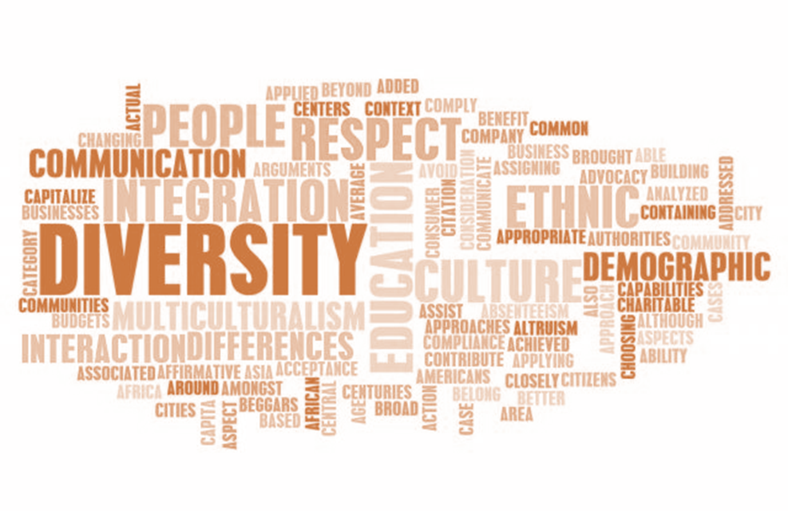
DISCUSSION
Cultural…
Awareness
Sensitivity
Competence
Humility
Notes:
SUBJECT MATTER: CULTURAL CONSIDERATIONS
DISCUSSION: Ask the students the following questions regarding the terms on the slide (cultural awareness, cultural sensitivity, cultural competence, cultural humility). Talk about each key point individually.
What do these mean?
How are they different and distinct?
Key Points:
Cultural Awareness: is a critical feature of effective health and mental health policy, planning, resource allocation, and service delivery across the entire spectrum of care, including health promotion and prevention.
Cultural Sensitivity: is being aware of cultural differences and NOT judging or assigning value to those differences (positive or negative)
Cultural Competence: doesn’t mean you are an authority in the values and beliefs of every culture. There is a shift in the paradigm we should be aiming to achieve cultural competence and rather, we should seek to achieve cultural humility.
Cultural Humility: is defined by the willingness to have ‘Courageous Conversations’ – diversity and inclusion are necessary to create a safe space to courageously let our guards down in order to be vulnerable, honest, and transparent about our unique experiences of the world; being willing to ask questions with intentions of gaining an understanding of someone’s else’s culture and lived experiences.
Image Credit: Flickr

Slide 10
Indigenous Mental Health
History of trauma = Intergenerational Trauma
Individuals forcibly removed from their homes and raised in boarding schools still impact how indigenous parents raise their children.
Indigenous peoples experience higher rates substance use and related disorders, PTSD, and suicide and 526% more likely to die from alcohol use than are non-indigenous people.
Notes:
SUBJECT MATTER: CULTURAL CONSIDERATIONS
This history of trauma has resulted in intergenerational trauma. Most American Indians and Alaska Natives believe that historical trauma, including the loss of culture, lies at the heart of substance use and mental illness within their communities.
Children being forcibly removed from their homes to be raised in boarding schools still impact how parents raise their children. Indigenous peoples experience higher rates of substance use and related disorders, PTSD, and suicide, all of which are directly associated with this intergenerational trauma on Indigenous peoples.
As one staggering example, Indigenous peoples are 526% more likely to die from alcohol use than non-indigenous people.
1 in 8 Native American adults in need of substance use treatment received it at a specialty facility.
READ: slide.
References:
Roessel, M. (n.d.). Best Practice Highlights Indigenous/Native American Patients. American Psychiatric Association https://www.psychiatry.org/File%20Library/Psychiatrists/Cultural-Competency/Treating-Diverse-Populations/Best-Practices-NativeAmericans-Patients.pdf
U.S. Department of Health and Human Services, & Services, U. S. D. H. H. (2019). Tip 61 - Behavioral Health Services for American Indians and Alaska Natives. https://store.samhsa.gov/sites/default/files/d7/priv/tip_61_aian_full_document_020419_0.pdf

Slide 11
What is Cultural Awareness
Having a firm grasp of what culture is and what it is not
Having insight into intracultural variation
Understanding how people acquire their cultures and culture’s important role in personal identities, life ways, and mental and physical health of individuals and communities;
Being conscious of one’s own culturally shaped values, beliefs, perceptions, and biases
Observing one’s reactions to people whose cultures differ from one’s own and reflecting upon these responses
Seeking and participating in meaningful interactions with people of differing cultural backgrounds.
Notes:
SUBJECT MATTER: CULTURAL CONSIDERATIONS
READ: read or select a student to read the slide to define cultural awareness.
Discussion Questions:
Why is it important to be conscious of your own culturally shaped values, beliefs, perceptions, and biases?
Why do you think it is important to seek and participate in meaningful interactions with people from different cultural backgrounds?
What opportunities do you have on campus, to participate in meaningful interactions with people from a different cultural backgrounds?
Key Points:
There are many variations of cultural identity, requiring equal consideration and respect.
Challenging your existing perceptions is what causes change and transformation of thought.
Resource: American Psychiatric Association (2013): https://www.psychiatry.org/File%20Library/Psychiatrists/Practice/DSM/DSM-5-TR/APA-DSM5TR-CulturalFormulationInterviewInformant.pdf

Slide 12
Importance of Cultural Awareness
Cultural awareness is a critical feature of effective health and mental health policy, planning, resource allocation, and service delivery across the entire spectrum of care, including health promotion and prevention.
This is so because cultural perspectives inform people’s identification and interpretation of symptoms and define the diseases, illnesses, and disabilities they recognize. Culture also shapes their ideas of appropriate treatment.
Notes:
SUBJECT MATTER: CULTURAL CONSIDERATIONS
READ: read or select a student to read the slide to define cultural awareness.
Potential Discussion Questions:
What are some examples of how culture informs the identification and interpretation of symptoms and definitions of diseases, illness, and disability? Latino Culture and “possession” and/or religious affliction-
Critical thinking- Is it the professional’s job to ”label’ symptoms as negative?
Key Points:
Perspective is key in both the patient and the provider, during the identification process and recognizing signs and symptoms.
Resource: American Psychiatric Association (2013): https://www.psychiatry.org/File%20Library/Psychiatrists/Practice/DSM/DSM-5-TR/APA-DSM5TR-CulturalFormulationInterviewInformant.pdf

Slide 13
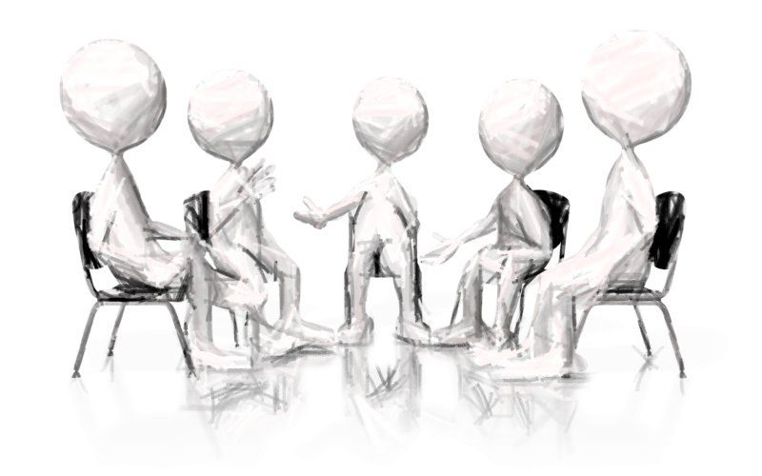
Small Group Discussion
In your group, think about and discuss the first time you were aware of being “different” and what that was like for you.
Notes:
SUBJECT MATTER: CULTURAL CONSIDERATIONS
Small group discussion: break the classroom into groups of 2-5 and provide 5-10 minutes for students to respond to the question on the slide within their group. Have the small group write down similarities and differences. These findings can be shared within the large group or within the small group only. Below are additional questions that can be explored.
Discussion extension: Are we more likely to assign a negative feeling to the experience of being “different”?
If so, why?
Discussion extension: How many of you felt like you were the only one that was ”different” in that way?
If so, how did that make you feel as opposed to knowing there are more people sharing in a similar experience as you, at that moment?

Slide 14
Latino Mental Health
Latinos are a diverse community, including misconceptions and stereotypes regarding Latino history, presence of Latinos in the US, and the difference between Latinos and Hispanics.
Hispanic refers to language whose ancestry comes from a country where Spanish is spoken, Latino refers to geography.
 | U.S. Hispanic Origins Groups, 2021
1 | Mexican | 59.9% of Hispanics
2 | Puerto Ricans | 9.3% of Hispanics
3 | Cubans | 4.0% of Hispanics
4 | Salvadorans | 3.8% of Hispanics
5 | Dominicans | 3.8% of Hispanics
(Pew Research, 2021)
Notes:
SUBJECT MATTER: CULTURAL CONSIDERATIONS
READ: read slide
Latinos are a diverse community. There are many misconceptions and stereotypes about who Latinos are and about the history and presence of Latinos in the United States, including the difference between Latinos and Hispanics. While Hispanic refers to language and those whose ancestry comes from a country where Spanish is spoken, Latino refers to geography. Specifically, to Latin America, to people from the Caribbean, South America, and Central America.
Additional Statistics:
According to 2020 Census data, there are 62.1 million Hispanics living in the United States. This group represents 18.9 percent of the total U.S. population, the nation’s second-largest racial or ethnic group after non-Hispanic whites.
The U.S. Hispanic population reached 62.1 million in 2020, an increase of 23% over the previous decade that outpaced the nation’s 7% overall population growth.
The Hispanic population in the U.S. 2021, by origin, Published by Erin Duffin, Oct 5, 2022, As of 2021, 37.24 million people of Mexican descent were living in the United States - the largest of any Hispanic group. Puerto Ricans, Salvadorans, Cubans, and Dominicans rounded out the top five Hispanic groups living in the U.S. in that year.
Resource:
American Psychiatric Association (n.d.) Best Practice Highlights Latino/as and Hispanics. Lisa Fortuna, M.D. APA https://www.psychiatry.org/File%20Library/Psychiatrists/Cultural-Competency/Treating-Diverse-Populations/Best-Practices-Latinos-Patients.pdf
https://www.pewresearch.org/fact-tank/2022/09/23/key-facts-about-u-s-latinos-for-national-hispanic-heritage-month/#:~:text=People%20of%20Mexican%20origin%20accounted,the%20island%20as%20of%202021).
https://www.statista.com/statistics/234852/us-hispanic-population/
HHS: https://minorityhealth.hhs.gov/omh/browse.aspx?lvl=3&lvlid=64

Slide 15
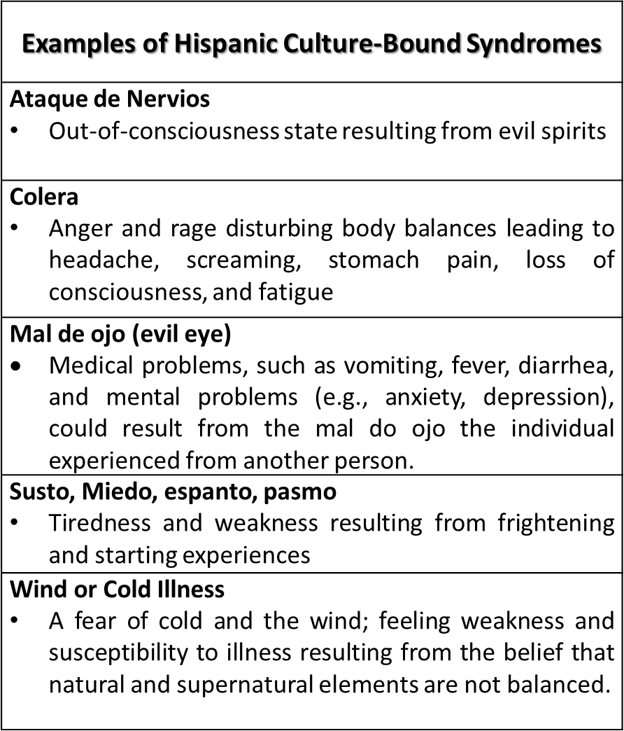
Cultural Differences
(Derived from The Massachusetts General Hospital Textbook on Diversity and Cultural Sensitivity in Mental Health)
Notes:
SUBJECT MATTER: CULTURAL CONSIDERATIONS; Latino Mental Health continued
ADD MORE NOTES Cultural differences between Anglo Americans and Latinos(as)
READ slide.
Image Credit: Modified from Paniagua, F.A. (2000). Culture-bound syndromes, cultural variations, and psychopathology, in I. Cuéllar & F.A. Paniagua, Eds., Handbook of multicultural mental health: Assessment and treatment of diverse populations (pp. 140-141). New York: Academic Press.
Resource:
American Psychiatric Association (n.d.) Best Practice Highlights Latino/as and Hispanics. Lisa Fortuna, M.D. APA https://www.psychiatry.org/File%20Library/Psychiatrists/Cultural-Competency/Treating-Diverse-Populations/Best-Practices-Latinos-Patients.pdf

Slide 16
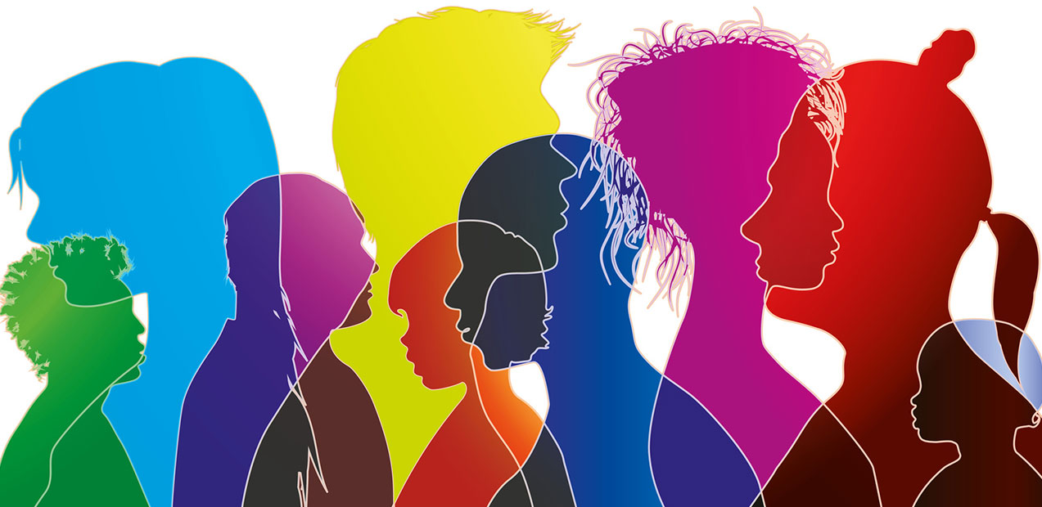
Cultural Sensitivity
Cultural Sensitivity is defined as: a) Being aware that cultural differences and similarities between people exist without assigning them a value – positive or negative, better or worse, right or wrong.
Retrieved from www.nyc.gov on 12.13.22
Notes:
SUBJECT MATTER: CULTURAL CONSIDERATIONS
Read definition offered by The Official Website of the City of New York website.
Potential Discussion Questions:
How does assigning value to cultural differences function (or benefit) groups in today’s society?
How does assigning value to cultural differences serve as a means of dysfunction (or detriment) to certain groups today?
Key Points:
When we as humans, seek to assign value to our cultural differences, that often forces us into binary perception- positive OR negative, better OR worse, right OR wrong.
Sensitivity can also be defined as shifting from “either”, “or” to “and” thinking.
Reference:
Cultural Sensitivity Workshop, Bronx Partners for Healthy Communities; The Official Website of the City of New York (n.d.), www.nyc.gov, retrieved 12.13.22: https://www.nyc.gov/assets/ochia/downloads/pdf/cultural_sensitivity_wkshp.pdf
Image Credit:

Slide 17
Cultural Sensitivity Tips
Ask non-judgmentally about the individual’s beliefs around and understanding of their illness.
Don’t push individuals to accept a psychiatric diagnosis—build trust over time and use terms that are acceptable to them, including: "stress," "nerves," "sadness," "worries," etc.
Consider describing mental illness as a biological disorder rather than a psychological problem or weakness.
Bedford, M, 2019
Notes:
SUBJECT MATTER: CULTURAL CONSIDERATIONS
READ: Six Cultural Sensitivity Tips, tips 1-3
Discussion Questions:
What are some alternatives to using the term “illness” (mental illness), for a prevention strategy?
What are some examples of describing a mental health condition as a biological disorder versus a psychological problem?
Key Points:
Building a rapport- trust over time is absolutely necessary.
Crisis prevention does not involve ‘assigning an individual a diagnosis’ based on your assessment or even a standardized assessment which is unlikely to have all the necessary cultural considerations.
Prevention is creating a safe space for individuals to share their unique experiences of the problem before it becomes a crisis situation.
Reference:
Bedford, M. (2019, June 13). 6 Culturally Sensitive Ways to Approach Mental Health. https://www.qualityinteractions.com/blog/6-culturally-sensitive-ways-to-approach-mental-health

Slide 18
Cultural Sensitivity Tips
Ask if the patient observes any religious or traditional customs or practices that you should know about. Also ask about religion and spirituality in general, which can be a helpful source of support for those with mental health problems.
If possible, request a referral for the individual to a mental health provider that speaks their language, and ideally is from the same cultural background.
If a language concordant provider is not possible, be sure a professional interpreter is used when there is a language barrier. Don’t rely on family members to interpret. Bedford, 2019
Notes:
SUBJECT MATTER: CULTURAL CONSIDERATIONS
READ SLIDE: Six Cultural Sensitivity Tips, tips 4-6
Discussion Questions:
Why would asking about religion and spirituality (spiritual practices) be an important strategy in prevention?
Why are Minority Tax, Gratitude Tax, and Emotional Tax important experiences to be aware of in relation to prevention? Ex: Prevention is like casting a wide fishing net, and awareness of The Taxes is recognizing the bandwidths of those responsible for preparing the fish, we bring onto the boat. If our valuable multicultural assets are taxed and experience burnout (a very real, workforce crisis), then we truly lack the ability to prevent crises for the community.
Key Points:
Spirituality is a protective factor in suicide prevention- also called a barrier to suicide crisis.
Although it reflects cultural sensitivity to refer individuals to a language-concordant provider, ideally from the same cultural background, we must be aware of cultural sensitivities in the workforce as well; as the prevalence of ”Minority Tax”, “Gratitude Tax”, and ”Emotional Tax” experienced by underrepresented minorities in medicine (URMM).
Minority Tax: The feeling of being treated as a token, as a person whose value is minimal to the organization, is pervasive across disciplines and demographics.
Gratitude Tax: Describes the expectation that URMM faculty forgo promotion or advancement at other institutions out of a sense of obligation to their current institution.
Emotional Tax: Is the emotional toll of defending or explaining one’s underrepresented history, identity, and culture to non-underrepresented colleagues.
An example of Minority Tax is when: Underrepresented Minorities in Medicine (URMM) are given increased responsibilities in recruitment, mentorship, or other diversity efforts. This disparity is evident in many areas: diversity efforts, racism, isolation, mentorship, clinical responsibilities, and promotion. Ex: a Latino case worker is always called to interpret for Spanish-speaking patients, despite the fact, there is rarely an increase in pay or decrease in caseload, in consideration of the added responsibility.
An example of Gratitude Tax is: the feeling of obligation that URMM faculty have to the academic institution and to future generations of URMMs for being given the opportunity to be a physician. This newly described nuance to the minority tax affects both inner decision-making processes and personal ambitions.
Reference:
Bedford, M. (2019, June 13). 6 Culturally Sensitive Ways to Approach Mental Health. https://www.qualityinteractions.com/blog/6-culturally-sensitive-ways-to-approach-mental-health

Slide 19
Cultural Humility
Lifelong commitment to self-evaluation & self-critique
Correct power imbalances
Develop partnerships with people & groups who advocate for others
Notes:
SUBJECT MATTER: CULTURAL CONSIDERATIONS
READ or select a student to read the Cultural Humility definition
Potential Discussion Questions:
What are some examples of power imbalances in today’s society? Ex: Wage gap and gender inequality.
Why are partnerships with advocacy groups an important component of prevention work?
Key Points:
Cultural Humility is not situational, it’s a commitment to a complete attitude shift.
Acknowledging power imbalances and the concept of privilege should not be perceived as a guilt-filled experience.
Chief examples of advocate groups for prevention:
American Foundation for Suicide Prevention
The American Psychiatric Association (APA)
The American Psychological Association (APA)
American Society of Addiction Medicine (ASAM)
The National Alliance for Mentally Ill (NAMI)
Reference: Bedford, M. (2019, June 13). 6 Culturally Sensitive Ways to Approach Mental Health. https://www.qualityinteractions.com/blog/6-culturally-sensitive-ways-to-approach-mental-health
Image Credit: Multi-Ethnic Group of University Students Looking Down stock photo (15,400 + Multi Culture People Stock Photos, Pictures & Royalty-Free Images – iStock)

Slide 20
African American Mental Health
Notes:
SUBJECT MATTER: CULTURAL CONSIDERATIONS
WATCH VIDEO: How to Provide Better Care to African American Patients (3:40) https://youtu.be/YYQoYX_1AkA
Steven Starks, M.D., is the representative to the Assembly for the APA Caucus of Black Psychiatrists. He is a geriatric psychiatrist and clinical assistant professor at the University of Houston College of Medicine, discusses the mental health needs of African American patients.
Reference:
Black and African American Communities and Mental Health. (n.d.). Mental Health America. https://www.mhanational.org/issues/black-and-african-american-communities-and-mental-health

Slide 21
Asian American Mental Health
Notes:
SUBJECT MATTER: CULTURAL CONSIDERATIONS
WATCH VIDEO: Linh An Asian Hate and Mental Health. (4:17) https://youtu.be/-58rTGsq6zc
The language of the American mental healthcare system is English, which automatically casts away people who don’t speak the language. When examining its racism, a culture competent health care system needs to serve everyone. For more: https://worldchannel.org/collection/decolonizing-mental-health/
Resource:
Asian American / Pacific Islander Communities and Mental Health. (n.d.). Mental Health America. https://www.mhanational.org/issues/asian-american-pacific-islander-communities-and-mental-health

Slide 22
Latino Mental Health
Notes:
SUBJECT MATTER: CULTURAL CONSIDERATIONS
WATCH VIDEO: Best Practice Highlights for Working with Latino/a Patients (5:29) https://vimeo.com/152625229
Reference:
Fortuna, L. (n.d.). Best Practice Highlights Latino/as and Hispanics. American Psychiatric Association. https://www.psychiatry.org/File%20Library/Psychiatrists/Cultural-Competency/Treating-Diverse-Populations/Best-Practices-Latinos-Patients.pdf

Slide 23
LGBTQIA+ Mental Health
who struggle with higher rates of anxiety, affective disorder related conditions, and substance use disorders most likely experienced stigma and the coming out and self-acceptance process.
have a nearly three-time higher risk of suicide or suicidal behavior.
face disparities in the physical medical context, including increased tobacco use, HIV and AIDS, and weight-related problems.
greater risk for discrimination, verbal abuse, physical assaults and violence, and perhaps even childhood sexual abuse.”
Notes:
SUBJECT MATTER: CULTURAL CONSIDERATIONS
READ
“LGBTQ persons who struggle with higher rates of anxiety, affective disorder related conditions, and substance use disorders most likely have struggled with stigma and the coming out and self-acceptance process. Alarmingly, LGBTQ people also have a nearly three-time higher risk of suicide or suicidal behavior. LGBTQ people also face disparities in the physical medical context, including increased tobacco use, HIV and AIDS, and weight-related problems.
LGBTQ people are also at greater risk for discrimination, verbal abuse, physical assaults and violence, and perhaps even childhood sexual abuse.”
Reference:
Cabaj, R. (n.d.). Best Practice Highlights Lesbian, Gay, Bisexual, Transgender and people who may be questioning their sexual orientation or sexual identity (LGBTQ). American Psychiatric Association. https://www.psychiatry.org/File%20Library/Psychiatrists/Cultural-Competency/Treating-Diverse-Populations/Best-Practices-LGBTQ-Patients.PDF

Slide 24
LGBTQIA+ Mental Health
Notes:
SUBJECT MATTER: CULTURAL CONSIDERATIONS
WATCH VIDEO: Best Practice Highlights for Working with LGBTQ Patients. (6:35) https://vimeo.com/152624959
Reference:
Cabaj, R. (n.d.). Best Practice Highlights Lesbian, Gay, Bisexual, Transgender and people who may be questioning their sexual orientation or sexual identity (LGBTQ). American Psychiatric Association. https://www.psychiatry.org/File%20Library/Psychiatrists/Cultural-Competency/Treating-Diverse-Populations/Best-Practices-LGBTQ-Patients.PDF

Slide 25
Indigenous Mental Health
Notes:
SUBJECT MATTER: CULTURAL CONSIDERATIONS
WATCH VIDEO: Best Practice Highlights for Working with Native American Patients. (8:22) https://vimeo.com/152625891
Reference:
Roessel, M. (n.d.). Best Practice Highlights Indigenous/Native American Patients. American Psychiatric Association. https://www.psychiatry.org/File%20Library/Psychiatrists/Cultural-Competency/Treating-Diverse-Populations/Best-Practices-NativeAmericans-Patients.pdf

Slide 26
African American Mental Health
There are significant differences in the rates of access, diagnosis and treatment for African Americans that negatively impact their health.
Notes:
SUBJECT MATTER: CULTURAL CONSIDERATIONS
READ slide.
Historical adversity- for example, slavery, sharecropping, and segregation, along with other means of race-based exclusion from health, educational, social and economic resources- has led to socioeconomic disparities in the Black Community. Institutional racism extended beyond the realm of social injustice and the struggle for civil rights.
Trainers Notes: below are statistics you can use for discussion or facts.
According to SAMHSA’s 2018 National Survey on Drug Use and Health:
Sixteen percent (4.8 million) of Black and African American people reported having a mental illness, and 22.4 percent of those (1.1 million people) reported a serious mental illness over the past year.
Serious mental illness (SMI) rose among all ages of Black and African American people between 2008 and 2018.
Despite rates being less than the overall U.S. population, major depressive episodes increased from 9 percent-10.3 percent in Black and African American youth ages 12-17, 6.1 percent to 9.4 percent in young adults 18-25, and 5.7 percent to 6.3 percent in the 26-49 age range between 2015 and 2018.
Suicidal thoughts, plans, and attempts are also rising among Black and African American young adults. While still lower than the overall U.S. population aged 18-25, 9.5 percent (439,000) of Black and African American 18-25-year-olds had serious thoughts of suicide in 2018, compared to 6 percent (277,000) in 2008. 3.6 percent (166,000) made a plan in 2018, compared to 2.1 percent (96,000) in 2008, and 2.4 percent (111,000) made an attempt in 2018, compared to 1.5 percent (70,000) in 2008.
Binge drinking, smoking (cigarettes and marijuana), illicit drug use and prescription pain reliever misuse are more frequent among Black and African American adults with mental illnesses.
Reference:
Black and African American Communities and Mental Health. (n.d.). Mental Health America. https://www.mhanational.org/issues/black-and-african-american-communities-and-mental-health
Substance Abuse and Mental Health Services Administration,, U.S. Department of Health and Human Services, National Survey on Drug Use and Health: African Americans, 2018. https://www.samhsa.gov/data/sites/default/files/reports/rpt23247/2_AfricanAmerican_2020_01_14_508.pdf

Slide 27
African American Mental Health
more likely to receive treatment for mental health in emergency and hospital settings;
misdiagnosed at a higher rate with schizophrenia spectrum disorders, and
less likely to be offered antidepressant therapy—even when they have access to insurance or financial resources.
Notes:
SUBJECT MATTER: CULTURAL CONSIDERATIONS
Institutional racism extended beyond the realm of social injustice and the struggle for civil rights.
It also permeated American medical education, medical practice, and scientific research that remains to impact the community today.
Research shows that African American or black patients are:
more likely to receive treatment for mental health in emergency and hospital settings;
misdiagnosed at a higher rate with schizophrenia spectrum disorders, and
less likely to be offered antidepressant therapy—even when they have access to insurance or financial resources.
READ slide.
Reference:
Black and African American Communities and Mental Health. (n.d.). Mental Health America. https://www.mhanational.org/issues/black-and-african-american-communities-and-mental-health

Slide 28
Asian American Mental Health
As immigrants, Asian Americans as any other group, experience emotional and behavioral problems. They tend to underuse services unless they are culturally and linguistically compatible.
Asians differ from their Western counterparts in their view of "self", the mind body- interface, and their approach to mental health care, and in their response to psychotropic medications.
NOTE: this group encompasses a tremendous heterogeneity in language, culture, religious traditions, dietary practices and immigration history.
Notes:
SUBJECT MATTER: CULTURAL CONSIDERATIONS
READ slide.
Reference:
Asian American / Pacific Islander Communities and Mental Health. (n.d.). Mental Health America. https://www.mhanational.org/issues/asian-american-pacific-islander-communities-and-mental-health

Slide 29
LGBTQIA+ Mental Health
There really is no single LGBTQ community… rather a diverse population that comes from all racial, ethnic, cultural, socioeconomic, and geographic backgrounds.
People who are LGBTQ may move to urban areas, if they can, where there may be a sense of greater acceptance and personal safety.
Notes:
SUBJECT MATTER: CULTURAL CONSIDERATIONS
READ slide.
In the context of Psychiatry, APA removed homosexuality from the DSM in 1973 based on the new scientific studies, opening the way for new understanding and treatment LGBTQ. DSM-5. The DSM-5, published in 2013, does not include any diagnostic category that can be applied to people based on their sexual orientation.
Reference:
Cabaj, R. (n.d.). Best Practice Highlights Lesbian, Gay, Bisexual, Transgender and people who may be questioning their sexual orientation or sexual identity (LGBTQ). American Psychiatric Association. https://www.psychiatry.org/File%20Library/Psychiatrists/Cultural-Competency/Treating-Diverse-Populations/Best-Practices-LGBTQ-Patients.PDF

Slide 30
LGBTQIA+ Mental Health
Notes:
SUBJECT MATTER: CULTURAL CONSIDERATIONS
READ slide.
Reference:
Cabaj, R. (n.d.). Best Practice Highlights Lesbian, Gay, Bisexual, Transgender and people who may be questioning their sexual orientation or sexual identity (LGBTQ). American Psychiatric Association. https://www.psychiatry.org/File%20Library/Psychiatrists/Cultural-Competency/Treating-Diverse-Populations/Best-Practices-LGBTQ-Patients.PDF

Slide 31
Indigenous Mental Health
Indigenous peoples may call themselves “American Indian, Native American,” “First Nations” and “Indigenous.” Alaska Natives and Native Hawaiians are included as well.
To indigenous peoples, the United States & Canada is collectively called “Turtle Island.”
People who are “part indigenous” usually don’t identify that way. In fact, it is perceived as marginalizing and insensitive to introduce an indigenous person as “half Navajo” when the person self-identifies simply as Navajo.
Notes:
SUBJECT MATTER: CULTURAL CONSIDERATIONS
READ slide.
Reference:
Roessel, M. (n.d.). Best Practice Highlights Indigenous/Native American Patients. American Psychiatric Association. https://www.psychiatry.org/File%20Library/Psychiatrists/Cultural-Competency/Treating-Diverse-Populations/Best-Practices-NativeAmericans-Patients.pdf

Slide 32
Implicit Bias
…commonly known as unconscious bias refers to the various social stereotypes and judgments that people unknowingly assign to others based on a variety of factors, such as their age, socioeconomic status, weight, gender, race, or sexual orientation.
DISCUSSION QUESTION:
What are some ways to overcome implicit bias?
Notes:
SUBJECT MATTER: CULTURAL CONSIDERATIONS
Read Implicit Bias definition- slide
Implicit bias, also commonly known as unconscious bias, refers to the various social stereotypes and judgments that people unknowingly assign to others based on a variety of factors, such as their age, socioeconomic status, weight, gender, race, or sexual orientation.
Types of Implicit Biases:
1. Race and Ethnicity Bias
2. Age Bias
3. Gender Bias
4. LGBTQIA+ Community Bias
5. Ability Bias
Potential Discussion Questions:
Why is being aware of our otherwise unconscious biases, important for the assessment process?
What are some real-life examples of implicit bias having negative consequences in patient care?
Key Points:
We all have implicit bias. It doesn’t mean we are ‘bad people’
Becoming aware of our own implicit bias contributes to us being better evaluators and assessors
Our brains are decoding millions of messages each day and distinguishing what’s real; and categorizing risks- implicit bias is our way of attempting to be more efficient however it can certainly damage the rapport we have with our patients.
Making a generalized assessment, and creating a course of action based on unconscious bias is what crosses a line of moral ethics
Types of Implicit Biases:
1. Race and Ethnicity Bias
2. Age Bias
3. Gender Bias
4. LGBTQIA+ Community Bias
5. Ability Bias
6. Other biases include:
Affinity Bias: The tendency for individuals to gravitate toward people similar to themselves.
Beauty Bias: The tendency for individuals to treat attractive people more favorably.
Name Bias: The tendency for individuals to judge someone based on their name — and thus perceived background — which can negatively impact a company’s hiring processes.
Weight Bias: The tendency for individuals to judge someone negatively, or assume negative things about them, if they’re overweight or underweight.
In an example from 2018, two Black men walked into a Philadelphia Starbucks to attend a business meeting. The manager asked them to leave, and they declined, saying they were waiting for their associate. The manager called the police, who then arrested the men. In interviews after the arrest, the men said they believed the manager had targeted them because of their race. Starbucks responded by holding companywide training to “address implicit bias, promote conscious inclusion, and prevent discrimination.”
Everyone holds implicit beliefs about various social groups, and these biases can have a negative impact in our social, study, and work environments. Implicit biases are harmful because they influence the way we perceive and interact with others — and can lead us to depersonalize people from different groups based on perceived characteristics. Learning to identify and overcome them is an important step toward overcoming prejudice and social and racial stereotypes.
We live in a time where racial tensions are high, and differences are being met with acts of violence and civil discord.
In a world of speed and convenience, it’s difficult to walk in any space without offending someone-
So what are some ways we can overcome implicit bias?
Let’s discuss! What are some ways to overcome implicit bias.
***Ways to overcome implicit bias:
Introspection: Set aside time to understand your biases by taking a personal inventory of them. This can be done by taking tests to identify the biases you may have.
Mindfulness: Once you understand the biases you hold, be mindful that you’re more likely to give in to them when you’re under pressure or need to make quick decisions. If you’re feeling stressed, pause for a minute, collect yourself, and take a few deep breaths.
Perspective-Taking: If you think you may be stereotyping people or groups, imagine what it would feel like for others to stereotype you.
Learn to Slow Down: Before jumping to conclusions about others, remind yourself of positive examples of people from their age group, class, ethnicity, or sexual orientation. This can include friends; colleagues; or public figures, such as athletes, members of the clergy, or local leaders.
Individualization: Remind yourself that all people have individual characteristics that are separate from others within their group. Focus on the things you have in common.
Check Your Messaging: Instead of telling yourself that you don’t see people based on their color, class, or sexual orientation, learn to use statements that embrace inclusivity. For example, Apple Inc.’s inclusion statement circles around the topic of being different together: “At Apple, we’re not all the same, and that’s our greatest strength.”
Institutionalize Fairness: In the workplace, learn to embrace and support diversity.
Take Two: Overcoming unconscious biases takes time. Understand that this is a lifelong process and that deprogramming your biases requires constant mindfulness and work.

Slide 33
Other Types of Implicit Bias
Affinity Bias: The tendency for individuals to gravitate toward people like themselves.
Beauty Bias: The tendency for individuals to treat attractive people more favorably.
Name Bias: The tendency for individuals to judge someone based on their name — and thus perceived background — which can negatively impact a company’s hiring processes.
Weight Bias: The tendency for individuals to judge someone negatively, or assume negative things about them, if they’re overweight or underweight.
Notes:
SUBJECT MATTER: CULTURAL CONSIDERATIONS
Read Other Types of Implicit Bias- slide
Other biases include:
Affinity Bias: The tendency for individuals to gravitate toward people similar to themselves.
Beauty Bias: The tendency for individuals to treat attractive people more favorably.
Name Bias: The tendency for individuals to judge someone based on their name — and thus perceived background — which can negatively impact a company’s hiring processes.
Weight Bias: The tendency for individuals to judge someone negatively, or assume negative things about them, if they’re overweight or underweight.
Potential Discussion Questions:
Describe a time you have either personally experienced or witnessed one or more of these other types of implicit bias in a healthcare (or behavioral healthcare) setting?
What are some differences between perhaps mispronouncing someone’s name and name bias?
What are the short-term and long-term effects of implicit bias in healthcare and behavioral healthcare?
Key Points:
Affinity bias poses a barrier to diversity, inclusion, and courageous conversations which challenges our perspectives creating new thoughts and opening opportunities for new, beliefs, feelings, behavior, and experiences
Beauty & Weight biases contribute to a chief factor in behavioral health crises- which is body dysmorphia- Our views of our physical selves lends to the experience of several mood and anxiety symptoms, connected with behavioral health crises.

Slide 34
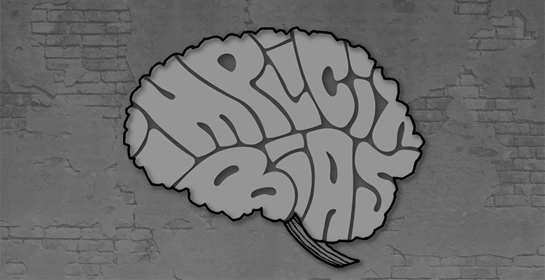
Discussion
What are some recent examples of implicit bias?
Notes:
SUBJECT MATTER: CULTURAL CONSIDERATIONS
In an example from 2018, two Black men walked into a Philadelphia Starbucks to attend a business meeting. The manager asked them to leave, and they declined, saying they were waiting for their associate. The manager called the police, who then arrested the men. In interviews after the arrest, the men said they believed the manager had targeted them because of their race. Starbucks responded by holding companywide training to “address implicit bias, promote conscious inclusion, and prevent discrimination.”
Everyone holds implicit beliefs about various social groups, and these biases can have a negative impact in our social, study, and work environments. Implicit biases are harmful because they influence the way we perceive and interact with others — and can lead us to depersonalize people from different groups based on perceived characteristics. Learning to identify and overcome them is an important step toward overcoming prejudice and social and racial stereotypes.

Slide 35
Overcoming Implicit Bias
Introspection
Mindfullness
Perspective
Learn to slow down
Individuation
Check your messaging
Institutionalize fairness
Take two
Notes:
According to the article, taking steps to recognize and correct unconscious assumptions toward groups can promote health equity. These eight tactics, which spell out “IMPLICIT,” can help you mitigate your own implicit biases.
The next few slides will explain some of these steps.
Reference:
The American Academy of Family Physicians (AAFP) Article: “How to Identify, Understand, and Unlearn Implicit Bias in Patient Care”. Family Practice Manager. 2019;26(4):29-33. Dr. Edgoose.

Slide 36
Overcoming Implicit Bias
Introspection: Set aside time to understand your biases by taking a personal inventory of them. This can be done by taking tests to identify the biases you may have.
Mindfulness: Once you understand the biases you hold, be mindful that you’re more likely to give in to them when you’re under pressure or need to make quick decisions. If you’re feeling stressed, pause for a minute, collect yourself, and take a few deep breaths.
Notes:
SUBJECT MATTER: CULTURAL CONSIDERATIONS
Read slide
Potential Discussion Questions:
What do you do- How do you respond, when you take personal inventory and realize you hold potentially harmful implicit bias? – What is a group therapy exercise which supports making these kinds of shifts in attitude and perspective?
How do you plan to create more time to pause, breathe, and avoid making quick decisions? – What is a group therapy exercise which encourages this?
Key Points:
When we speak about the transition from the unconscious to conscious awareness, we must start with the most powerful act of consciousness which IS looking in the mirror! – Introspection is key to overcoming implicit bias
Introspection is very much an independent activity, however modeling the appropriateness and a willingness to participate in this activity, and positively rewarding group members for their engagement are powerful tools, done in the group setting.
Setting aside time, unpacking pressure and stress, and avoiding quick decision-making are challenges for most of us who have a lot on our plates and who strive for peak performance and production. Practicing these healthy habits in a group setting is helpful to create a ‘muscle memory’ of the process.
References:
The American Academy of Family Physicians (AAFP) Article: “How to Identify, Understand, and Unlearn Implicit Bias in Patient Care”. Family Practice Manager. 2019;26(4):29-33. Dr. Edgoose.
Smedley BD, Stith AY, Nelson AR, eds Unequal Treatment: Confronting Racial and Ethnic Disparities in Health Care. Washington, DC: Institute of Medicine, National Academy Press; 2003
Image Credit: Microsoft stock image

Slide 37
Overcoming Implicit Bias
Perspective-taking: If you think you may be stereotyping people or groups, imagine what it would feel like for others to stereotype you.
Learn to Slow Down: Before jumping to conclusions about others, remind yourself of positive examples of people from their age group, class, ethnicity, or sexual orientation. This can include friends; colleagues; or public figures, such as athletes, members of the clergy, or local leaders.
Notes:
SUBJECT MATTER: CULTURAL CONSIDERATIONS
Read slide
Potential Discussion Questions:
What if the show WAS on the other foot? How would you feel if others were to stereotype you because of the ways you may be different?
What are some ways to draw upon positive examples of diverse cultural groups, if you have limited experiences with diverse cultural groups? Apply this to group therapy-
Key Points:
We’ve all heard the cliché, treat others how you want to be treated- but the Why? behind the saying is because we are constantly reshaping our identities; groups have such a power of influence in how each other reshapes the identity, so we are treating others the ways we want to be treated as a means for teaching others how we want to be treated, and group therapy empowers us to practice teaching these important points.
Group therapy is a safe space to process some of the intense feelings we experience, when bias has offended or worked against us.
Slowing down is the key! Time Management groups are appropriate spaces to practice the skill of overcoming implicit bias.
References:
The American Academy of Family Physicians (AAFP) Article: “How to Identify, Understand, and Unlearn Implicit Bias in Patient Care”. Family Practice Manager. 2019;26(4):29-33. Dr. Edgoose.
Smedley BD, Stith AY, Nelson AR, eds Unequal Treatment: Confronting Racial and Ethnic Disparities in Health Care. Washington, DC: Institute of Medicine, National Academy Press; 2003
Image Credit: Microsoft stock image

Slide 38
Overcoming Implicit Bias
Individualization: Remind yourself that all people have individual characteristics that are separate from others within their group. Focus on the things you have in common.
Check Your Messaging: Instead of telling yourself that you don’t see people based on their color, class, or sexual orientation, learn to use statements that embrace inclusivity. For example, Apple Inc.’s inclusion statement circles around the topic of being different together: “At Apple, we’re not all the same, and that’s our greatest strength.”
Notes:
SUBJECT MATTER: CULTURAL CONSIDERATIONS
Read slide
References:
The American Academy of Family Physicians (AAFP) Article: “How to Identify, Understand, and Unlearn Implicit Bias in Patient Care”. Family Practice Manager. 2019;26(4):29-33. Dr. Edgoose.
Smedley BD, Stith AY, Nelson AR, eds Unequal Treatment: Confronting Racial and Ethnic Disparities in Health Care. Washington, DC: Institute of Medicine, National Academy Press; 2003
Image Credit: Microsoft stock image

Slide 39
Overcoming Implicit Bias
Institutionalize Fairness: In the workplace, learn to embrace and support diversity.
Take Two: Overcoming unconscious biases takes time. Understand that this is a lifelong process and that deprogramming your biases requires constant mindfulness and work.
Notes:
SUBJECT MATTER: CULTURAL CONSIDERATIONS
Read slide
References:
The American Academy of Family Physicians (AAFP) Article: “How to Identify, Understand, and Unlearn Implicit Bias in Patient Care”. Family Practice Manager. 2019;26(4):29-33. Dr. Edgoose.
Smedley BD, Stith AY, Nelson AR, eds Unequal Treatment: Confronting Racial and Ethnic Disparities in Health Care. Washington, DC: Institute of Medicine, National Academy Press; 2003
Image Credit: Microsoft stock image

Slide 40
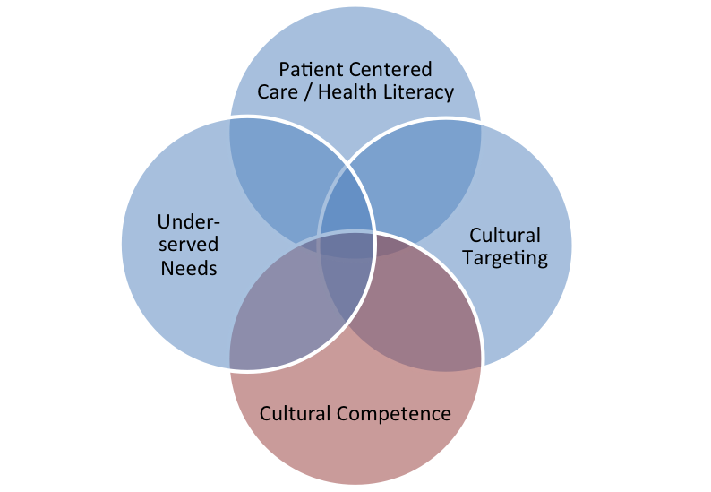
Effective Healthcare Program
Figure 1. Health services research concepts that overlap with cultural competence
Retrieved from the Agency for Healthcare Research & Quality on 12.13.22
Notes:
SUBJECT MATTER: CULTURAL CONSIDERATIONS

Slide 41
Culturally, Linguistically Appropriate Interventions
“People first” care interventions that promote “individuation.”
These interventions prompt providers to make a conscious effort to view people in terms of their individual characteristics rather than group membership and being aware of one’s own biases and stereotypes.
The interventions can also take place at the system level, engineering a system that promotes providing needed care universally, such as equitable receipt of preventive or chronic disease management.
Agency for Healthcare Research & Quality, 12.13.22
Notes:
SUBJECT MATTER: CULTURAL CONSIDERATIONS
READ slide.
This is an important component of the work you will do in the helping field. We must see each person as an individual and incorporate interventions applicable to who is sitting across from you.
Reference: Butler M, McCreedy E, Schwer N, Burgess D, Call K, Przedworski J, Rosser S, Larson S, Allen M, Fu S, Kane RL. Improving Cultural Competence To Reduce Health Disparities. Comparative Effectiveness Review No. 170. (Prepared by the Minnesota Evidence-Based Practice Center under Contract No. 290-2012-00016-I.) AHRQ Publication No. 16EHC006-EF. Rockville, MD: Agency for Healthcare Research and Quality; March 2016. www.effectivehealthcare.ahrq.gov/reports/final.cfm.

Slide 42
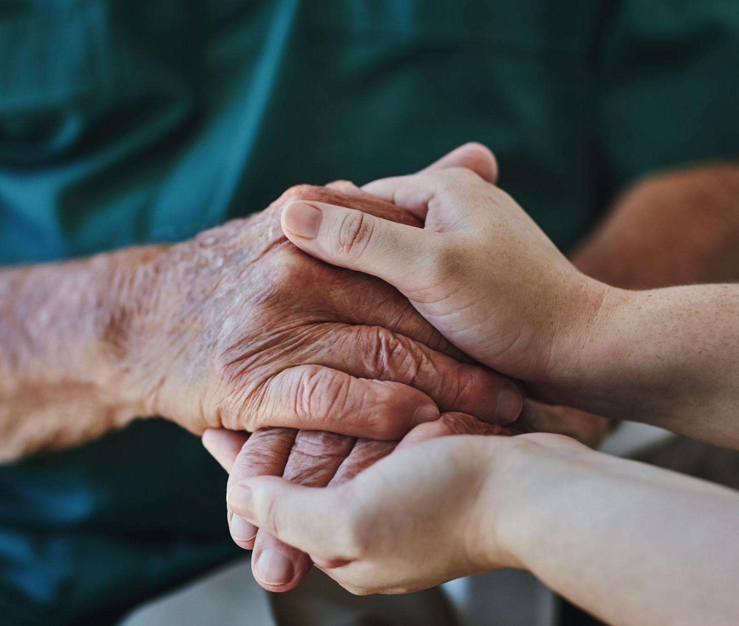
Culturally, Linguistically Appropriate Interventions
Cultural competence interventions that improve the ability of providers to provide health care services to patients who are unlike the providers (or the providers’ culture) in important ways.
Targeted providers in such cases can include physicians, nursing staff, allied health professionals, paraprofessionals, and clinic staff who have regular contact with patients, or health system factors intended to engineer the system to support and sustain cultural competence.
Agency for Healthcare Research & Quality, 12.13.22
Notes:
SUBJECT MATTER: CULTURAL CONSIDERATIONS
READ slide.
Discussion Points:
Being competent is different than being confident. What are the noted differences between confidence and competence?
Responses include along the lines of the following: Competence is how good you are at something. Confidence is how good you think you are at something.
How does someone become culturally competent?
Reading books about cultural awareness, or about a culture specifically.
Inquiring with those you come into contact with how their culture impacted their upbringing, how they conceptualize drug/alcohol addiction,
Image Credit:
Reference: Butler M, McCreedy E, Schwer N, Burgess D, Call K, Przedworski J, Rosser S, Larson S, Allen M, Fu S, Kane RL. Improving Cultural Competence To Reduce Health Disparities. Comparative Effectiveness Review No. 170. (Prepared by the Minnesota Evidence-Based Practice Center under Contract No. 290-2012-00016-I.) AHRQ Publication No. 16EHC006-EF. Rockville, MD: Agency for Healthcare Research and Quality; March 2016. www.effectivehealthcare.ahrq.gov/reports/final.cfm.

Slide 43
Culturally, Linguistically Appropriate Interventions
Interventions that assist people from priority populations to competently navigate their provider relationship and the larger health system
Interventions that address physical barriers to access.
Agency for Healthcare Research & Quality, 12.13.22
Notes:
SUBJECT MATTER: CULTURAL CONSIDERATIONS
READ slide.
Reference: Butler M, McCreedy E, Schwer N, Burgess D, Call K, Przedworski J, Rosser S, Larson S, Allen M, Fu S, Kane RL. Improving Cultural Competence To Reduce Health Disparities. Comparative Effectiveness Review No. 170. (Prepared by the Minnesota Evidence-Based Practice Center under Contract No. 290-2012-00016-I.) AHRQ Publication No. 16EHC006-EF. Rockville, MD: Agency for Healthcare Research and Quality; March 2016. www.effectivehealthcare.ahrq.gov/reports/final.cfm.

Slide 44
Culturally, Linguistically Appropriate Interventions
Interventions that educate providers about, and to look for, the common secondary conditions specific to the target populations. For example, people with disabilities commonly experience an identifiable set of health conditions secondary to the disability such as urinary tract infections, asthma, obesity, hypertension, and pressure ulcers.
Agency for Healthcare Research & Quality, 12.13.22
Notes:
SUBJECT MATTER: CULTURAL CONSIDERATIONS
READ slide.
Reference: Butler M, McCreedy E, Schwer N, Burgess D, Call K, Przedworski J, Rosser S, Larson S, Allen M, Fu S, Kane RL. Improving Cultural Competence To Reduce Health Disparities. Comparative Effectiveness Review No. 170. (Prepared by the Minnesota Evidence-Based Practice Center under Contract No. 290-2012-00016-I.) AHRQ Publication No. 16EHC006-EF. Rockville, MD: Agency for Healthcare Research and Quality; March 2016. www.effectivehealthcare.ahrq.gov/reports/final.cfm.

Slide 45
Resources
Suicide Prevention:
Zero Suicide Institute
Zero Suicide Listserv
NV Office for Suicide Prevention
NV Zero Suicide Initiative
The Lifeline and 988
UNR LiveWell Resource Page
Notes:
Resources are provided and should assist in maintaining important referral agencies/support services as well as resources for students.
Zero Suicide Institute: https://zerosuicideinstitute.com/
Zero Suicide Listserv: https://zerosuicide.edc.org/movement/zero-suicide-listserv
NV Office for Suicide Prevention: http://suicideprevention.nv.gov/
NV Zero Suicide Initiative: https://nvopioidresponse.org/initiatives/zs/
The Lifeline and 988: https://988lifeline.org/current-events/the-lifeline-and-988
UNR LiveWell Resource Page: https://www.unr.edu/livewell
Image Credit: SAMHSA 988 Partner Toolkit

Slide 46
Resources
Community Resources:
UNR Disabilities Resource Center
Nevada Center for Excellence in Disabilities Directory
CASAT on Demand Resources & Downloads
Pacific Southwest Addiction Technology Transfer Center (PSATTC)
The Mental Health Technology Transfer Center Network
The Prevention Technology Transfer Center Network
Dep. of Health & Human Services Aging and Disability Services Division
SAMHSA’s Technology Transfer Center (TTC) Programs
Notes:
Resources are provided and should assist in maintaining important referral agencies/support services as well serve as resources for students.
Community Resources:
UNR Disabilities Resource Center: https://www.unr.edu/drc
Nevada Center for Excellence in Disabilities Directory: https://www.unr.edu/education/faculty-and-staff/nevada-center-for-excellence-in-disabilities
CASAT on Demand Resources & Downloads: https://casatondemand.org/resources_downloads/
Pacific Southwest Addiction Technology Transfer Center (PSATTC): psattc.org
The Mental Health Technology Transfer Center Network: https://mhttcnetwork.org/
The Prevention Technology Transfer Center Network: https://pttcnetwork.org/
Department of Health & Human Services Aging and Disability Services Division: https://adsd.nv.gov/
SAMHSA’s Technology Transfer Centers (TTC) Programs: techtransfercenters.org

Slide 47
Notes:
The goal of the Pathways in Crisis Services (PICS) Project is to ensure that undergraduate/graduate students get exposed to crisis intervention services and skills while in school in order to prepare them to do crisis intervention services which includes: risk determination; early intervention; de-escalation strategies; how to conduct warm hand off; and understanding the new (988) system.

