Slide 1
Pathways in Crisis Services Project
Crisis Response System
Notes:
Pathways to Crisis Services (PICS) Curriculum Infusion Packages (CIPs) are a product for educators and trainers developed in 2022/2023 by the Center for the Application of Substance Abuse Technologies (CASAT). The main developers of crisis services materials are April Lang-Barroga, LMFT, LCADC, NCC, and Bianca D. McCall, LMFT. Additional guidance and editing support were provided by, Terra Hamblin, MA, Nancy Roget, MS, and Sophia Graham, BS.
This product was developed to help community college/university faculty, as well as clinical supervisors and recovery support staff have access to brief, science-based content with the goal of providing materials that can be easily infused into existing substance use disorder and related courses (e.g., social work, nursing, criminal justice, foundation of addiction courses, ethics, counseling courses, etc.). Individuals can select the specific content to infuse into existing curricula/materials depending on the specific needs of their learners. Each slide in the slide decks contains notes to provide guidance on the topics along with references and handouts where appropriate. If you require further information, please do not hesitate to contact the CASATs PICS Project Staff located at CASAT (775-784-6265) You are free to use these slides and pictures, but please give credit to PICS when using them by referencing the PICS Program at the beginning of your presentation.
Funding for this product/publication was made possible in whole or in part by the Nevada Division of Public and Behavioral Health Bureau of Behavioral Health, Prevention, and Wellness (DHHS). The views expressed in these materials do not necessarily reflect the official policies or views of DHHS or the State of Nevada nor does mention of trade names, commercial practices, or organizations imply endorsement by the U.S. Government or the State.
Additional resources are available to enhance and support the information provided in this brief presentation.
Date last updated: January 2023

Slide 2
Overview of
Crisis Response System
Notes:
Crisis Now - National Guidelines provides a comprehensive overview of the national guidelines for behavioral health crisis services and their alignment with the Crisis Now model. Participants will gain an in-depth understanding of the key principles and best practices outlined in the national guidelines for delivering effective crisis services.
Crisis System Impact. explores the impact of crisis response systems and focuses specifically on the Nevada crisis response system, while striving to align it with the ideal crisis system framework. Participants will gain a comprehensive understanding of the various components of a crisis response system and their effects on individuals in crisis. Participants review the ideal crisis system model, which prioritizes accessibility, coordination, and effectiveness of crisis services.
Crisis System - Phases of Disaster Response provides an in-depth exploration of the phases of disaster response and the grief cycles experienced by individuals affected by disasters. Participants will gain a comprehensive understanding of the different stages of disaster response, including preparedness, response, recovery, and mitigation. Various grief models and cycles, equipping students/participants with the knowledge and tools to recognize and support individuals in different stages of the grief process.
Crisis System - Psychological First Aid focuses on the 8 core actions of Psychological First Aid (PFA) for building resilience in individuals facing crisis or adversity. Participants will learn practical strategies and techniques to provide immediate emotional and psychological support to those in need.
Each slide contains detailed notes for the trainer to provide guidance in effectively presenting the content, as necessary. Full citations for the content are included in the notes for each slide.

Slide 3
Disclaimer
This presentation may include readings, media, and discussion on topics which include suicide, trauma, and crisis intervention. These topics may result in stress reactions.
Please monitor your reactions and if necessary, reach out to someone you trust if these topics cause considerable discomfort.
Notes:
Read the Disclaimer: This presentation may include readings, media, and discussion on topics which include suicide, trauma, and crisis intervention. These topics may result in stress reactions. Please monitor your reactions and if necessary, reach out to someone you trust if these topics cause considerable discomfort.

Slide 4
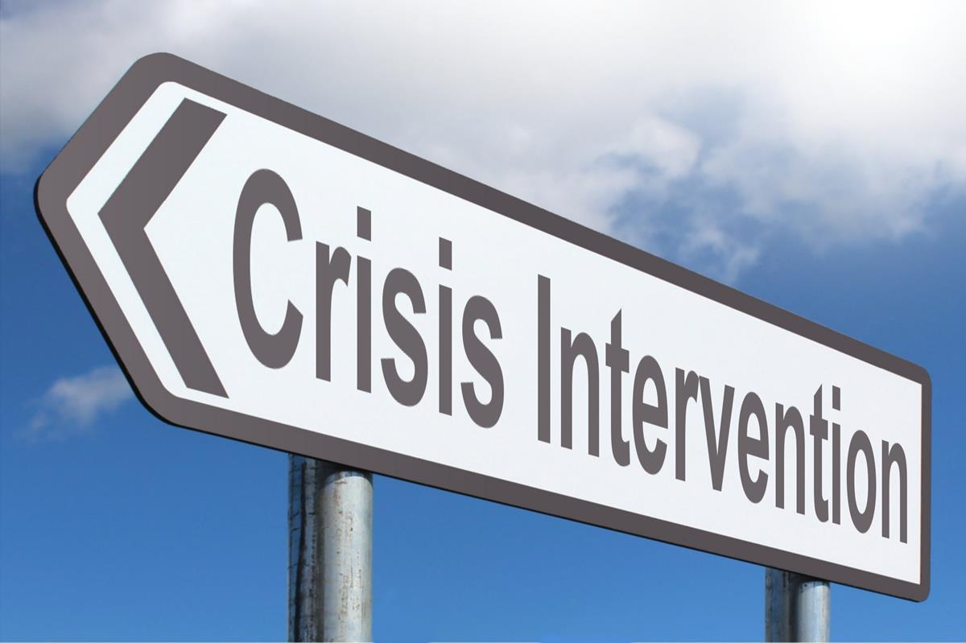
Crisis Intervention
Notes:
SUBJECT MATTER: CRISIS RESPONSE SYSTEM
Transition slide: Inform participants we will be covering Crisis Response System information. The crisis continuum includes various crisis services for individuals with urgent behavioral health needs, and the response to such crises and pathways toward a more complete assessment and treatment when needed.
Image: Picpedia

Slide 5
How to help in an emotional crisis:
If you suspect a friend or family member is experiencing an emotional crisis, your help can make a difference.
Spotting the Signs:
Neglect of Personal Hygiene
Dramatic change in sleep habits, sleeping more often or not well.
Weight gain or loss.
Decline in performance at work or school.
Pronounced changes in mood, such as irritability, anger, anxiety or sadness.
Withdrawal from routine activities and relationships.
Notes:
SUBJECT MATTER: CRISIS RESPONSE SYSTEM
READ:
Today we are going to introduce how we can begin to have crisis recognition at home with a person you care about. Learning how to navigate an emotional crisis can help make a difference.
ASK: What constitutes a crisis?
Possible answers include substance use, depression, breakup, death/grief, suicidal thoughts/plan, natural disasters, moving from one location to another, etc.
READ THE SLIDE
Spotting the Signs:
Neglect of Personal Hygiene
Dramatic change in sleep habits, sleeping more often or not well.
Weight gain or loss.
Decline in performance at work or school.
Pronounced changes in mood, such as irritability, anger, anxiety or sadness.
Withdrawal from routine activities and relationships.
ASK: How can you be helpful to another person?
Possible answers: listening to the person, connecting the person to professional help, contacting 988, etc.
Emphasize to the student that ANY person can help another person. You do not have to be licensed or a medical provider to acknowledge a person’s pain and suffering. Whether you are a peer, family member, or friend we all have an investment in the welfare of another human being. CONNECTION is what heals.
Resource:
American Psychological Assocation: How to help in an emotional crisis. (2013) https://www.apa.org/topics/mental-health/help-emotional-crisis

Slide 6
National Guidelines for
Behavioral Health Crisis Services
ANYONE, ANYWHERE, ANYTIME
Effective strategy for suicide prevention
Approach aligns care to the unique needs of the individual
Strategy that offers services focused on resolving mental health/substance use crisis
Key element to reduce psychiatric hospital bed overuse
Essential resource to eliminate psychiatric boarding in ER
Solution to the drains on law enforcement resources
Reduce the fragmentation of mental health care
Notes:
SUBJECT MATTER: CRISIS RESPONSE SYSTEM
After identifying gaps in a crisis system as risk factors for abuse, fraud, and waste & mental health crises such as overdose death and suicide. These national guidelines support a crisis system that supports the delivery of the appropriate services to ANYONE, ANYWHERE, and ANYTIME- using technology to make it in real-time. In order to achieve this anyone, anywhere, and anytime – no wrong door to access the right care in the right place goal
These 7 components must be addressed [READ]
•An effective strategy for suicide prevention
•An approach that better aligns care to the unique needs of the individual
•A preferred strategy for the person in distress that offers services focused on resolving mental health and substance use crisis
•A key element to reduce psychiatric hospital bed overuse
•An essential resource to eliminate psychiatric boarding in emergency departments
•A viable solution to the drains on law enforcement resources in the community
•Reduce the fragmentation of mental health care.
Perhaps the most important element of all, in an effective crisis service system, isn’t listed so much as it is implied. It’s the relationships within the system! In order to foster healthy relationships, we must return to embracing what it means to be human. Honoring the human experience- not just what will get a ton of views, likes, and watch time.
We must be more compassionate towards ourselves and improve our self-care and self-management. And then we will know what it is to be compassionate towards others. Self-care is an act of self-love. Love is entangled with our sense of entitlement- meaning what we believe we deserve. And these guidelines define for us the notion that everyone and anyone is entitled to immediate access to help, hope, and healing.
We know from experience that immediate access to help, hope, and healing- saves lives.
Reference: National Guidelines for Behavioral Health Crisis Care Best Practice Toolkit. SAMHSA 2020.
https://www.samhsa.gov/sites/default/files/national-guidelines-for-behavioral-health-crisis-care-02242020.pdf

Slide 7
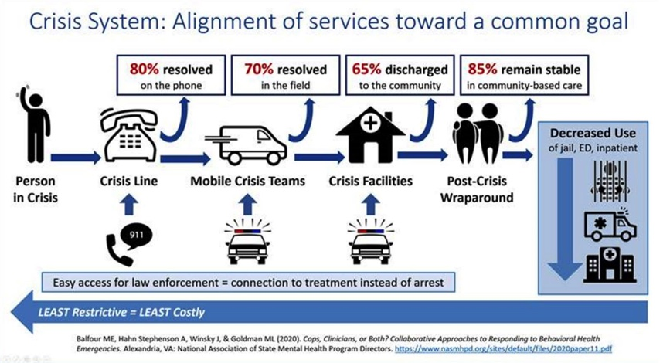
Crisis Services in Alignment
Notes:
SUBJECT MATTER: CRISIS RESPONSE SYSTEM
The diagram from the National Association of State Mental Health Program Directors shows that in a given crisis system, 80% of mental health crises can be resolved on the phone- through the utilization of a crisis line designated specifically for mental health, substance use and suicide crises. A 988 crisis line that is effectively resourced and promoted to be able to:
Connect a person in a behavioral health crisis to trained staff who can address their immediate needs and help connect them to ongoing care
Reduce healthcare spending with more cost-effective early intervention
Reduce the use of law enforcement, public health, and other safety resources
Meet the growing need for crisis intervention
Help end stigma toward those seeking or accessing behavioral healthcare
The Guiding Principles of 988 are:
To provide Universal and convenient access
Public awareness and engagement
Resources for self-help
Multi-channel availability
Reliable and timely response
Connection to resources and follow-up
Localized response
Connection to local public health and safety services
Follow-up as needed
High-quality and personalized experience
Tailored support
Consistency in line with best practices
Reference:
National Association of State Mental Health Program Directors (2020): https://www.nasmhpd.org/sites/default/files/2020paper11.pdf
Image Credit: National Association of State Mental Health Program Directors. Cops, Clinicians, or Both? Collaborative Approaches to Responding to Behavioral Health Emergencies. (August 2020). https://www.nasmhpd.org/sites/default/files/2020paper11.pdf

Slide 8
Crisis Response System Impact
Suicide
Family pain
Psychiatric Boarding
The wrong care in the wrong place
Law enforcement working as “mobile crisis”
Notes:
SUBJECT MATTER: CRISIS RESPONSE SYSTEM
Read the slide topics explaining these are the issues we are facing in the Crisis Response System.
We’ve opened the discussion about overdose death and suicide, however, there is also a human cost of emotional pain to families who are struggling to access care, such as:
The increasing cost of psychiatric boarding and inpatient healthcare. The average cost for an emergency department to board a psychiatric patient is nearly $2,500
In addition to the high cost to board psychiatric patients in hospitals, this typically leads to longer wait times for all emergency patients and lower productivity in hospitals which risks a higher cost of human life.
In some cases, psychiatric patients don’t stay long enough to receive the services they need, and these individuals who are unable to access needed community-based services in a timely manner, are not the problem or to blame for this although they are too often treated as though they are.
These individuals are finding themselves in the wrong care in the wrong place- and that’s why relapse, readmission, and recidivism have such an unreasonable stronghold in the recovery space.
At which point are we going to heal the system? Healing the system is not passing along responsibility throughout the system.
We’ve seen this with an over-reliance on law enforcement driving up the costs to employ law enforcement to fill the gaps throughout the Crisis Response System
The costs of law enforcement and the justice system teams dedicating a disproportionate amount of resources to address issues that result from a person’s untreated crisis.
Reference:
Pinals, D.A. (2020). Crisis Services: Meeting Needs and Saving Lives. Alexandria, VA: National Association of State Mental Health Program Directors

Slide 9




Nevada Crisis Response System
HIGH-TECH CRISIS CALL CENTERS
24/7 MOBILE CRISIS
CRISIS STABILIZATION PROGRAMS
ESSENTIAL PRINCIPLES & PRACTICES
Notes:
SUBJECT MATTER: CRISIS RESPONSE SYSTEM
According to Mental Health America’s 2020 State of Mental Health in America report, NEVADA CURRENTLY RANKS 51st IN THE NATION overall for mental health, a ranking that indicates a high prevalence of mental illness and low levels of access to mental health care. Every day there are an AVERAGE of 102 INDIVIDUALS waiting in emergency rooms across Nevada for behavioral health services. Hospital emergency departments are the primary means by which people in Nevada gain access to necessary behavioral health services, and they have become a bottleneck to appropriate treatment. Furthermore, even after transitioning patients to other services, Nevada’s system still struggles to match the “right treatment” to the person. Mental health care systems and services are inadequate.
Crisis mental health care in Nevada is reactive and fragmented, creating a REVOLVING DOOR for people in crisis, increasing costs to the community, and increasing risks for human error, crises, and premature and preventable death. A significant contributor to the gaps in the Crisis Response System is the lack of accountability- essential principles and practices documented and enforced in behavioral health and healthcare facilities.
Without policies and procedures, and universal guidelines for behavioral health patient monitoring and tracking, we’re missing data points such as:
• The number of people turned away from services due to a lack of beds or appropriate care
• The number of referrals made and accepted to various mental health services
• The number of people experiencing a mental health crisis becoming justice-involved
• Patient assessment information that identifies individuals’ needs and the services appropriate to address those needs.
There is HOPE in Nevada. There is incredible work being done to implement something called the Crisis Now Model to improve pathways to crisis services. Nevada has sustained assets to climb out of the 51st spot and legislative decisions are being made to improve accountability.
• Crisis Call Centers: Nevada has one of six National Suicide Prevention Lifeline National Call Centers and the crisis line is experiencing great success deploying resources when necessary and otherwise de-escalating people in crisis.
• Mobile Crisis: Various configurations of mobile crisis teams have already been established throughout the state and include law enforcement deflection and diversion programs. These programs are also facilitating diversion from hospitals and meeting patients where they are at in the community.
• Stabilization Programs: Community Triage Centers were defined in Nevada Revised Statute in 2005 and provide a different pathway for accessing mental health services, ensuring stabilization within a community setting without first accessing a hospital. These centers were funded creatively, braiding together resources from both state and local sources. Currently, three Triage Centers are operating in Nevada (two in Las Vegas, and one in Reno).
In addition to new crisis programming, the following have had a positive impact on crisis response in Nevada:
Insurance coverage expansion resulting from the Affordable Care Act
The launch of the Certified Community Behavioral Health Centers,
The Excellence in Mental Health Act, and
The implementation of First Episode Psychosis programs throughout the state.
The State has also moved to implement Open-Beds technology to support these efforts, a directory of all ”open bed placements” at hospitals and treatment facilities in Nevada.
Pursuant to the evidence-based model for Crisis Response Systems, which is called the CRISIS NOW Model:
Crisis Call Centers are Regional, accessible 24/7/365, clinically staffed and serves as a hub/crisis call center that provides crisis intervention capabilities (telephonic, text and chat). Such a service should meet National Suicide Prevention Lifeline (NSPL) standards for risk assessment and engagement of individuals at imminent risk of suicide and offer air traffic control (ATC) - quality coordination of crisis care in real-time
Crisis Mobile Teams are available to reach any person in the service area in his or her home, workplace, or any other community-based location of the individual in crisis in a timely manner
Crisis Receiving and Stabilization Facilities: must be recovery-supportive facilities, providing short-term (under 24 hours) observation and crisis stabilization services to all referrals in a living room model, non-hospital environment.
Essential principles and practices must address recovery needs, significant use of peers, and trauma-informed care; promote “Suicide safer” care; address the safety and security for staff and those in crisis; and promote Law enforcement and emergency medical services collaboration. And the addition of Peer to Peer support provides great outcomes in helping others, sharing lived experiences in a team approach.
Reference(s): Pinals, D.A. (2020). Crisis Services: Meeting Needs and Saving Lives. Alexandria, VA: National Association of State Mental Health Program Directors

Slide 10
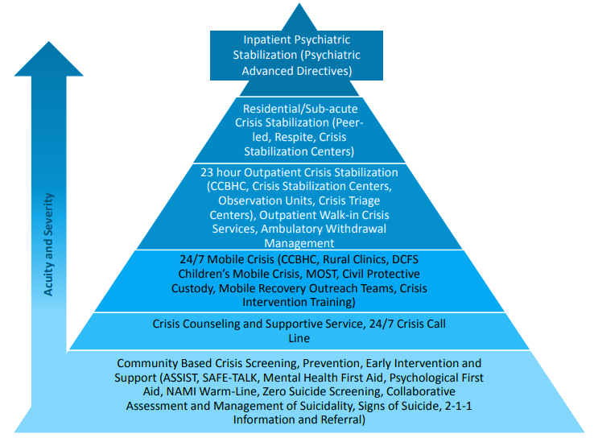
Nevada’s Ideal Crisis Continuum
Notes:
SUBJECT MATTER: CRISIS RESPONSE SYSTEM
The Vision for Nevada Crisis Continuum is to provide the right care in the right place. The graphic above demonstrates an ideal system. You’ll notice from the pyramid- Inpatient Hospitalization is not the first stop. We are starting at the community level, ideally, we want to be screening for behavioral health crisis and suicide. Some examples of those screening tools; as well as, tools for prevention, early intervention, and support are:
ASIST
SAFETalk
Mental Health First Aid
Psychological First Aid
Training is available through the Nevada Department of Public & Behavioral Health, Office of Suicide Prevention, CASAT, and partners including Living Works.
Nevada’s Warm Line & Text Lines supported by NAMI Nevada & Western Region & Nevada 2-1-1
Zero Suicide Framework, CAMS Assessment and Management of Suicidality, Signs of Suicide
And we’ll introduce a few of these in later sections.
As the acuity and severity of crisis incidents increase, so do the response and the opening of doors to again; get people in the right place at the right time.
Reference: Pinals, D.A. (2020). Crisis Services: Meeting Needs and Saving Lives. Alexandria, VA: National Association of State Mental Health Program Directors
Image Credit: “Towards a Comprehensive Crisis Response System in Nevada,” Nevada Dept of Health and Human Services: Division of Public and Behavioral Health

Slide 11
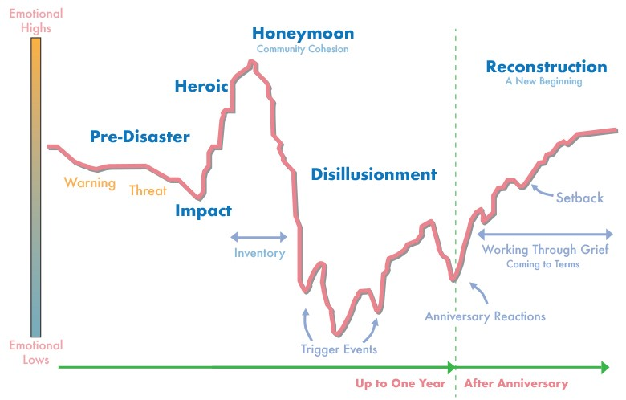
Phases of Disaster Response & Grief Cycles
Notes:
SUBJECT MATTER: CRISIS RESPONSE SYSTEM
After reviewing the National Guidelines for Behavioral Health Crisis Services and the Crisis Services in Alignment image. Remember that in a given crisis system 80% of mental health crises can be resolved by phone!! CAS 255 you reviewed the Crisis Response Systems in Nevada that include: call centers (crisis support services), 24/7 mobile crisis (mobile crisis response team (youth and families) and mobile outreach safety teams (attached to local law enforcement), crisis stabilization programs (2 in Las Vegas, 1 in Reno), and the essential principles and practices (trauma-informed care, suicide safer care, peer to peer support). You also reviewed Nevada’s Crisis Continuum and the problems we have seen with crisis response systems across the nation.
There are 6 phases of disaster response- to be considered for any crisis response system in addition to understanding the emotional highs and lows we will experience throughout the course of a crisis.
Crisis responses services should be sustainable and suitable for a marathon and not a sprint. The 6 phases are as follows:
Pre-Disaster where the responsibility of the CRS is to provide warning of the threat and prevention is also done at this time
The Impact of the threat
A Heroic Response from first responders and the community
The Honeymoon is when the community comes together in solidarity
Then we experience Disillusionment when inventory and resources are exhausted and activating events for trauma brains, leaving us to our vices or coping strategies
As we rise again, during the Reconstruction phase- rising to the occasion of The New Normal
Grief is any situation where there is an actual or perceived loss. It is important to understand there are different types of grief and rather than cycles per se- we are looking at specific tasks of grief. A lot of us are familiar with the traditional but linear stages of grief model by Kessler (Finding Meaning: The Sixth Stage of Grief David Kessler)- which proposes we all experience stages of denial, anger, bargaining, depression, and eventually acceptance. This model was based on what is called anticipatory grief… someone falls ill or is getting older and we expect the end of life, as a natural part of the life span. But this doesn’t necessarily apply to more complicated grief, like an unexpected and significant loss of a loved one, loss of a person- even speaking to the loss of our person meaning our identities. How many of us lost our identities as working people, heads of households, full time parents, community educators, etc.? The pandemic certainly caused what I would call complicated grief which forces us to consider our grief experiences differently. Because the problem is we can sometimes experience relapse in any of those stages because we are frustrated, and we can’t seem to figure out how to get to ‘acceptance’ right? Just accept the loss and move on- There are newer more fluid models which explains our individual processes of grief.
Four steps of mourning
William Morton suggests we all experience 4 Tasks of Mourning and I’m going to give examples of the grief being a death; those tasks are:
Understand reality of the death
Allow the feelings and thoughts of grief
Reinvest in life/meaning in life
Keep an enduring connection with loved one after death;
In addition to previously mentioned models, there is the Dual Process Model by Stoby and Strutt. This model suggests we experience Loss Orientation and Restoration Orientation. Prior to the 1950’s we experienced the end of life in the home, then the hospital systems and hospice removed death from occurring in the home and that sort of disconnected us from the concept and more significantly, the conversation about death in our homes and with our families.
Discussion: How might this information be important when forming a group? When supporting people in a group?
Image Credit: Graph from Samsha.gov. adapted from Zunin and Myers
Reference(s): “Phases of Disaster” Adapted from Zunin & Myers as cited in DeWolfe, D. J., 2000. Training manual for mental health and human service workers in major disasters

Slide 12
Psychological First-Aid (PFA) for Resilience
8 Core Actions
Contact and Engagement
Safety and Comfort
Stabilization
Information Gathering
Practical Assistance
Connection with Social Supports
Information on Coping
Linkage with Collaborative Services
Notes:
SUBJECT MATTER: CRISIS RESPONSE SYSTEM
READ:
Assuming you have reviewed the National Guidelines for Behavioral Health Crisis Services and the Crisis Services in Alignment image. Remember that in a given crisis system 80% of mental health crisis can be resolved by phone!! CAS 255 you reviewed the Crisis Response Systems in Nevada that include: call centers (crisis support services), 24/7 mobile crisis (mobile crisis response team (youth and families) and mobile outreach safety teams (attached to local law enforcement), crisis stabilization programs (2 in Las Vegas, 1 in Reno), and the essential principles and practices (trauma-informed care, suicide safer care, peer to peer support). You also reviewed Nevada’s Crisis Continuum and the problems we have seen with crisis response systems across the nation. In CAS 354 you reviewed the 6 Phases of Disaster Response and Grief Cycles.
Now we are going to discuss the eight PFA Core Actions which include:
Contact and Engagement: To respond to contacts initiated by survivors, or to initiate contacts in a non-intrusive, compassionate, and helpful manner.
Safety and Comfort: To enhance immediate and ongoing safety, and provide physical and emotional comfort.
Stabilization (if needed): To calm and orient emotionally overwhelmed or disoriented survivors.
Information Gathering on Current Needs and Concerns: To identify immediate needs and concerns, gather additional information, and tailor Psychological First Aid interventions.
Practical Assistance: To offer practical help to survivors in addressing immediate needs and concerns.
Connection with Social Supports: To help establish brief or ongoing contacts with primary support persons and other sources of support, including family members, friends, and community helping resources.
Information on Coping: To provide information about stress reactions and coping to reduce distress and promote adaptive functioning.
Linkage with Collaborative Services: To link survivors with available services needed at the time or in the future.
Discussion: How might you ensure you implement all 8 when working with someone?
Reference: National Child Traumatic Stress Network and National Center for PTSD, Psychological First Aid: Field Operations Guide, September, 2005.

Slide 13
Discussion Questions:
How might you utilize the Crisis Response System in your area when assessing a person?
Who are the Mobile Crisis Teams in Nevada?
How do you have a conversation about Crisis Services with a person who is struggling?
Notes:
SUBJECT MATTER: CRISIS RESPONSE SYSTEM
Listen for the students learning to articulate that in all aspects of a person's treatment, they can witness a person in crisis and will need to navigate the Crisis Response System. Listen for students mentioning when a person talks about suicidality, homicidality, or inability to care for themself a referral to higher level care is needed.
Reminding participants they can provide resources:
988/crisis support services (24/7 Crisis Lifeline for all ages, all struggles welcome.)
NAMI (775-470-5600) (National Alliance for the Mentally Ill – local resources for persons struggling and resources for the impacted family)
Nevada Teen Support Text Line (775-296-8336) (Crisis text line for individuals 14-24yo, 7 days week, 2p-10p. All struggles welcome.)
Veterans Suicide Hotline (988, press 1) – This 24/7 crisis line is dedicated to veterans, and will provide resources, access to treatment, and empathy regarding veteran related concerns.)
Reno Behavioral Healthcare Hospital (Reno) (775-393-2200) or Desert Parkway Behavioral Healthcare Hospital (Las Vegas) (877-663-7976)– This hospital is 24/7 and provides inpatient treatment for youth and adults struggling with mental health (suicidal, medication instability, homicidal, unable to care for self) and substance use problems (medical detox is needed). They offer free assessments with a licensed professional. This is a high level of care as they are staffed 24/7 with a nurse and requires the person to need medical monitoring.)
Mobile Crisis Teams in Nevada:
Mobile Outreach Safety Teams (MOST) - co-responder model with Law Enforcement Departments. The MOST team is comprised of licensed therapists (MFT, CPC, LCSW) that provide crisis intervention services, connect people to resources, and assist officers in effectively communicating with individuals struggling with mental health and substance use concerns. Northern Nevada MOST is located at Sparks Police Department, Reno Police Department, Washoe County Sheriff’s Office, and Carson City Sheriff’s Office.
Mobile Crisis Intervention Team (MCIT) –This team is comprised of licensed clinicians in Southern Nevada. They work alongside paramedics as a co-responder model and assist with behavioral health crises in the community.
Mobile Crisis Response Team (MCRT) – this team provides crisis intervention and short term stabilization for families struggling with a behavioral or mental health crisis. MCRT has a 24/7 number (775-688-1670 or 702-486-7865) where information will be gathered and an assessment will be scheduled for the youth and family.
Conversation starters for introductions to crisis services:
Hey, have you heard about the mobile crisis teams? Let me share how they can be helpful during a crisis.
Have you used a crisis lifeline before? I’d like to share with you about 988 and how it might be a resource during this time.
Sounds like you might need to detox. Have you heard of the inpatient hospital (insert one closest to you) and how they can assist with detox and connection to a rehab?
Sometimes we need someone who will just listen. The NAMI teen text line does just that. Let me share their number.

Slide 14
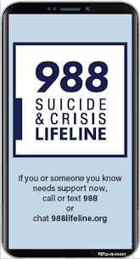
Resources
Suicide Prevention:
Zero Suicide Institute
Zero Suicide Listserv
NV Office for Suicide Prevention
NV Zero Suicide Initiative
The Lifeline and 988
UNR LiveWell Resource Page
Notes:
Resources are provided and should assist in maintaining important referral agencies/support services as well as resources for students.
Zero Suicide Institute: https://zerosuicideinstitute.com/
Zero Suicide Listserv: https://zerosuicide.edc.org/movement/zero-suicide-listserv
NV Office for Suicide Prevention: http://suicideprevention.nv.gov/
NV Zero Suicide Initiative: https://nvopioidresponse.org/initiatives/zs/
The Lifeline and 988: https://988lifeline.org/current-events/the-lifeline-and-988
UNR LiveWell Resource Page: https://www.unr.edu/livewell
Image Credit: SAMHSA 988 Partner Toolkit

Slide 15
Resources
Community Resources:
UNR Disabilities Resource Center
Nevada Center for Excellence in Disabilities Directory
CASAT on Demand Resources & Downloads
Pacific Southwest Addiction Technology Transfer Center (PSATTC)
The Mental Health Technology Transfer Center Network
The Prevention Technology Transfer Center Network
Dep. of Health & Human Services Aging and Disability Services Division
SAMHSA’s Technology Transfer Center (TTC) Programs
Notes:
Resources are provided and should assist in maintaining important referral agencies/support services as well as resources for students.
Community Resources:
UNR Disabilities Resource Center: https://www.unr.edu/drc
Nevada Center for Excellence in Disabilities Directory: https://www.unr.edu/education/faculty-and-staff/nevada-center-for-excellence-in-disabilities
CASAT on Demand Resources & Downloads: https://casatondemand.org/resources_downloads/
Pacific Southwest Addiction Technology Transfer Center (PSATTC): https://attcnetwork.org/centers/pacific-southwest-attc/home
The Mental Health Technology Transfer Center Network: https://mhttcnetwork.org/
The Prevention Technology Transfer Center Network: https://pttcnetwork.org/
Department of Health & Human Services Aging and Disability Services Division: https://adsd.nv.gov/
SAMHSA’s Technology Transfer Centers (TTC) Programs: techtransfercenters.org

Slide 16
Notes:
The Pathways in Crisis Services (PICS) Project provides academic course and professional learning events and content focused on evidence-based crisis programs that include crisis intervention, de-escalation services, mobile crisis and crisis stabilization for Pre-service (students) and Practicing Behavioral Health Professionals with the goal of increasing knowledge and skills leading to use in practice.
This is accomplished by guaranteeing students get exposed to crisis intervention services and skills while in school in order to prepare them to do crisis intervention services which includes: risk determination; early intervention; de-escalation strategies; how to conduct warm-hand-off; and understanding the new (988) system through the development of curriculum infusion and training. Practicing Professionals will have the opportunity to attend a variety of training and technical assistance (T/TA) events to ensure that T/TA in crisis-based programs is available to help prepare these professionals with the knowledge and skills to provide crisis-based services.
This project was supported in whole or in part by the Nevada Division of Public and Behavioral Health Bureau of Behavioral Health, Prevention, and Wellness. The opinions, findings, conclusions and recommendations expressed in this publication are those of the author(s) and do not necessarily represent the official views of the State of Nevada or CASAT.

