Slide 1
This product was funded under a cooperative agreement from the Substance Abuse and Mental Health Services Administration (SAMHSA) Center for Substance Abuse Treatment (CSAT) (Grant Number TI-080200). All material, except that taken directly from copyrighted sources, is in the public domain and may be used and reprinted for training purposes without special permission. However, any content used should be attributed to the Mountain Plains Addiction Technology Transfer Center.

Slide 2
Recovery Capital... building materials for initiating and sustaining long-term recovery
Notes:
This 10-slide deck provides a brief overview of the role recovery capital plays in increasing assets and identifying barriers to recovery (Hennessey, 2017). Please feel free to use this slide deck as part of a larger presentation on recovery and recovery support services, or as a stand alone presentation. The material presented is referenced, with many of the articles being available publicly.
This slidedeck was created by the Mountain Plains ATTC so please reference our regional center and SAMHSA, our funder.
Hennessey, E. (2017). Recovery capital: a systematic review of the literature. Addiction Research & Theory, 25(5), 349–360. https://doi.org/10.1080/16066359.2017.1297990

Slide 3
Resolving alcohol and other drug problems is not just a matter of abstinence or symptom reductions but…
improvements in functioning, psychological well-being, and
Quality of Life.
Kelly et al., 2018; White, 2018
Notes:
This slide reinforces the point that recovery is not just about abstinence but about improvements in all areas of an individual’s life. The concept of Recovery Capital (defined and discussed later) helps build that case.
Kelly, J.F., Greene, M.C., & Bergman, B.G. (2018). Beyond abstinence: Changes in indices of quality of life with time in recovery in a nationally representative sample of U.S. adults. Alcoholism: Clinical & Experimental Research, 42(4), 770-780.
White, W.L. (2018, June 18). Quality of Life in Early Recovery and Beyond. (Blog Post). Retrieved from http://www.williamwhitepapers.com/blog/2018/06/quality-of-life-in-early-recovery-and-beyond.html 1/3

Slide 4
Imagine a serious substance use problem like a burning building… we know how to extinguish the fire – stopping substance use (getting someone detoxed and clinically stable)
Kelly et al., 2018; White, 2018
Notes:
This analogy appears in the article by John Kelley and colleagues and is useful when discussing recovery and recovery capital.
Much of the current SUD research demonstrates that professionals understand how to initially stop substance use, meaning that these professionals know how to medically detox someone from opioids, alcohol, and other sedative hypnotics, and ensure that the patient is clinically stable. Medical professionals can effectively treat overdoses in many cases and stabilize the patients. This wasn’t true 50 years ago so advancements have been made. The next slide discusses the challenges behavioral health professionals continue to face with individuals with SUDs post detoxification.
Kelly, J.F., Greene, M.C., & Bergman, B.G. (2018). Beyond abstinence: Changes in indices of quality of life with time in recovery in a nationally representative sample of U.S. adults. Alcoholism: Clinical & Experimental Research, 42(4), 770-780.
White, W.L. (2018, June 18). Quality of Life in Early Recovery and Beyond. (Blog Post). Retrieved from http://www.williamwhitepapers.com/blog/2018/06/quality-of-life-in-early-recovery-and-beyond.html 1/3

Slide 5
BUT… we have been less successful in:
preventing the fire from restarting— preventing relapse
providing the architectural planning for reconstructing that person’s life once the fire is out—
providing access to the building materials— recovery capital— necessary to reconstruct their lives.
granting the “rebuilding permits” needed to allow the recovery process to begin.
If someone has a criminal record, for example—often directly related to their substance use—they often cannot get a job, housing, or a loan for college or job training.
Kelly et al., 2018; White, 2018
Notes:
Continuing with the house on fire analogy…
Review these bullets and related them to providing treating and recovery services to individuals with SUDs and keeping the fire extinguished and the processes of rebuilding the house.
The SUD field has been less successful in:
Preventing relapse
Helping the individual create plans to reconstruct their life (comprehensive treatment planning with more than one agency)
Providing guidance, direction, and support to increase recovery capital
Helping and advocating for individuals to navigate difficult systems that might have barriers
White’s paper listed below has a list of steps that the SUD field can do to increase recovery capital which are not listed here.
Kelly, J.F., Greene, M.C., & Bergman, B.G. (2018). Beyond abstinence: Changes in indices of quality of life with time in recovery in a nationally representative sample of U.S. adults. Alcoholism: Clinical & Experimental Research, 42(4), 770-780.
White, W.L. (2018, June 18). Quality of Life in Early Recovery and Beyond. (Blog Post). Retrieved from http://www.williamwhitepapers.com/blog/2018/06/quality-of-life-in-early-recovery-and-beyond.html 1/3

Slide 6
Partnerships between treatment providers and RCOs are needed to help people gain access to the “building materials” (recovery capital), especially to reconstruct their lives early in the recovery phase.
Kelly et al., 2018; White, 2018
Notes:
The final slide related to the house fire and rebuilding metaphor recommends that helping individuals gain access to jobs, schooling, child care, housing, finding a community group to belong to, etc. (all of which are related to recovery capital) is especially important in the early recovery phases. Partnerships between treatment centers and RCOs would assist in this rebuilding process by treatment centers increasing their involvement in the community and RCOs creating easier paths for individuals to re-enter treatment services when facing difficult times (e.g., reuniting with family members or children or onset of depression/anxiety symptoms, etc.).
Kelly, J.F., Greene, M.C., & Bergman, B.G. (2018). Beyond abstinence: Changes in indices of quality of life with time in recovery in a nationally representative sample of U.S. adults. Alcoholism: Clinical & Experimental Research, 42(4), 770-780.
White, W.L. (2018, June 18). Quality of Life in Early Recovery and Beyond. (Blog Post). Retrieved from http://www.williamwhitepapers.com/blog/2018/06/quality-of-life-in-early-recovery-and-beyond.html 1/3

Slide 7
‘recovery capital’ refers to the sum of resources necessary to initiate and sustain recovery from substance misuse
Best & Laudet, 2010
Notes:
Recovery capital is a term used to describe the resources that individuals possess that will assist them in establishing and maintaining recovery from SUDs. The definition by Granfield and Cloud below is helpful when explaining the term ‘recovery capital’.
“.... the breadth and depth of internal and external resources that can be drawn upon to initiate and sustain recovery from AOD [alcohol and other drug] problems”. Typically, higher resources indicate more support for recovery. However, individuals with years of experiencing SUD-related problems can deplete their resources and can have little recovery capital when entering recovery .
The next two slides describe the types of recovery capital and provide a matrix of low/high recovery capital and low/high problem severity.
Best, D., & Laudet, A. 2010 The Potential of Recovery Capital. RSA Projects. Royal Society for the Arts. RSA: London. Retrieved https://www.thersa.org/globalassets/pdfs/blogs/a4-recovery-capital-230710-v5.pdf
Granfield, R. & Cloud, W. (1999) Coming clean: Overcoming addiction without treatment. New York: New York University Press.

Slide 8
Key Components of Recovery Capital
Social capital – the sum of resources each person has as a result of their relationships, and includes both support from and obligations
Physical capital – tangible assets, such as property and money
Human capital – the skills, positive health, aspirations and hopes, and personal resources that will enable the individual to prosper
Cultural capital – the values, beliefs and attitudes that link to social conformity
Cloud & Granfield, 2008
Notes:
There are several different definitions of recovery capital. For example, a recent article by Hennessey (2017) defined Recovery Capital as… ‘a lens that could help identify distinct areas of assets that could be enhanced and barriers to be addressed in individuals’ recovery processes’. Using this definition, the key components of recovery capital include social, physical, human, and cultural capital. So, what are the resources that are available to individuals when they initiate recovery? Do they have: family or friends that support their recovery (social); do they have a place to live or a car, or a savings/checking account (physical); job or career skills or enrolled in school or learning a trade, a plan or a commitment to improving their health (human capital); and values, beliefs, and attitudes that link them to their communities (cultural)? It is important that peer support specialists and/or behavioral health professionals assess an individual’s recovery capital to determine what their assets are and where additional capital is needed. The next slides provides a way of looking at recovery capital and problem severity.
Cloud, W., & Granfield, R. (2008) Conceptualizing recovery capital: Expansion of a theoretical concept. Substance Use and Misuse.
Hennessey, E. (2017). Recovery capital: a systematic review of the literature. Addiction Research & Theory, 25(5), 349–360. https://doi.org/10.1080/16066359.2017.1297990

Slide 9
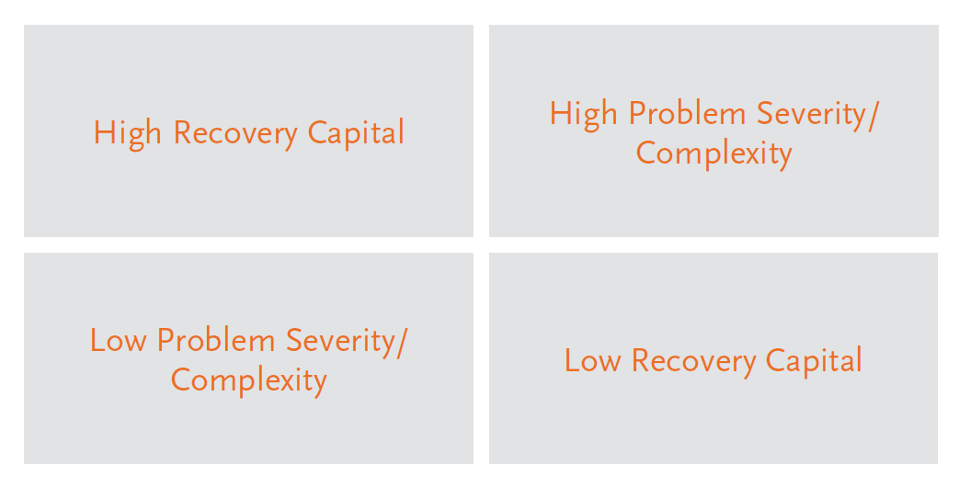
Recovery Capital Problem Severity Matrix
White & Cloud, 2008
Notes:
This Recovery Capital Problem Severity Matrix is one way of looking at assessing an individual’s needs for treatment, recovery support, and additional services (housing, job, child care, transportation, family support, etc.). So if an individual has high recovery capital and low problem severity, they may not require intensive treatment services or extended recovery support. However, an individual with high problem severity/complexity and low recovery capital would require more intensive services. The point is that recovery capital (high or low) should be taken into consideration when determining levels of care or need for treatment services. No assumption is made using this matrix that individuals with high problem severity/complexity will always have low recovery capital.
Burns, J. an Marks, D. (2013). Can recovery capital predict addiction problem severity?. Alcoholism Treatment Quarterly, 31(3), 303-320, DOI: 10.1080/07347324.2013.800430
Groshkova, T., Best, D. & White, W. (2013). The assessment of recovery capital: Properties and psychometrics of a measure of addiction recovery strengths. Drug and Alcohol Review, 32(2), pp. 187-94
Vilsaint, C.L., Kelly, J.F., Bergman, B.G., Groshkova, T., Best, D., White, W. (2017). Development and validation of a Brief Assessment of Recovery Capital (BARC-10) for alcohol and drug use disorder. Drug Alcohol Depend 177, 71–76.
White, W. & Cloud, W. (2008) Recovery capital: A primer for addiction professionals. Counselor, 9(5), pp22-27

Slide 10
Recovery Capital Scales
35 item scale
Rates areas of their life that relate to recovery capital
Examples of Questions
I have the financial resources to provide for myself and my family.
I have personal transportation or access to public transportation.
I live in a home and neighborhood that is safe and secure.
I live in an environment free from alcohol and other drugs.
I have an intimate partner supportive of my recovery process.
I have family members who are supportive of my recovery.
I have access to Online recovery support groups.
Two Newer Assessments
Assessment of Recovery Capital-50 items
Brief Assessment of Recovery Capital BARC-10 items
Notes:
The Recovery Capital Scale was created by Granfield and Cloud (2001). This scale can be used to help individuals determine areas that need to be focused on regarding building recovery capital. There are also two newer scales, the ARC and the BARC-10. The sample questions from the original scale provide an example of the type of questions that these assessment tools or scales ask.
The box around the question about access to an online recovery support group is noted because the authors were certainly forward-thinking to include questions about online support in their assessment. The presenter does not have to include this comment and may simply take out the box.
Granfield, R. & Cloud, W. (2001) Social context and “Natural Recovery”: The role of social capital in the resolution of drug associated problems. Substance Use and Misuse, 36, pp1543- 1570.
Groshkova, T., Best, D. and White, W. (2013). The assessment of recovery capital: properties and psychometrics of a measure of addiction recovery strengths. Drug and Alcohol Review, 32(2), pp. 187-94
Vilsaint, C.L., Kelly, J.F., Bergman, B.G., Groshkova, T., Best, D., & White, W. (2017). Development and validation of a Brief Assessment of Recovery Capital (BARC-10) for alcohol and drug use disorder. Drug Alcohol Depend, 177:71–76.

Slide 11
Increases in recovery capital can spark turning points that end addiction careers, trigger recovery initiation, elevate coping abilities, and enhance quality of life in long-term recovery….
Cloud & Granfield, 2008; Laudet, Morgan, & White, 2006
Notes:
Use this slide to make the following points:
Any increase in recovery capital can be a springboard to making positive changes and enhance recovery (e.g., getting a job, re-uniting with family member, starting school, finding a safe place to live, etc.).
Recovery capital can be assessed and used to help determine level of care for treatment (e.g. individuals with higher recovery capital and lower problem severity may require less intensive treatment services)
Raising recovery capital can improve quality of life
The Housing First Program is an example of focusing on recovery capital first before addressing behavioral health issues.
Cloud, W., & Granfield, R. (2008) Conceptualizing recovery capital: Expansion of a theoretical concept. Substance Use and Misuse.
Laudet, A.B., Morgen, K., White, W.L. (2006). The role of social supports, spirituality, religiousness, life meaning and affiliation with 12-Step fellowships in quality of life satisfaction among individuals in recovery from alcohol and drug problems. Alcoholism Treatment Quarterly, 24(1-2):33-73. doi:10.1300/J020v24n01_04.
Tsemberis, S. & Stefancic, A. (2007). Housing first for long-term shelter dwellers with psychiatric disabilities in a suburban county: A four-year study of housing access and retention.
White, W. & Cloud, W. (2008). Recovery capital: A primer for addictions professionals. Counselor, 9(5), 22-27.

